Slide 1
ICS 432 – 01 Distributed and Cloud Computing Fall 2021
Instructor: Thanaa Ghanem
thanaa.ghanem@metrostate.edu
Lecture 6
October 2, 2021

Slide 2
Networking, Load Balancing, and Autoscaling in the cloud

Slide 3
Networking & Autoscaling
Networking in AWS
AWS Module 5: Networking and Content Delivery
Lab: 2 Build your VPC and Launch a Web Server
AWS Module 10: Auto Scaling and Monitoring
Lab 6: Scale & Balance your Architecture
Reading:
AWS Certified Developer Official Study Guide (AWSCD) Chapter 2: Introduction to Compute and Networking. Pages 51 - 68.
Networking in GCP
GCP Module 7: It helps to Network
Lab exercises: we will do related exercises on 10/9
Networking concepts
-Basic Networking concepts
-Cloud Networking Services
Reading:
* CompTiA Cloud Essentials+ Study Guide (CESG) Chapter 2: Cloud Networking and Storage. Pages: 57 – 70.

Slide 4
Lab 5: Networking in AWS
Exercise 1: AWS VPC and subnets
Exercise 2: Connecting machines within AWS VPC
Exercise 3: AWS load balancing and auto scaling
Assignment 2: Exercise 1: Building a scalable infrastructure on AWS to host ICS 432 web site.
Lab 6: Networking in GCP
Assignment 2: Exercise 2: Building a scalable infrastructure on GCP to host ICS 432 web site.

Slide 5
Introduction
Without networking, the cloud doesn't exist.
Networking allows users to access virtualized servers somewhere on the Internet.
Topics:
the underlying technology that enables modern networking.
details on five methods used to connect to the cloud.
five networking services that give the cloud more functionality.

Slide 6
Networking: A Quick Primer
A network is two or more computers or devices that can communicate with each other.
Those devices need to have software that enables them to talk to each other, called a network client, which is built into every operating system (OS).
Three things are required to accomplish networking:
Network adapter (or Network Interface Card -- NIC).
Transmission method.
Protocol.

Slide 7
Network Adapter
Practically every computing device today has a built-in network adapter called Network Interface Card (NIC).
Each NIC can communicate using one type of networking technology (e.g., cellular, Bluetooth, Wi-Fi, or wired Ethernet).
For two devices to talk to each other, they need to use NICs using the same technology.

Slide 8
Transmission Method
Transmission method is about how data travels from device to device.
In the old days of computing, this meant copper or fiber optic cables.
While wired connections are still used today, fast wireless networking methods cellular, Wi-Fi, and Bluetooth are ubiquitous.

Slide 9
Networking Protocol
This is the language that computers speak to facilitate communication.
Protocols are analogous to human languages in many ways, in that they provide the rules and standards for common understanding.
Transmission Control Protocol/Internet Protocol (TCP/IP) is the protocol of the Internet.
a modular suite of protocols working together to enable communication

Slide 10
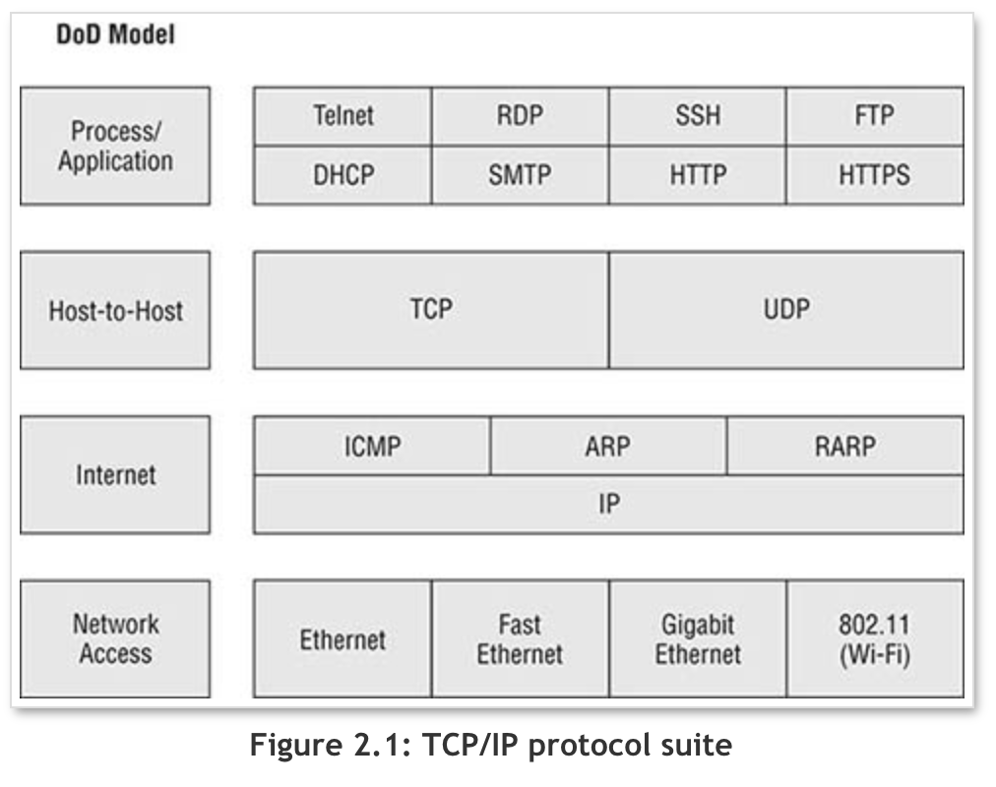
TCP/IP Model
For communication to happen, each device uses
one component from each of the four levels.
Network Interface Layer: responsible for delivering data over the wire at the physical level.
Internet Layer: allows for the breaking down of the data into individual packets/frames on the transmitting side and their reassemble on the receiving side.
Host-to-host layer: responsible for the building up and tearing down of the communication sessions between connected network nodes.
Application layer: defines how the host programs interface with transport layer services to use the network.
Notes:
OSI model: Open Systems Interconnection model describes seven layers that computer systems use to communicate over a network.
The modern Internet is not based on OSI, but on the simpler TCP/IP model.

Slide 11
Important terms
Host: Any device on a TCP/IP network
including computers, printers, and router interfaces.
IP address: logical addressing
any host has an IP address
Domain Name System (DNS): a system that is used to resolve IP addresses.

Slide 12
Section 1: Networking basics
Module 5: Networking and Content Delivery
Notes:
Section 1: Networking basics
In this section, you will review a few basic networking concepts that provide the necessary foundation to your understanding of the AWS networking service, Amazon Virtual Private Cloud (Amazon VPC).

Slide 13


Networks
Subnet 1
Subnet 2
Router
Notes:
A computer network is two or more client machines that are connected together to share resources. A network can be logically partitioned into subnets. Networking requires a networking device (such as a router or switch) to connect all the clients together and enable communication between them.

Slide 14
IP addresses
192
.
0
.
2
.
0
11000000
00000000
00000010
00000000
Notes:
Each client machine in a network has a unique Internet Protocol (IP) address that identifies it. An IP address is a numerical label in decimal format. Machines convert that decimal number to a binary format.
In this example, the IP address is 192.0.2.0. Each of the four dot (.)-separated numbers of the IP address represents 8 bits in octal number format. That means each of the four numbers can be anything from 0 to 255. The combined total of the four numbers for an IP address is 32 bits in binary format.

Slide 15
IPv4 and IPv6 addresses
IPv4 (32-bit) address: 192.0.2.0
IPv6 (128-bit) address: 2600:1f18:22ba:8c00:ba86:a05e:a5ba:00FF
can accommodate more user devices
Notes:
A 32-bit IP address is called an IPv4 address.
IPv6 addresses, which are 128 bits, are also available. IPv6 addresses can accommodate more user devices.
An IPv6 address is composed of eight groups of four letters and numbers that are separated by colons (:). In this example, the IPv6 address is 2600:1f18:22ba:8c00:ba86:a05e:a5ba:00FF. Each of the eight colon-separated groups of the IPv6 address represents 16 bits in hexadecimal number format. That means each of the eight groups can be anything from 0 to FFFF. The combined total of the eight groups for an IPv6 address is 128 bits in binary format.

Slide 16
Classless Inter-Domain Routing (CIDR)
Network identifier (routing prefix)
Host identifier
192
.
0
.
2
.
0
/
24
Tells you how many bits are fixed
11000000
00000000
00000010
00000000 to 11111111
Fixed
Fixed
Fixed
Flexible
CIDR is a way to express a group of IP addresses that are consecutive to each other.
Notes:
Information about CIDR: https://www.keycdn.com/support/what-is-cidr
A common method to describe networks is Classless Inter-Domain Routing (CIDR). The CIDR address is expressed as follows:
An IP address (which is the first address of the network)
Next, a slash character (/)
Finally, a number that tells you how many bits of the routing prefix must be fixed or allocated for the network identifier
The bits that are not fixed are allowed to change. CIDR is a way to express a group of IP addresses that are consecutive to each other.
In this example, the CIDR address is 192.0.2.0/24. The last number (24) tells you that the first 24 bits must be fixed. The last 8 bits are flexible, which means that 2⁸ (or 256) IP addresses are available for the network, which range from 192.0.2.0 to 192.0.2.255. The fourth decimal digit is allowed to change from 0 to 255.
If the CIDR was 192.0.2.0/16, the last number (16) tells you that the first 16 bits must be fixed. The last 16 bits are flexible, which means that 2¹⁶ (or 65,536) IP addresses are available for the network, ranging from 192.0.0.0 to 192.0.255.255. The third and fourth decimal digits can each change from 0 to 255.
There are two special cases:
Fixed IP addresses, in which every bit is fixed, represent a single IP address (for example, 192.0.2.0/32). This type of address is helpful when you want to set up a firewall rule and give access to a specific host.
The internet, in which every bit is flexible, is represented as 0.0.0.0/0

Slide 17
Open Systems Interconnection (OSI) model
The OSI model is a conceptual model that is used to explain how data travels over a network.
Layer | Number | Function | Protocol/Address
Application | 7 | Means for an application to access a computer network | HTTP(S), FTP, DHCP, LDAP
Presentation | 6 | Ensures that the application layer can read the data Encryption | ASCI, ICA
Session | 5 | Enables orderly exchange of data | NetBIOS, RPC
Transport | 4 | Provides protocols to support host-to-host communication | TCP, UDP
Network | 3 | Routing and packet forwarding (routers) | IP
Data link | 2 | Transfer data in the same LAN network (hubs and switches) | MAC
Physical | 1 | Transmission and reception of raw bitstreams over a physical medium | Signals (1s and 0s)
Notes:
The Open Systems Interconnection (OSI) model is a conceptual model that is used to explain how data travels over a network. It consists of seven layers and shows the common protocols and addresses that are used to send data at each layer. For example, hubs and switches work at layer 2 (the data link layer). Routers work at layer 3 (the network layer). The OSI model can also be used to understand how communication takes place in a virtual private cloud (VPC), which you will learn about in the next section.

Slide 18
Connecting to the Cloud
If a user can open an Internet browser, then that user can connect to cloud resources.
Five different connectivity methods:
Hypertext transfer Protocol Secure (HTTPS)
Remote Desktop Protocol
Secure Shell
Virtual Private Network (VPN)
Direct Connect

Slide 19
Connectivity methods (1/5): HTTPs
Connecting a single client to cloud resources is most often done through a web browser and Hypertext Transfer Protocol Secure (HTTPS).
HTTPS is a secure protocol in the Process/Application layer in the TCP/IP suite.
specifically designed to fetch web pages and encrypt data that is transmitted between a web server and its client.
HTTPS secures transmissions, you can be confident in typing in usernames, passwords, and other personal information to websites that use it with little fear of it being hacked.
HTTPS encrypts data transmissions, but not data on the client or server.
it encrypts data in transit but not data at rest.
HTTP does not encrypt transmissions
anyone scanning network traffic can read HTTP.

Slide 20
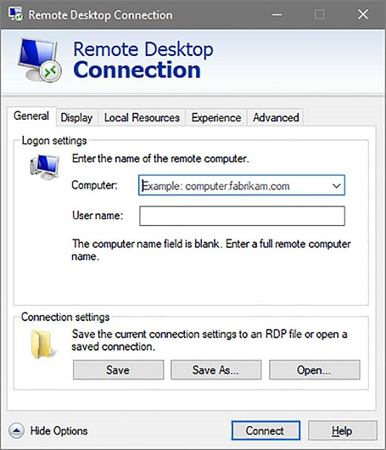
Connectivity methods (2/5): Remote Desktop Protocol
Remote Desktop Protocol (RDP) is used to log into an online Windows instance.
install an RDP client onto the device that will be logging in to the virtual instance.
RDP uses encryption to secure communications between the client and the virtual instance.
Upon opening the RDP client, a user will be required to supply several pieces of information to connect.
ID or address of the instance
username and password,
the location of the private security key.

Slide 21
Using Security Key Pairs
the use of a public/private key pair to is far more secure than requiring just a username and password
private key is an encrypted security key is created for a specific user.
a security code encrypted in a file stored on the user's device (with extension .pem).
When the user presents that private key to another device holding the corresponding public key, the public key is used to decipher the private key and validate the holder's identity.
A user needs to not let anyone else have access to their private key!
The public key can be sent to anyone who needs to verify the identity of the private key holder.

Slide 22
Connectivity methods (3/5): Secure Shell (SSH)
SSH allows clients to remotely connect to a virtual Linux machine securely:
SSH is to Linux instances what RDP is to Windows Server instances.
SSH is run as a text command from a command prompt by specifying:
the name of the security key file
the username
the address of a virtual Ubuntu Linux server
ssh -i "QDt1.pem" ubuntu@ec2-13-58-100-31.us-east-2.compute.amazonaws.com

Slide 23
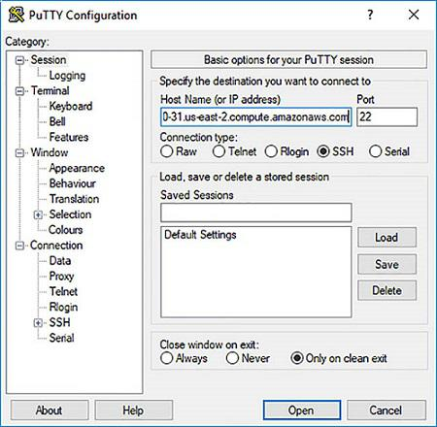
PuTTY
PuTTY is a software that can be used to run SSH on Windows machines.
To log in, provide:
the hostname of the server
the location of the security key file

Slide 24
Connectivity methods (4/5): Virtual Private Network (VPN)
The Internet is a public network. Data sent from point A bounces through several routers and, even if HTTPs is used, there is a (very small) chance that the data will be hacked.
A Virtual Private Network (VPN) is another way to secure your data.
A VPN is a secure (private) network connection that occurs through a public network.
VPNs can be used to connect individual users to a corporate network or server or to connect company networks or clouds across the Internet or other public networks

Slide 25
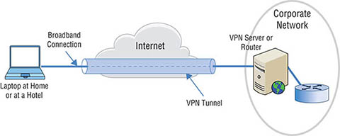
VPN (continued)
For an individual user, this might look like sending HTTPS data through a VPN
two layers of encryption are more secure than one
A VPN is a point-to-point secure tunnel through the Internet.
When using a VPN, the remote end appears to be connected to the network as if it were connected locally.

Slide 26
Connectivity methods (5/5): Direct Connect
Direct connect is used to provide a physical connection between a company's on-site network and the cloud service provider’s network.
Direct connect is the fastest and most cost-effective option if
large number of users need persistent access to cloud services
there is a large amount of data transferred between the cloud and the on-site network
Most CSPs offer connections that support 100Gbps data transfers.
Cost:
Lower bandwidth plans can be as cheap as about $50 per month.
Faster plans with unlimited data transfers can cost more than $50,000 per month.
Examples:
Azure ExpressRoute.
AWS Direct Connect.
Google Cloud Interconnect.

Slide 27
Cloud Networking Services
Cloud providers provide other networking services for a charge:
Software-defined Networking (used to define VPCs)
Load Balancing
Domain Name System (DNS)
Firewalls
Content Delivery Networks (CDN)

Slide 28


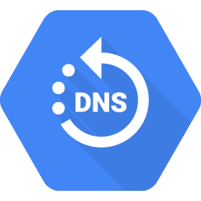
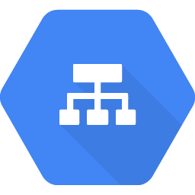
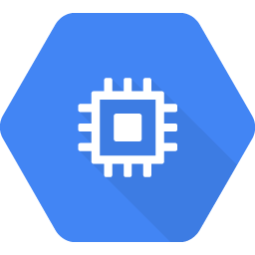
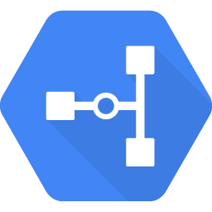
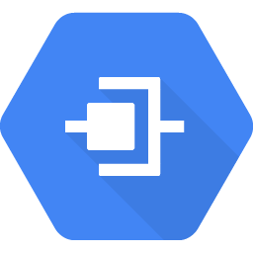
How Google networking works
Network
Global container for
subnetworks
Cloud DNS
Internet
Web clients
Cloud Load Balancer
Subnetwork 1
(10.1.0.0/16)
Frontend
Compute Engine
Cloud DNS Cached content
Enterprise data center
Enterprise networks
(192.168.0.0/16)
Enterprise computing
Subnetwork 2
(10.2.0.0/16)
Cloud VPN
Backend
Compute Engine
Cloud Interconnect
Cloud firewall
Copyright Google LLC. For educational purposes in accordance with the terms of use set forth on the program Website.
Notes:
Optional content available for use if required
Here’s an example network diagram for an application which bridges an organization's physical data center and Google Cloud.
The web client, or end user, performs a Domain Name System lookup, which is served by Cloud DNS. Content Delivery Networks, or CDNs, are locations within the Google network that is used to cache content closer to the users to improve application performance. The user requests a page. If the CDN option was selected when you configured the Cloud Load Balancer, then the request will go to the closest CDN location, which will serve that page without getting it from the servers, if the CDN has the page stored.
For a page that the CDN doesn’t have, it will call to the cloud load balancer. The cloud load balancer will pick an appropriate frontend server to serve the request, and return the page to the user.
In Google Cloud, a "network" is an isolated global resource holding network configuration. Instances are deployed in regional subnetworks, however the policy (firewall, routing, and so on), and access through VPN, are configured at the global network level.
Depending on the content of the page, the frontend Compute Engine server may have to talk to a Compute Engine backend server, which is regularly updated with data feeds from other sites. The subnetworks are configured so that the frontend subnet cannot talk directly to the data center or colocation facility.

Slide 29
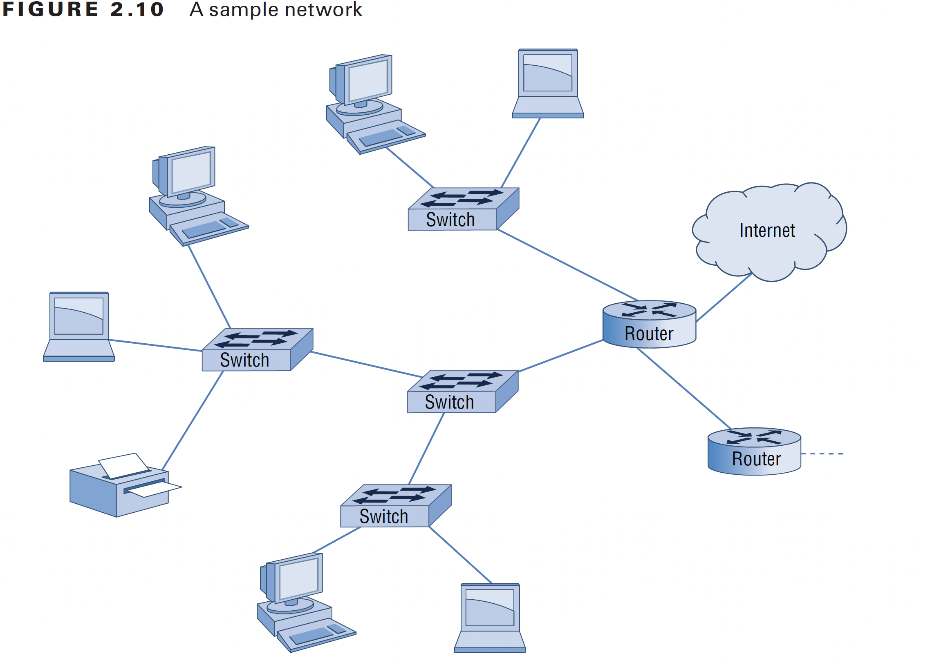
Traditional Networking
A network is usually built using:
routers (connects a network to Internet)
switches (manage internal network traffic)
client devices (connect to switches)
wireless access points can be connected to a router
or a switch with a network cable.
Additional network appliances:
load balancers
firewalls
A network can be expanded by adding routers
requires a lot of configurations so that routers can talk to each other.

Slide 30
Routers
Routers play a critical role in intra-network communication.
a router takes incoming data packets,
read the destination address, and
send the packet on to the next network that gets the data closer to delivery
There are two critical pieces to the router's job:
physical connections: internal circuitry that makes routing happen.
logical component: each router has its own database, called a routing table, which it uses to determine where to send the packets.
each router is responsible for maintaining its table

Slide 31
Cloud Networking Services (1/5): Software-defined Networking
Software-defined networking (SDN) is the separation of the control functions from the forwarding functions, which enables greater automation and programmability in the network.
SDN creates a centralized brain for the network that can communicate and command the rest of the network.
SDN is used to create virtual overlay networks which are software-defined networks that sit on top of the physical hardware infrastructure.
The goal of SDN is to make networks:
more agile and flexible
centralized network monitoring instead of running monitoring apps for each piece of network hardware
Notes:
https://www.sdxcentral.com/networking/sdn/

Slide 32
Three features the define SDN
Virtualization:
use network resources without worrying about where it is physically located and how it is organized.
Abstract the hardware
Programmable
shift away from static manual operations to fully configurable and dynamic.
Centralized control of policies:
policy delegation and management.
Dynamic scaling

Slide 33
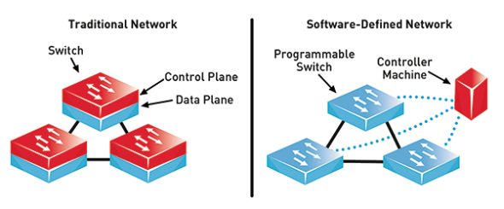
SDN vs. Traditional Network
Notes:
https://www.commsbusiness.co.uk/features/software-defined-networking-sdn-explained/

Slide 34
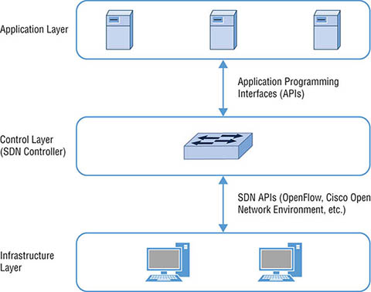
Software-defined Networking
The three layers in an SDN architecture are:
Application: the applications and services running on the network
Control: the SDN controller or “brains” of the network
Infrastructure: switches and routers, and the supporting physical hardware
the underlying network hardware and configuration can change, and it won't affect how the applications work

Slide 35
Network Virtualization
Real network:
five servers all using the same hardware
servers send data through their network cards for delivery on the network through a switch or router.
Virtual network:
five virtual servers may be residing on the same physical server (i.e., same hardware)
they have the same network adapter.
software-defined networks manages the communication between the servers
each server will be assigned a logical NIC

Slide 36
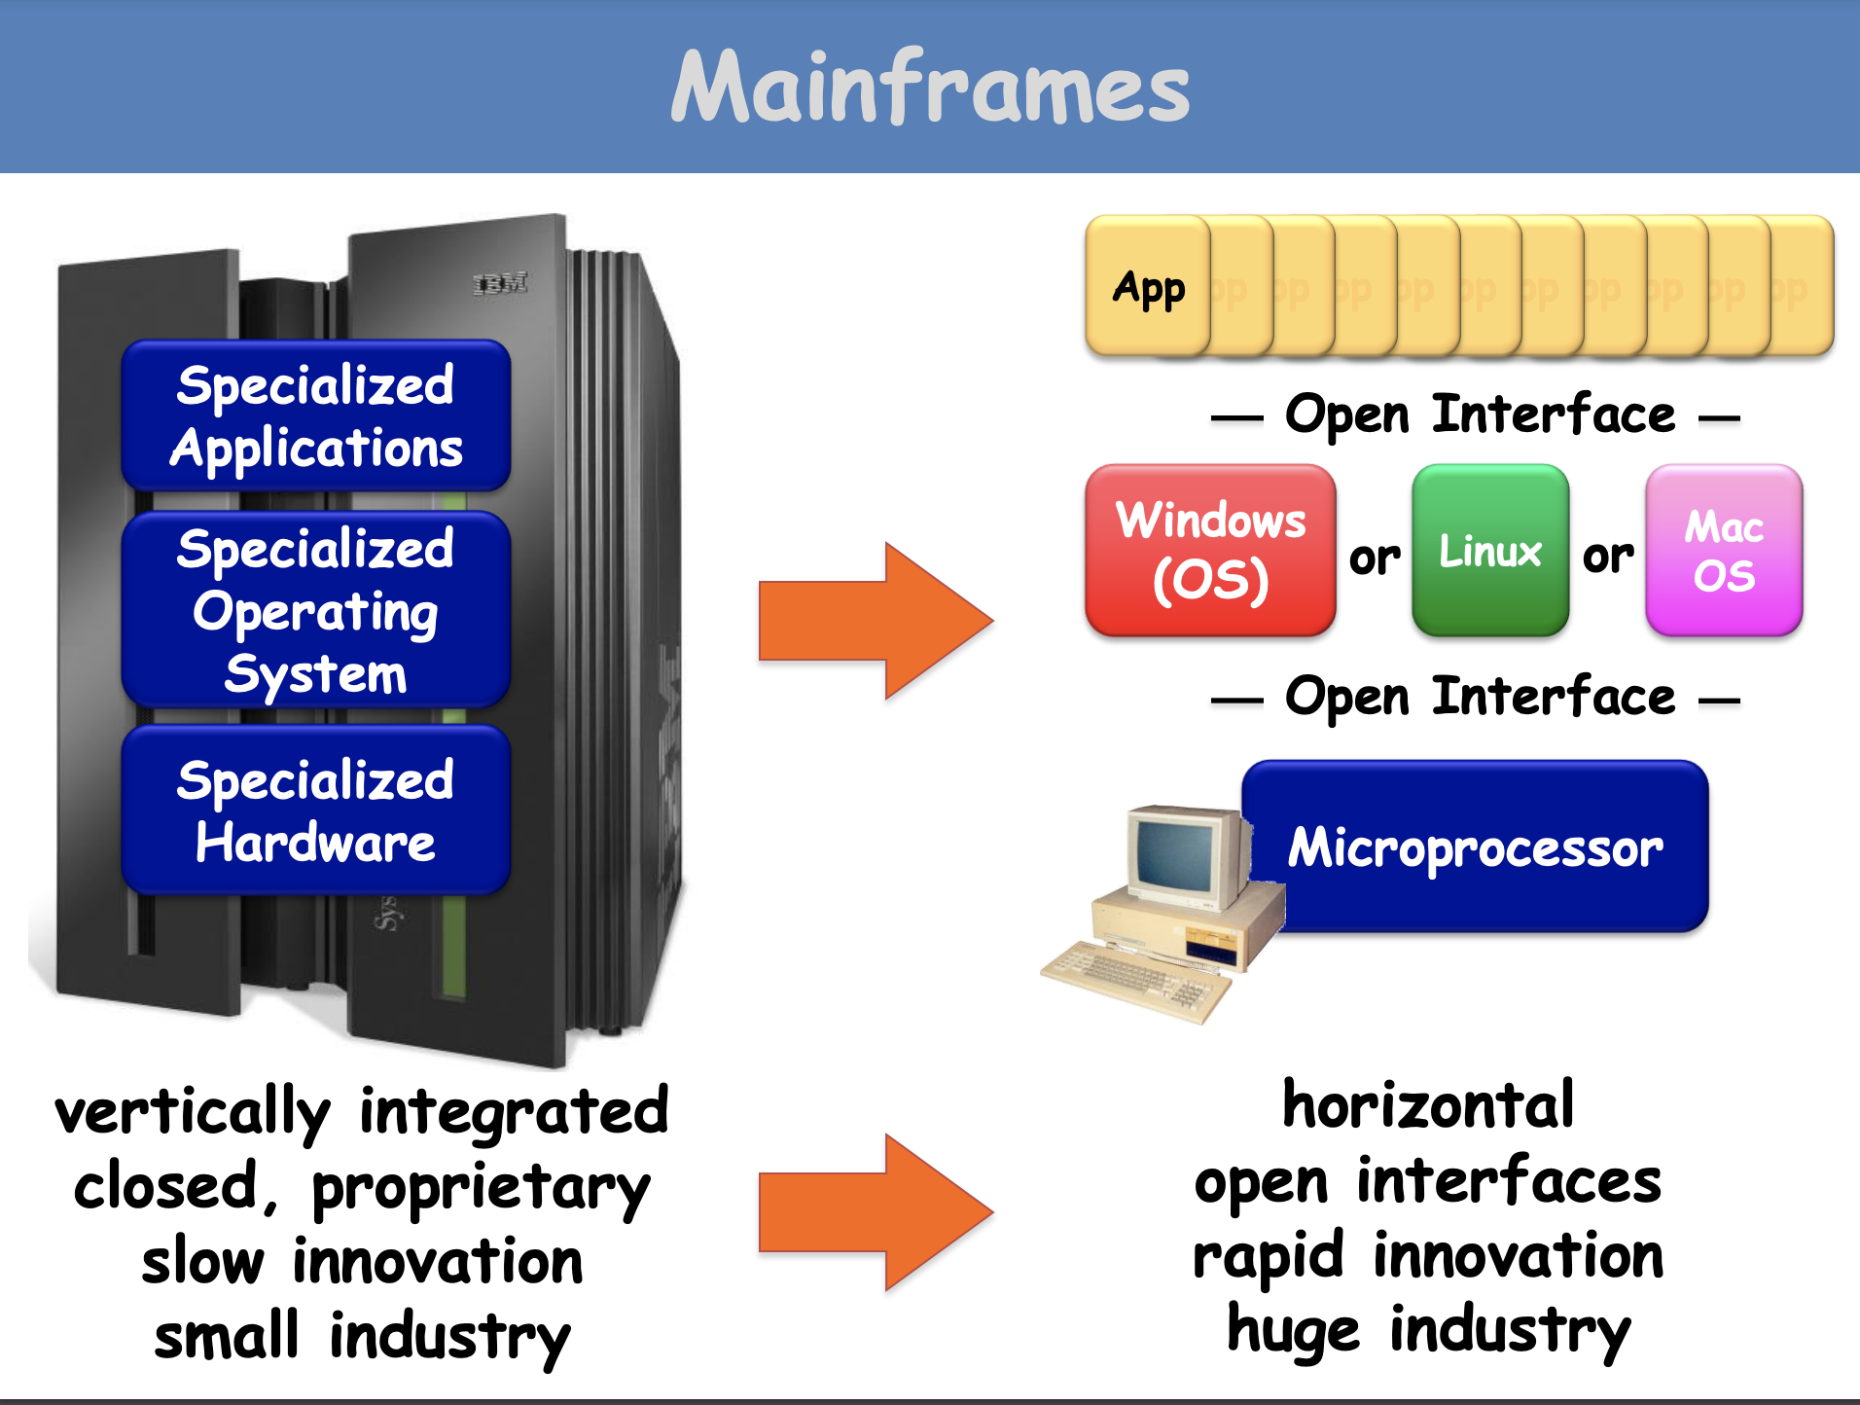
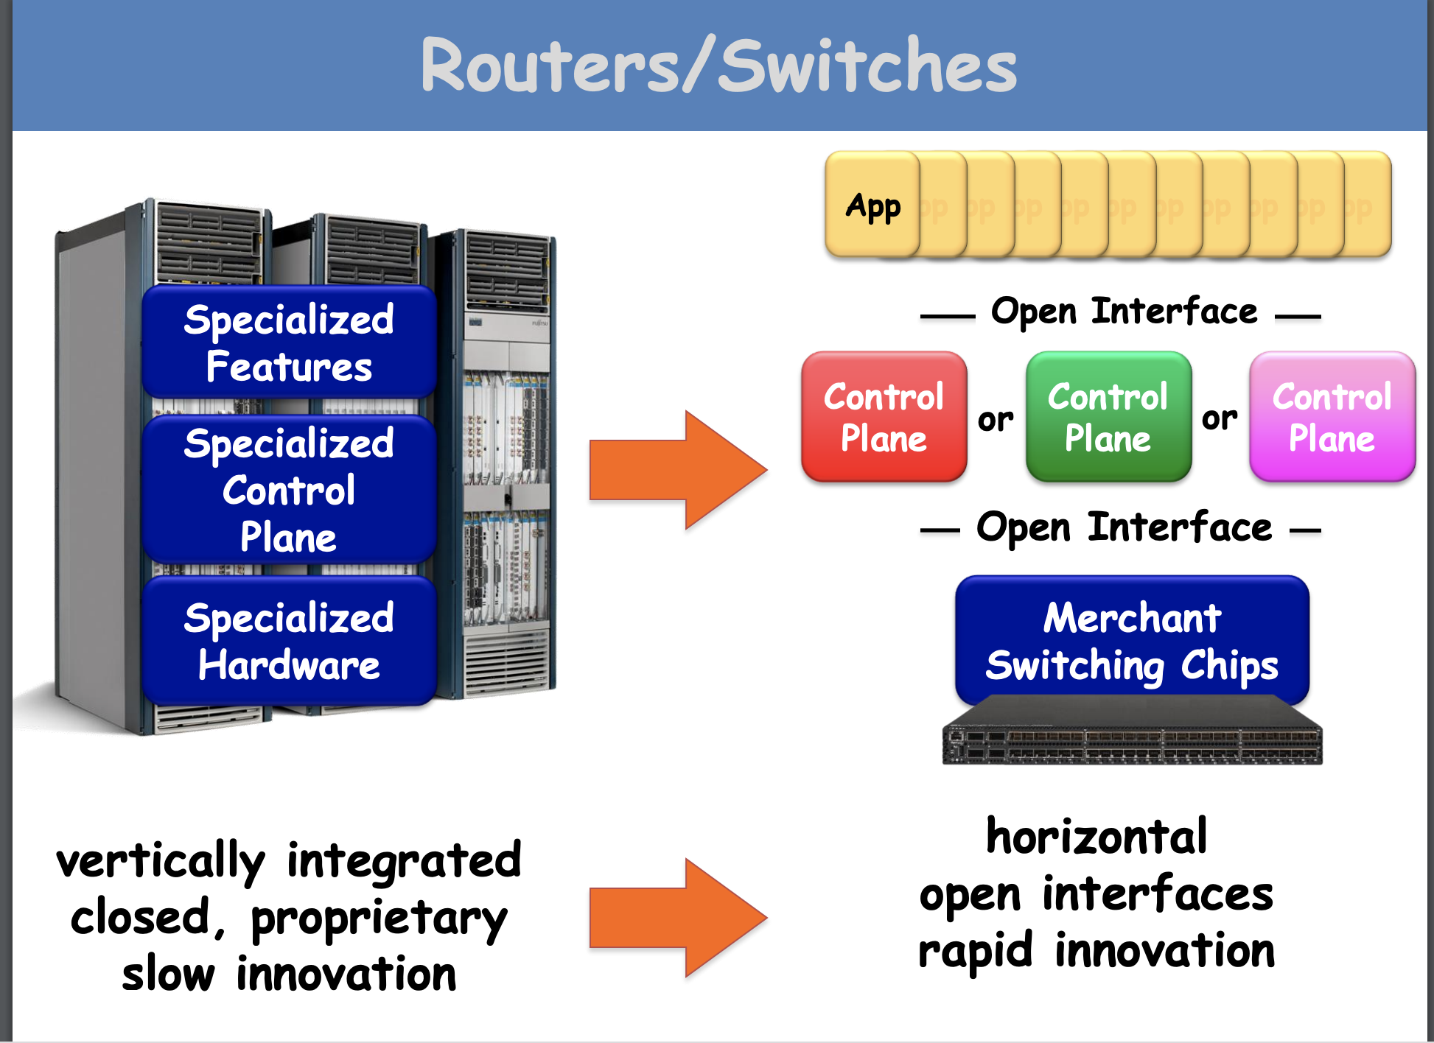
Analogy

Slide 37
Virtual Private Cloud (VPC)
A cloud service to define virtual networks.
you can connect your cloud resources in a virtual private cloud and isolate them from each other for purposes of security, compliance, and development versus test versus production.
Virtual machines that are in the same VPC can communicate privately.
instances are isolated from
Virtual machines that reside in different VPCs, even if the subnets are in the same region, need to communicate via the internet.

Slide 38




VPCs and subnets
VPCs:
Logically isolated from other VPCs
Dedicated to your AWS account
Belong to a single AWS Region and can span multiple Availability Zones
VPCs in GCP are global
Subnets:
Range of IP addresses that divide a VPC
Belong to a single Availability Zone
subnets in GCP can cross zones
Classified as public or private
AWS Cloud
Region
Availability Zone 1
Availability Zone 2
VPC
Subnet
Subnet
Notes:
Amazon VPC enables you to provision virtual private clouds (VPCs). A VPC is a virtual network that is logically isolated from other virtual networks in the AWS Cloud. A VPC is dedicated to your account. VPCs belong to a single AWS Region and can span multiple Availability Zones.
After you create a VPC, you can divide it into one or more subnets. A subnet is a range of IP addresses in a VPC. Subnets belong to a single Availability Zone. You can create subnets in different Availability Zones for high availability. Subnets are generally classified as public or private. Public subnets have direct access to the internet, but private subnets do not.

Slide 39



A VPC network is a virtual version of a physical network and is a global resource
On Premises
Internet
VPC Network
Internet Gateway
VPN Gateway
Region: us-west1
Region: us-east1
VPC Routing
Zone: us-west1-a
Zone: us-east1-a
Zone: us-east1-b
VM
10.240.0.2
VM
10.240.0.3
VM
192.168.1.2
VM
192.168.1.3
VM
10.2.0.2
VM
10.2.0.3
subnet1: 10.240.0.0/24
subnet2: 192.168.1.0/24
subnet3: 10.2.0.0/16
Copyright Google LLC. For educational purposes in accordance with the terms of use set forth on the program Website.
Notes:
Subnets are regional resources. They must be created in VPC networks to define sets of usable IP ranges for instances. VMs in different zones within the same region can share the same subnet.
In this example, subnet1 is defined as 10.240.0.0/24 in the us-west1 region. Two VM instances in the us-west1-a zone are in this subnet. Their IP addresses both come from the available range of addresses in subnet1.
Subnet2 is defined as 192.168.1.0/24 in the us-east1 region. Two VM instances in the us-east1-a zone are in this subnet. Their IP addresses both come from the available range of addresses in subnet2.
Subnet3 is defined as 10.2.0.0/16, also in the us-east1 region. One VM instance in the us-east1-a zone and a second instance in the us-east1-b zone are in subnet3, each receiving an IP address from its available range. Because subnets are regional resources, instances can have their network interfaces associated with any subnet in the same region that contains their zones.
A single VPN can be used to give private connectivity from a physical data center to the VPC.

Slide 40
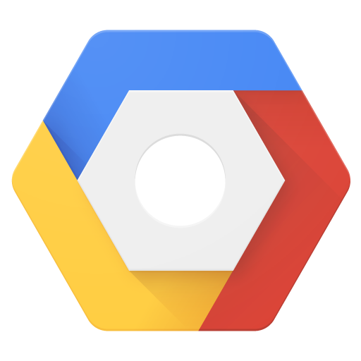
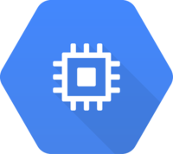
Network behavior within a project
Google Cloud Project
Internet
Public IP
Public IP
VPC
Network 1
VPC
Network 2
VPC
Network 3
VPC
Network 4
VPC
Network 5
VM2
VM3
VM4
us-east1
Private IP
Private IP
VM1
asia-east1
Copyright Google LLC. For educational purposes in accordance with the terms of use set forth on the program Website.
Notes:
Virtual machines that are in different regions but in the same VPC can communicate privately. VM1 and VM2 can communicate at a local level even though they’re separated geographically.
Virtual machines that reside in different VPCs, even if the subnets are in the same region, need to communicate via the internet. In this instance, VM3 and VM4 will need public IP addresses to traverse the Internet. Networks don’t communicate with any other network by default.

Slide 41
Cloud Networking Services (2/5): Load Balancing
An online application (e.g., for shopping) usually has dozens, if not hundreds, of web servers, each of them capable of fulfilling the same tasks to make your accessing the web site experience as easy as possible.
Load balancers are hardware devices that essentially act like the webserver to the outside world.
when a user visits the website, the load balancer would send the request to one of many real web servers to fulfill the request
Cloud implementations have made load balancing easier to configure since the servers can be virtual instead of physical.
Cloud’s load balancer as a service (LBaaS) offerings are cheaper and more convenient to set up and manage.

Slide 42
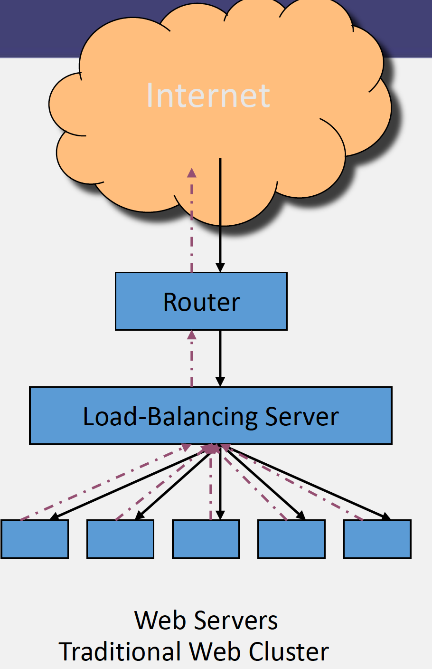
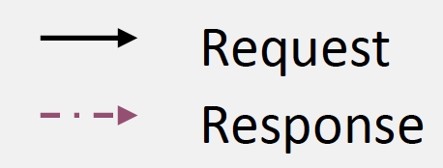
How Load Balancing Work?
Request enters a router
Load balancing server determines which web server should serve the request
Send the request to the appropriate web server.
Maybe we've got 10,000 nodes in the cloud and we make a web request, it will go to one of those 10,000, farmed out by the load balancer.
we have to make sure the server have the data to answer the request.

Slide 43
How do we split up information?

Slide 44
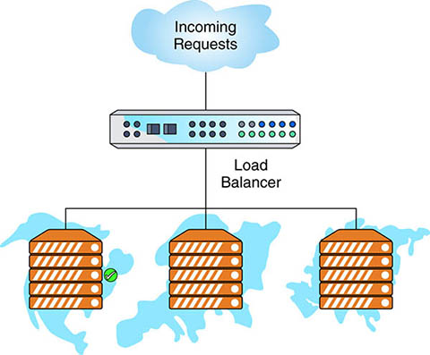
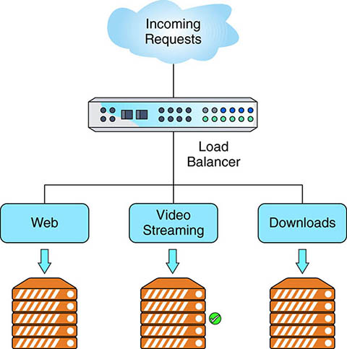
Common Load Balancing Configurations
Cross-region load balancing:
all servers likely provide access to the same types of content
there are servers local to each region's proximity to the users that will help speed up network performance
when a request comes in, the load balancer checks the incoming IP address and routes the request to a server in that region.
Content-based load balancing:
split up servers to handle specific types of requests
one group of servers could handle web requests, while a second set hosts streaming video and a third set manages downloads

Slide 45
Load Balancing Benefits
Performance
servers that are specialized to handle a specific content type are often more efficient than multipurpose ones.
Scalability
web traffic spikes can be handled by quickly provisioning additional virtual servers to handle the traffic. When the capacity is no longer required, the servers are turned off.
Reliability/availability
different servers can host an application, even in different regions.
if a disaster wipes out one data center, the load balancer can direct users to other data centers in different region

Slide 46
Cloud Networking Services (3/5): Domain Name System
Domain Name Systems (DNS) are used to resolve uniform resource locator (URLs) to IP addresses.
URLs are easier to memorize.
Each DNS server has a database where it stores hostname to IP address pairs, called a zone file. If the DNS server does not know the address of the host you are seeking, it can query other DNS servers to help answer the request.
Any company hosting a website is required to maintain its DNS. The company is required to have two DNS servers for fault tolerance.

Slide 47
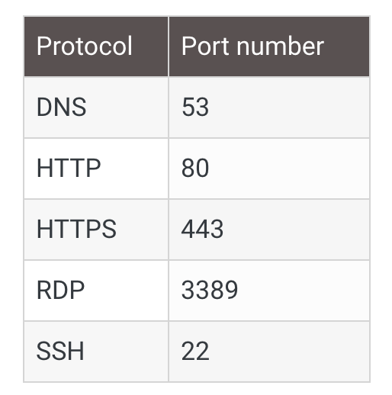
Protocols and Ports
To help keep network traffic organized across an IP based network, each Process/Application layer of the TCP/IP protocol uses what's called a port number.
The port number is combined with the IP address to form a socket.

Slide 48
Cloud Networking Services (4/5): Firewalls
A firewall is a hardware or software solution that serves as a network's security guard.
firewalls filter network traffic based on rules defined by the network administrator.
Why firewalls?
protect network resources from hackers
prevent computers on your network from accessing undesirable content on the Internet.
Firewalls can be stand-alone "black boxes" software installed on a server or router or some combination of hardware and software.
Two types:
network-based firewall: is designed to protect a whole network of computers and almost always is a hardware solution with the software on it.
host-based firewalls: protect only one computer and are almost always software solutions.

Slide 49
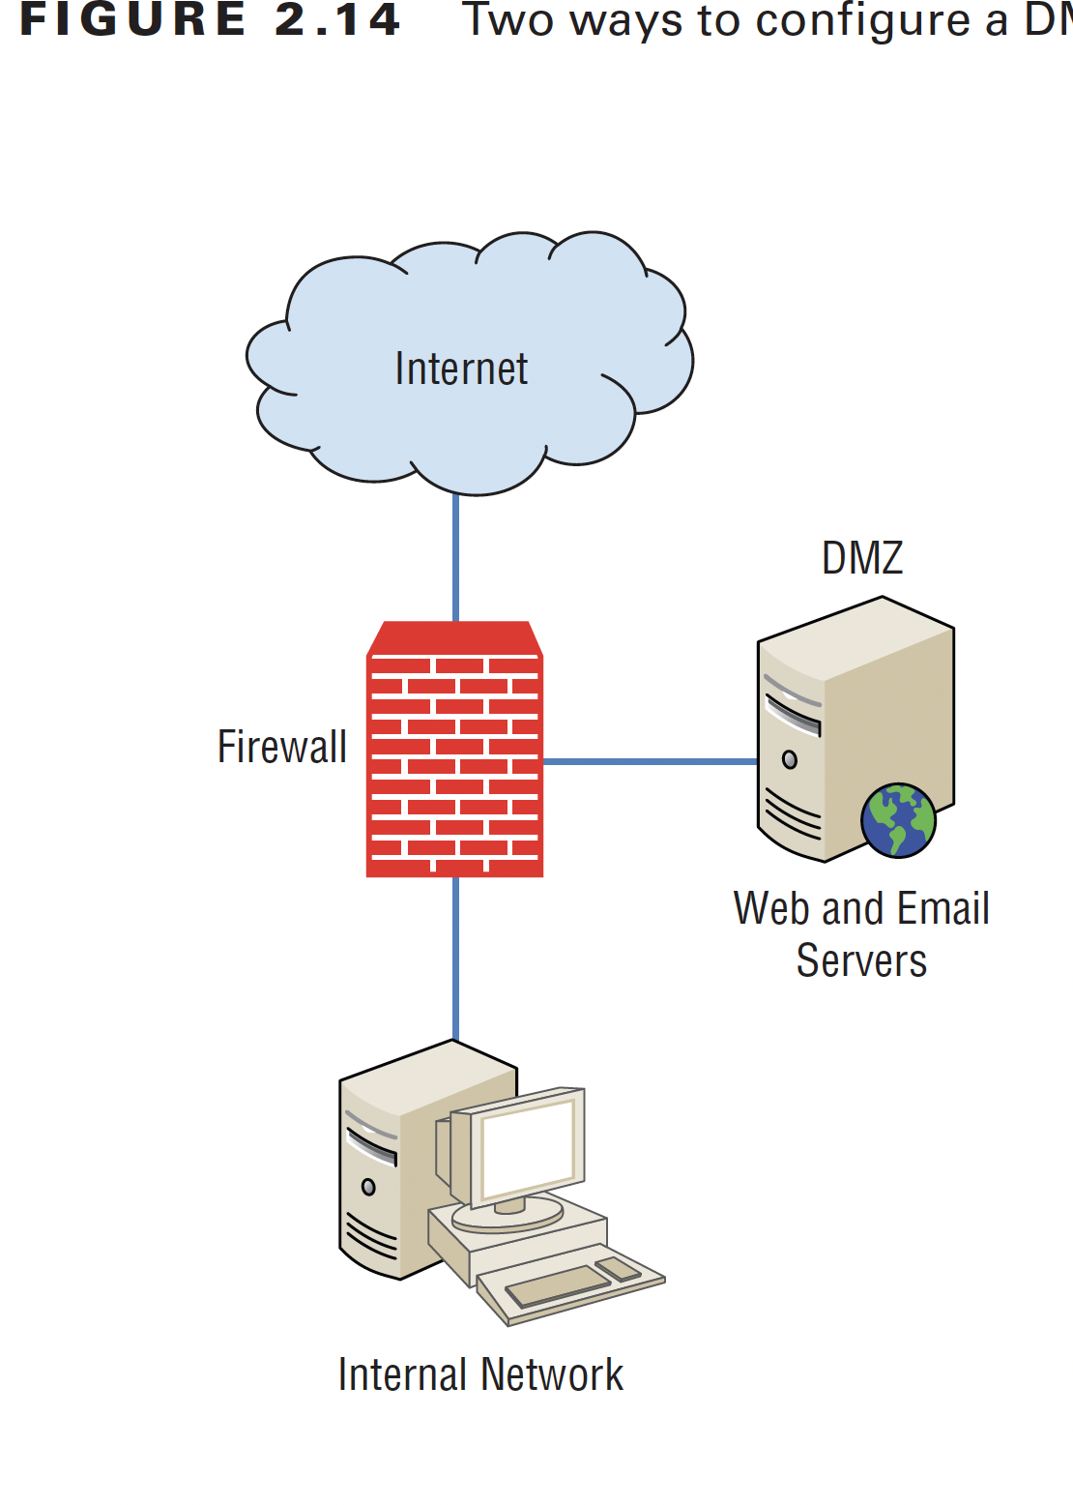
How Firewalls work?
Firewalls have at least three network connections:
public side to the Internet
private side to the internal network
port for a second semi-internal network for web and email servers
(demilitarized zone or DMZ)
A firewall is configured to allow only packets (network data) that pass specific security restrictions to get through.
default deny: all traffic is blocked unless specifically authorized by the administrator.
Firewalls is configured using Access Control Lists (ACLs):
ACL is the set of rules that determines which traffic gets through the firewall and which traffic is blocked.
different ACLs for inbound and outbound network traffic.
ACLs are configured to block traffic by IP address, protocol (such as HTTPS or RDP), domain name, or some combination of characteristics.

Slide 50
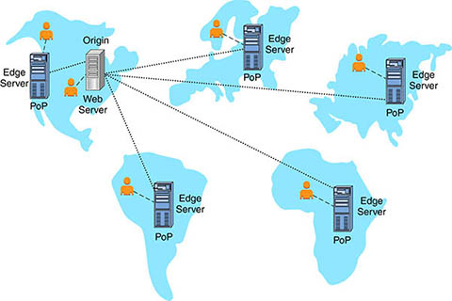
Cloud Networking Services (5/5): Content Delivery Network
A content delivery network (CDN) is a specialized type of load balancing used with web to speed up access to web resources for users in geographically distributed locations.
CDNs allow users in remote locations to access web data on servers that are closer to them than the original web server is.
The CDN creates a point of presence (PoP) in each remote location. Within each PoP will be one or more edge servers.
The job of the edge server is to cache the content of the origin and serve it to users who are located nearby.
From the end user's standpoint, the location of the server is transparent.

Slide 51
Key Benefits of CDN
Increased website performance via faster load times
Increased reliability, thanks to greater availability and redundancy
Decreased bandwidth costs
Greater scalability for web resources
Increased security
for example, a distributed denial of service attack (DDoS) may temporarily disable one edge server and it won’t affect the other locations.

Slide 52
Auto Scaling
Going to the cloud will not lower total cost pf ownership (TCO) without right-sizing.
Getting the right resources at the right time without having to set the resources levels manually.
Two types of scaling:
horizontal scaling → adding more resource, more fault tolerant
vertical scaling → increasing the size of your resources (e.g., adding CPUs or memory)

Slide 53
Example: Setting up a web site
Database in one zone
Two web application frontend servers one in each zone
Load balancer to spread the load between the two zones
If site comes under heavy load:
If CPU utilization on either web frontend reaches 80% for a sustained 5-minute window → create a new web frontend → horizontal scaling
If memory usage is over 90% on the database server for a sustained 10-minute window → increase memory on the master DB by 25%. –>vertical scaling
Why we don’t apply horizontal scaling on a database server?

Slide 54
Scaling Down
You may need to scale down if:
CPU utilization below 25% across all web frontends for sustained 30-minute → remove one instance
Memory utilization on the database server falls below 30% for a sustained 30-minutes → decrease memory
This cannot be done!
Software can expand use of memory but cannot collapse back if memory is removed. The only to do that is to restart the server with the new memory.
Things to consider:
You must specify minimum number of servers to guarantee a baseline that scaling will not go below.
Maximum resources → guard against processes that come from bad code or design.

Slide 55
Right Sizing
Right-sizing on the cloud is an ongoing process.
On-prem applications usually never scale down
resources are already purchased so it is more efficient to leave the over-provisioned application.
On the cloud, over-provisioning will increase costs and increases TCO.
this is one reason for cloud deployments to fail.
Tools to help in right-sizing: monitor (off-peak and on-peak times), use analysis, and cost analysis

Slide 56
Module 5: Networking and Content Delivery
AWS Academy Cloud Foundations
© 2019, Amazon Web Services, Inc. or its Affiliates. All rights reserved.
Notes:
Welcome to Module 5: Networking and Content Delivery

Slide 57
Module overview
Topics
Networking basics
Amazon VPC
VPC networking
VPC security
Amazon Route 53
Amazon CloudFront
Activities
Label a network diagram
Design a basic VPC architecture
Demo
VPC demonstration
Lab
Build your VPC and launch a web server
Notes:
This module addresses the following topics:
Networking basics
Amazon Virtual Private Cloud (Amazon VPC)
VPC networking
VPC security
Amazon Route 53
Amazon CloudFront
This module includes some activities that challenge you to label a network diagram and design a basic VPC architecture.
You will watch a recorded demonstration to learn how to use the VPC Wizard to create a VPC with public and private subnets.
You then get a chance to apply what you have learned in a hands-on lab where you use the VPC Wizard to build a VPC and launch a web server.

Slide 58
Module objectives
After completing this module, you should be able to:
Recognize the basics of networking
Describe virtual networking in the cloud with Amazon VPC
Label a network diagram
Design a basic VPC architecture
Indicate the steps to build a VPC
Identify security groups
Create your own VPC and add additional components to it to produce a customized network
Identify the fundamentals of Amazon Route 53 (a DNS service)
Recognize the benefits of Amazon CloudFront (a CDN service)
Notes:
After completing this module, you should be able to:
Recognize the basics of networking
Describe virtual networking in the cloud with Amazon VPC
Label a network diagram
Design a basic VPC architecture
Indicate the steps to build a VPC
Identify security groups
Create your own VPC and add additional components to it to produce a customized network
Identify the fundamentals of Amazon Route 53
Recognize the benefits of Amazon CloudFront

Slide 59
Section 1: Networking basics
Module 5: Networking and Content Delivery
Notes:
Section 1: Networking basics
In this section, you will review a few basic networking concepts that provide the necessary foundation to your understanding of the AWS networking service, Amazon Virtual Private Cloud (Amazon VPC).

Slide 60
Networks
Subnet 1
Subnet 2
Router
Notes:
A computer network is two or more client machines that are connected together to share resources. A network can be logically partitioned into subnets. Networking requires a networking device (such as a router or switch) to connect all the clients together and enable communication between them.

Slide 61
IP addresses
192
.
0
.
2
.
0
11000000
00000000
00000010
00000000
Notes:
Each client machine in a network has a unique Internet Protocol (IP) address that identifies it. An IP address is a numerical label in decimal format. Machines convert that decimal number to a binary format.
In this example, the IP address is 192.0.2.0. Each of the four dot (.)-separated numbers of the IP address represents 8 bits in octal number format. That means each of the four numbers can be anything from 0 to 255. The combined total of the four numbers for an IP address is 32 bits in binary format.

Slide 62
IPv4 and IPv6 addresses
IPv4 (32-bit) address: 192.0.2.0
IPv6 (128-bit) address: 2600:1f18:22ba:8c00:ba86:a05e:a5ba:00FF
can accommodate more user devices
Notes:
A 32-bit IP address is called an IPv4 address.
IPv6 addresses, which are 128 bits, are also available. IPv6 addresses can accommodate more user devices.
An IPv6 address is composed of eight groups of four letters and numbers that are separated by colons (:). In this example, the IPv6 address is 2600:1f18:22ba:8c00:ba86:a05e:a5ba:00FF. Each of the eight colon-separated groups of the IPv6 address represents 16 bits in hexadecimal number format. That means each of the eight groups can be anything from 0 to FFFF. The combined total of the eight groups for an IPv6 address is 128 bits in binary format.

Slide 63
Classless Inter-Domain Routing (CIDR)
Network identifier (routing prefix)
Host identifier
192
.
0
.
2
.
0
/
24
Tells you how many bits are fixed
11000000
00000000
00000010
00000000 to 11111111
Fixed
Fixed
Fixed
Flexible
CIDR is a way to express a group of IP addresses that are consecutive to each other.
Notes:
Information about CIDR: https://www.keycdn.com/support/what-is-cidr
A common method to describe networks is Classless Inter-Domain Routing (CIDR). The CIDR address is expressed as follows:
An IP address (which is the first address of the network)
Next, a slash character (/)
Finally, a number that tells you how many bits of the routing prefix must be fixed or allocated for the network identifier
The bits that are not fixed are allowed to change. CIDR is a way to express a group of IP addresses that are consecutive to each other.
In this example, the CIDR address is 192.0.2.0/24. The last number (24) tells you that the first 24 bits must be fixed. The last 8 bits are flexible, which means that 2⁸ (or 256) IP addresses are available for the network, which range from 192.0.2.0 to 192.0.2.255. The fourth decimal digit is allowed to change from 0 to 255.
If the CIDR was 192.0.2.0/16, the last number (16) tells you that the first 16 bits must be fixed. The last 16 bits are flexible, which means that 2¹⁶ (or 65,536) IP addresses are available for the network, ranging from 192.0.0.0 to 192.0.255.255. The third and fourth decimal digits can each change from 0 to 255.
There are two special cases:
Fixed IP addresses, in which every bit is fixed, represent a single IP address (for example, 192.0.2.0/32). This type of address is helpful when you want to set up a firewall rule and give access to a specific host.
The internet, in which every bit is flexible, is represented as 0.0.0.0/0

Slide 64
Open Systems Interconnection (OSI) model
The OSI model is a conceptual model that is used to explain how data travels over a network.
Layer | Number | Function | Protocol/Address
Application | 7 | Means for an application to access a computer network | HTTP(S), FTP, DHCP, LDAP
Presentation | 6 | Ensures that the application layer can read the data Encryption | ASCI, ICA
Session | 5 | Enables orderly exchange of data | NetBIOS, RPC
Transport | 4 | Provides protocols to support host-to-host communication | TCP, UDP
Network | 3 | Routing and packet forwarding (routers) | IP
Data link | 2 | Transfer data in the same LAN network (hubs and switches) | MAC
Physical | 1 | Transmission and reception of raw bitstreams over a physical medium | Signals (1s and 0s)
Notes:
The Open Systems Interconnection (OSI) model is a conceptual model that is used to explain how data travels over a network. It consists of seven layers and shows the common protocols and addresses that are used to send data at each layer. For example, hubs and switches work at layer 2 (the data link layer). Routers work at layer 3 (the network layer). The OSI model can also be used to understand how communication takes place in a virtual private cloud (VPC), which you will learn about in the next section.

Slide 65
Section 2: Amazon Virtual Private Cloud (VPC)
Module 5: Networking and Content Delivery
Notes:
Section 2: Amazon VPC
Many of the concepts of an on-premises network apply to a cloud-based network, but much of the complexity of setting up a network has been abstracted without sacrificing control, security, and usability. In this section, you learn about Amazon VPC and the fundamental components of a VPC.

Slide 66
Introduction
Many of the concepts of an on-premises network apply to a cloud-based network, but much of the complexity of setting up a network has been abstracted without sacrificing
control,
security, and
usability.

Slide 67
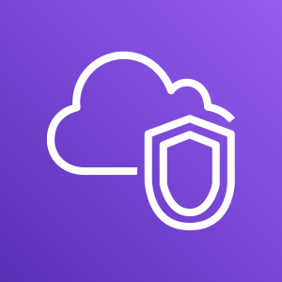
Amazon VPC
Enables you to provision a logically isolated section of the AWS Cloud where you can launch AWS resources in a virtual network that you define
Gives you control over your virtual networking resources, including:
Selection of IP address range
Creation of subnets
Configuration of route tables and network gateways
Enables you to customize the network configuration for your VPC
Enables you to use multiple layers of security
Amazon VPC
Notes:
Amazon Virtual Private Cloud (Amazon VPC) is a service that lets you provision a logically isolated section of the AWS Cloud (called a virtual private cloud, or VPC) where you can launch your AWS resources.
Amazon VPC gives you control over your virtual networking resources, including the selection of your own IP address range, the creation of subnets, and the configuration of route tables and network gateways. You can use both IPv4 and IPv6 in your VPC for secure access to resources and applications.
You can also customize the network configuration for your VPC. For example, you can create a public subnet for your web servers that can access the public internet. You can place your backend systems (such as databases or application servers) in a private subnet with no public internet access.
Finally, you can use multiple layers of security, including security groups and network access control lists (network ACLs), to help control access to Amazon Elastic Compute Cloud (Amazon EC2) instances in each subnet.

Slide 68
VPCs and subnets
VPCs:
Logically isolated from other VPCs
Dedicated to your AWS account
Belong to a single AWS Region and can span multiple Availability Zones
VPCs in GCP are global
Subnets:
Range of IP addresses that divide a VPC
Belong to a single Availability Zone
subnets in GCP can cross zones
Classified as public or private
AWS Cloud
Region
Availability Zone 1
Availability Zone 2
VPC
Subnet
Subnet
Notes:
Amazon VPC enables you to provision virtual private clouds (VPCs). A VPC is a virtual network that is logically isolated from other virtual networks in the AWS Cloud. A VPC is dedicated to your account. VPCs belong to a single AWS Region and can span multiple Availability Zones.
After you create a VPC, you can divide it into one or more subnets. A subnet is a range of IP addresses in a VPC. Subnets belong to a single Availability Zone. You can create subnets in different Availability Zones for high availability. Subnets are generally classified as public or private. Public subnets have direct access to the internet, but private subnets do not.

Slide 69
A VPC network is a virtual version of a physical network and is a global resource
On Premises
Internet
VPC Network
Internet Gateway
VPN Gateway
Region: us-west1
Region: us-east1
VPC Routing
Zone: us-west1-a
Zone: us-east1-a
Zone: us-east1-b
VM
10.240.0.2
VM
10.240.0.3
VM
192.168.1.2
VM
192.168.1.3
VM
10.2.0.2
VM
10.2.0.3
subnet1: 10.240.0.0/24
subnet2: 192.168.1.0/24
subnet3: 10.2.0.0/16
Copyright Google LLC. For educational purposes in accordance with the terms of use set forth on the program Website.
Notes:
Subnets are regional resources. They must be created in VPC networks to define sets of usable IP ranges for instances. VMs in different zones within the same region can share the same subnet.
In this example, subnet1 is defined as 10.240.0.0/24 in the us-west1 region. Two VM instances in the us-west1-a zone are in this subnet. Their IP addresses both come from the available range of addresses in subnet1.
Subnet2 is defined as 192.168.1.0/24 in the us-east1 region. Two VM instances in the us-east1-a zone are in this subnet. Their IP addresses both come from the available range of addresses in subnet2.
Subnet3 is defined as 10.2.0.0/16, also in the us-east1 region. One VM instance in the us-east1-a zone and a second instance in the us-east1-b zone are in subnet3, each receiving an IP address from its available range. Because subnets are regional resources, instances can have their network interfaces associated with any subnet in the same region that contains their zones.
A single VPN can be used to give private connectivity from a physical data center to the VPC.

Slide 70
Network behavior within a project
Google Cloud Project
Internet
Public IP
Public IP
VPC
Network 1
VPC
Network 2
VPC
Network 3
VPC
Network 4
VPC
Network 5
VM2
VM3
VM4
us-east1
Private IP
Private IP
VM1
asia-east1
Copyright Google LLC. For educational purposes in accordance with the terms of use set forth on the program Website.
Notes:
Virtual machines that are in different regions but in the same VPC can communicate privately. VM1 and VM2 can communicate at a local level even though they’re separated geographically.
Virtual machines that reside in different VPCs, even if the subnets are in the same region, need to communicate via the internet. In this instance, VM3 and VM4 will need public IP addresses to traverse the Internet. Networks don’t communicate with any other network by default.

Slide 71
Important Notes
Virtual machines that are in the same VPC can communicate privately. VM1 and VM2 can communicate at a local level even though they’re separated geographically.
Virtual machines that reside in different VPCs, even if the subnets are in the same region, need to communicate via the internet. In the previous slide, VM3 and VM4 will need public IP addresses to traverse the Internet. Networks don’t communicate with any other network by default.

Slide 72
IP addressing
When you create a VPC, you assign it to an IPv4 CIDR block (range of private IPv4 addresses).
You cannot change the address range after you create the VPC.
The largest IPv4 CIDR block size is /16.
The smallest IPv4 CIDR block size is /28.
IPv6 is also supported (with a different block size limit).
CIDR blocks of subnets cannot overlap.
VPC
x.x.x.x/16 or 65,536 addresses (max)
to x.x.x.x/28 or 16 addresses (min)
Notes:
IP addresses enable resources in your VPC to communicate with each other and with resources over the internet. When you create a VPC, you assign an IPv4 CIDR block (a range of private IPv4 addresses) to it. After you create a VPC, you cannot change the address range, so it is important that you choose it carefully. The IPv4 CIDR block might be as large as /16 (which is 2¹⁶, or 65,536 addresses) or as small as /28 (which is 2⁴, or 16 addresses).
You can optionally associate an IPv6 CIDR block with your VPC and subnets and assign IPv6 addresses from that block to the resources in your VPC. IPv6 CIDR blocks have a different block size limit.
The CIDR block of a subnet can be the same as the CIDR block for a VPC. In this case, the VPC and the subnet are the same size (a single subnet in the VPC). Also, the CIDR block of a subnet can be a subset of the CIDR block for the VPC. This structure enables the definition of multiple subnets. If you create more than one subnet in a VPC, the CIDR blocks of the subnets cannot overlap. You cannot have duplicate IP addresses in the same VPC.
To learn more about IP addressing in a VPC, see the AWS Documentation.

Slide 73
Reserved IP addresses
Example: A VPC with an IPv4 CIDR block of 10.0.0.0/16 has 65,536 total IP addresses. The VPC has four equal-sized subnets. Only 251 IP addresses are available for use by each subnet.
IP Addresses for CIDR block 10.0.0.0/24 | Reserved for
10.0.0.0 | Network address
10.0.0.1 | Internal communication
10.0.0.2 | Domain Name System (DNS) resolution
10.0.0.3 | Future use
10.0.0.255 | Network broadcast address
VPC: 10.0.0.0/16
Subnet 1 (10.0.0.0/24)
Subnet 2 (10.0.2.0/24)
251 IP addresses
251 IP addresses
Subnet 4 (10.0.1.0/24)
Subnet 3 (10.0.3.0/24)
251 IP addresses
251 IP addresses
Notes:
When you create a subnet, it requires its own CIDR block. For each CIDR block that you specify, AWS reserves five IP addresses within that block, and these addresses are not available for use. AWS reserves these IP addresses for:
Network address
VPC local router (internal communications)
Domain Name System (DNS) resolution
Future use
Network broadcast address
For example, suppose that you create a subnet with an IPv4 CIDR block of 10.0.0.0/24 (which has 256 total IP addresses). The subnet has 256 IP addresses, but only 251 are available because five are reserved.

Slide 74
Public IP address types
Public IPv4 address
Manually assigned through an Elastic IP address
Automatically assigned through the auto-assign public IP address settings at the subnet level
Elastic IP address
Associated with an AWS account
Can be allocated and remapped anytime
Additional costs might apply
Notes:
When you create a VPC, every instance in that VPC gets a private IP address automatically. You can also request a public IP address to be assigned when you create the instance by modifying the subnet’s auto-assign public IP address properties.
An Elastic IP address is a static and public IPv4 address that is designed for dynamic cloud computing. You can associate an Elastic IP address with any instance or network interface for any VPC in your account. With an Elastic IP address, you can mask the failure of an instance by rapidly remapping the address to another instance in your VPC. Associating the Elastic IP address with the network interface has an advantage over associating it directly with the instance. You can move all of the attributes of the network interface from one instance to another in a single step.
Additional costs might apply when you use Elastic IP addresses, so it is important to release them when you no longer need them.
To learn more about Elastic IP addresses, see Elastic IP Addresses in the AWS Documentation.

Slide 75


Elastic network interface
An elastic network interface is a virtual network interface that you can:
Attach to an instance.
Detach from the instance, and attach to another instance to redirect network traffic.
Its attributes follow when it is reattached to a new instance.
Each instance in your VPC has a default network interface that is assigned a private IPv4 address from the IPv4 address range of your VPC.
Subnet: 10.0.1.0/24
Elastic network interface
Notes:
An elastic network interface is a virtual network interface that you can attach or detach from an instance in a VPC. A network interface's attributes follow it when it is reattached to another instance. When you move a network interface from one instance to another, network traffic is redirected to the new instance.
Each instance in your VPC has a default network interface (the primary network interface) that is assigned a private IPv4 address from the IPv4 address range of your VPC. You cannot detach a primary network interface from an instance. You can create and attach an additional network interface to any instance in your VPC. The number of network interfaces you can attach varies by instance type.
For more information about Elastic Network Interfaces, see the AWS Documentation.

Slide 76
Route tables and routes
A route table contains a set of rules (or routes) that you can configure to direct network traffic from your subnet.
Each route specifies a destination and a target.
By default, every route table contains a local route for communication within the VPC.
Each subnet must be associated with a route table (at most one).
Main (Default) Route Table
Destination | Target
10.0.0.0/16 | local
VPC CIDR block
Notes:
A route table contains a set of rules (called routes) that directs network traffic from your subnet. Each route specifies a destination and a target. The destination is the destination CIDR block where you want traffic from your subnet to go. The target is the target that the destination traffic is sent through. By default, every route table that you create contains a local route for communication in the VPC. You can customize route tables by adding routes. You cannot delete the local route entry that is used for internal communications.
Each subnet in your VPC must be associated with a route table. The main route table is the route table is automatically assigned to your VPC. It controls the routing for all subnets that are not explicitly associated with any other route table. A subnet can be associated with only one route table at a time, but you can associate multiple subnets with the same route table.
To learn more about route tables, see the AWS Documentation.

Slide 77

Section 2 key takeaways
A VPC is a logically isolated section of the AWS Cloud.
A VPC belongs to one Region and requires a CIDR block.
A VPC is subdivided into subnets.
A subnet belongs to one Availability Zone and requires a CIDR block.
Route tables control traffic for a subnet.
Route tables have a built-in local route.
You add additional routes to the table.
The local route cannot be deleted.
Notes:
Some key takeaways from this section of the module include:
A VPC is a logically isolated section of the AWS Cloud.
A VPC belongs to one Region and requires a CIDR block.
A VPC is subdivided into subnets.
A subnet belongs to one Availability Zone and requires a CIDR block.
Route tables control traffic for a subnet.
Route tables have a built-in local route.
You add additional routes to the table.
The local route cannot be deleted.

Slide 78
Section 3: VPC networking
Module 5: Networking and Content Delivery
Notes:
Section 3: VPC networking
Now that you have learned about the basic components of a VPC, you can start routing traffic in interesting ways. In this section, you learn about different networking options.

Slide 79
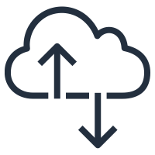
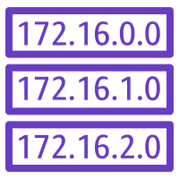


Internet gateway
AWS Cloud
Region
Availability Zone
VPC: 10.0.0.0/16
Public subnet:10.0.1.0/24
Public Subnet Route Table
Destination | Target
10.0.0.0/16 | local
0.0.0.0/0 | igw-id
Private subnet: 10.0.2.0/24
Route table
Internet gateway
(igw-id)
Internet
Notes:
An internet gateway is a scalable, redundant, and highly available VPC component that allows communication between instances in your VPC and the internet. An internet gateway serves two purposes: to provide a target in your VPC route tables for internet-routable traffic, and to perform network address translation for instances that were assigned public IPv4 addresses.
To make a subnet public, you attach an internet gateway to your VPC and add a route to the route table to send non-local traffic through the internet gateway to the internet (0.0.0.0/0).
For more information about internet gateways, see Internet Gateways in the AWS Documentation.

Slide 80

Network address translation (NAT) gateway
AWS Cloud
Region
Availability Zone
VPC: 10.0.0.0/16
Public subnet:10.0.1.0/24
Public Subnet Route Table
Public route table
Destination | Target
10.0.0.0/16 | local
0.0.0.0/0 | igw-id
NAT gateway (nat-gw-id)
Private subnet: 10.0.2.0/24
Internet gateway
(igw-id)
Private route table
Private Subnet Route Table
Destination | Target
10.0.0.0/16 | local
0.0.0.0/0 | nat-gw-id
Internet
Notes:
A network address translation (NAT) gateway enables instances in a private subnet to connect to the internet or other AWS services, but prevents the internet from initiating a connection with those instances.
To create a NAT gateway, you must specify the public subnet in which the NAT gateway should reside. You must also specify an Elastic IP address to associate with the NAT gateway when you create it. After you create a NAT gateway, you must update the route table that is associated with one or more of your private subnets to point internet-bound traffic to the NAT gateway. Thus, instances in your private subnets can communicate with the internet.
You can also use a NAT instance in a public subnet in your VPC instead of a NAT gateway. However, a NAT gateway is a managed NAT service that provides better availability, higher bandwidth, and less administrative effort. For common use cases, AWS recommends that you use a NAT gateway instead of a NAT instance.
See the AWS Documentation for more information about
NAT gateways
NAT instances
Differences between NAT gateways and NAT instances

Slide 81
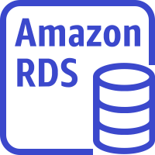

VPC sharing
AWS Cloud
Region
VPC: Account A (owner)
Private subnet
Router
Public subnet
Account D (participant)
Account B (participant)
Account C (participant)
NAT gateway
Internet gateway
EC2 instance
EC2 instance
EC2 instance
RDS instance
Amazon Redshift
EC2 instance
Notes:
VPC sharing enables customers to share subnets with other AWS accounts in the same organization in AWS Organizations. VPC sharing enables multiple AWS accounts to create their application resources—such as Amazon EC2 instances, Amazon Relational Database Service (Amazon RDS) databases, Amazon Redshift clusters, and AWS Lambda functions—into shared, centrally managed VPCs. In this model, the account that owns the VPC (owner) shares one or more subnets with other accounts (participants) that belong to the same organization in AWS Organizations. After a subnet is shared, the participants can view, create, modify, and delete their application resources in the subnets that are shared with them. Participants cannot view, modify, or delete resources that belong to other participants or the VPC owner.
VPC sharing offers several benefits:
Separation of duties – Centrally controlled VPC structure, routing, IP address allocation
Ownership – Application owners continue to own resources, accounts, and security groups
Security groups – VPC sharing participants can reference the security group IDs of each other
Efficiencies – Higher density in subnets, efficient use of VPNs and AWS Direct Connect
No hard limits – Hard limits can be avoided—for example, 50 virtual interfaces per AWS Direct Connect connection through simplified network architecture
Optimized costs – Costs can be optimized through the reuse of NAT gateways, VPC interface endpoints, and intra-Availability Zone traffic
VPC sharing enables you to decouple accounts and networks. You have fewer, larger, centrally managed VPCs. Highly interconnected applications automatically benefit from this approach.

Slide 82
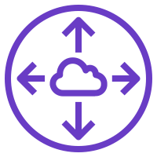
VPC peering
AWS Cloud
You can connect VPCs in your own AWS account, between AWS accounts, or between AWS Regions.
Restrictions:
IP spaces cannot overlap.
Transitive peering is not supported.
You can only have one peering resource between the same two VPCs.
VPC A: 10.0.0.0/16
VPC B: 10.3.0.0/16
Peering connection (pcx-id)
Route Table for VPC A
Route Table for VPC B
Destination | Target
10.0.0.0/16 | local
10.3.0.0/16 | pcx-id
Destination | Target
10.3.0.0/16 | local
10.0.0.0/16 | pcx-id
Notes:
A VPC peering connection is a networking connection between two VPCs that enables you to route traffic between them privately. Instances in either VPC can communicate with each other as if they are within the same network. You can create a VPC peering connection between your own VPCs, with a VPC in another AWS account, or with a VPC in a different AWS Region.
When you set up the peering connection, you create rules in your route table to allow the VPCs to communicate with each other through the peering resource. For example, suppose that you have two VPCs. In the route table for VPC A, you set the destination to be the IP address of VPC B and the target to be the peering resource ID. In the route table for VPC B, you set the destination to be the IP address of VPC A and the target to be the peering resource ID.
VPC peering has some restrictions:
IP address ranges cannot overlap.
Transitive peering is not supported. For example, suppose that you have three VPCs: A, B, and C. VPC A is connected to VPC B, and VPC A is connected to VPC C. However, VPC B is not connected to VPC C implicitly. To connect VPC B to VPC C, you must explicitly establish that connectivity.
You can only have one peering resource between the same two VPCs.
For more information about VPC peering, see VPC Peering in the AWS Documentation.

Slide 83
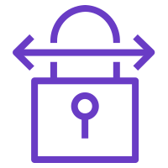



AWS Site-to-Site VPN
AWS Cloud
Public subnet route table
Region
Destination | Target
10.0.0.0/16 | local
0.0.0.0/0 | igw-id
Availability Zone
VPC: 10.0.0.0/16
Site-to-Site VPN connection
Public subnet:10.1.0.0/24
Private subnet route table
Internet
Destination | Target
10.0.0.0/16 | local
192.168.10.0/24 | vgw-id
Private subnet: 10.0.2.0/24
Route table
Virtual gateway (vgw-id)
Customer gateway
Corporate data center: 192.168.10.0/24
Notes:
By default, instances that you launch into a VPC cannot communicate with a remote network. To connect your VPC to your remote network (that is, create a virtual private network or VPN connection), you:
Create a new virtual gateway device (called a virtual private network (VPN) gateway) and attach it to your VPC.
Define the configuration of the VPN device or the customer gateway. The customer gateway is not a device but an AWS resource that provides information to AWS about your VPN device.
Create a custom route table to point corporate data center-bound traffic to the VPN gateway. You also must update security group rules. (You will learn about security groups in the next section.)
Establish an AWS Site-to-Site VPN (Site-to-Site VPN) connection to link the two systems together.
Configure routing to pass traffic through the connection.
For more information about AWS Site-to-Site VPN and other VPN connectivity options, see VPN Connections in the AWS Documentation.

Slide 84
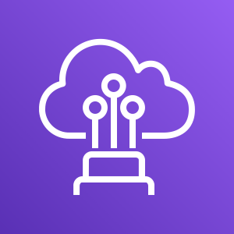
AWS Direct Connect
AWS Cloud
Region
Availability Zone
Internet
VPC: 10.0.0.0/16
Public subnet:10.1.0.0/24
802.1q VLAN
AWS Direct Connect
Private subnet: 10.0.2.0/24
Route table
Virtual gateway
Customer gateway
Corporate data center: 192.168.10.0/24
Notes:
One of the challenges of network communication is network performance. Performance can be negatively affected if your data center is located far away from your AWS Region. For such situations, AWS offers AWS Direct Connect, or DX. AWS Direct Connect enables you to establish a dedicated, private network connection between your network and one of the DX locations. This private connection can reduce your network costs, increase bandwidth throughput, and provide a more consistent network experience than internet-based connections. DX uses open standard 802.1q virtual local area networks (VLANs).
For more information about DX, see the AWS Direct Connect product page.

Slide 85
Activity: Label this network diagram
AWS Cloud
1
2
3
Public subnet:10.0.1.0/24
4
10
Internet
13
_5_ IP address
9
12
Destination | Target
14 | local
0.0.0.0/0 | 15
Private subnet: 10.0.2.0/24
6
11
7
_8_ IP address
10.0.0.0/16
Notes:
See if you can recognize the different VPC networking components that you learned about by labeling this network diagram.

Slide 86
Activity: Solution
AWS Cloud
Region
Availability Zone
VPC
Public subnet:10.0.1.0/24
Public subnet
Internet gateway
Route table
Internet
Private IP address
NAT gateway
Route
Destination | Target
10.0.0.0/16 | local
0.0.0.0/0 | igw-id
Private subnet
Private subnet: 10.0.2.0/24
Route table
Elastic network interface
Private IP address
10.0.0.0/16
Notes:
Now, see how well you did.

Slide 87
Section 3 key takeaways
There are several VPC networking options, which include:
Internet gateway
NAT gateway
VPC endpoint
VPC peering
VPC sharing
AWS Site-to-Site VPN
AWS Direct Connect
AWS Transit Gateway
You can use the VPC Wizard to implement your design.
Notes:
Some key takeaways from this section of the module include:
There are several VPC networking options, which include:
Internet gateway: Connects your VPC to the internet
NAT gateway: Enables instances in a private subnet to connect to the internet
VPC endpoint: Connects your VPC to supported AWS services
VPC peering: Connects your VPC to other VPCs
VPC sharing: Allows multiple AWS accounts to create their application resources into shared, centrally-managed Amazon VPCs
AWS Site-to-Site VPN: Connects your VPC to remote networks
AWS Direct Connect: Connects your VPC to a remote network by using a dedicated network connection
AWS Transit Gateway: A hub-and-spoke connection alternative to VPC peering
You can use the VPC Wizard to implement your design.

Slide 88
Section 4: VPC security
Module 5: Networking and Content Delivery
Notes:
Section 4: VPC security
You can build security into your VPC architecture in several ways so that you have complete control over both incoming and outgoing traffic. In this section, you learn about two Amazon VPC firewall options that you can use to secure your VPC: security groups and network access control lists (network ACLs).

Slide 89
Security groups
AWS Cloud
Region
Availability Zone
VPC: 10.0.0.0/16
Public subnet:10.0.1.0/24
Security group
Security groups act at the instance level.
Private subnet: 10.0.2.0/24
Security group
Notes:
A security group acts as a virtual firewall for your instance, and it controls inbound and outbound traffic. Security groups act at the instance level, not the subnet level. Therefore, each instance in a subnet in your VPC can be assigned to a different set of security groups.
At the most basic level, a security group is a way for you to filter traffic to your instances.

Slide 90
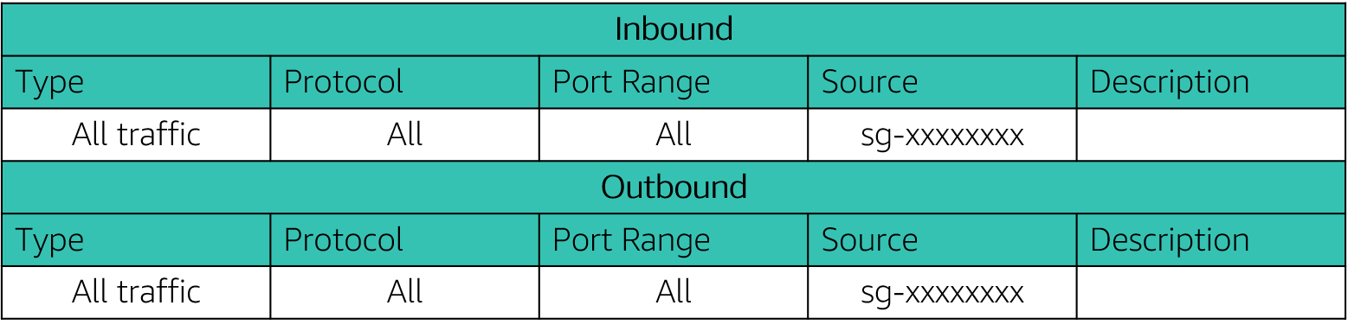
Security groups
Security groups have rules that control inbound and outbound instance traffic.
Default security groups deny all inbound traffic and allow all outbound traffic.
Security groups are stateful.
Notes:
Security groups have rules that control the inbound and outbound traffic. When you create a security group, it has no inbound rules. Therefore, no inbound traffic that originates from another host to your instance is allowed until you add inbound rules to the security group. By default, a security group includes an outbound rule that allows all outbound traffic. You can remove the rule and add outbound rules that allow specific outbound traffic only. If your security group has no outbound rules, no outbound traffic that originates from your instance is allowed.
Security groups are stateful, which means that state information is kept even after a request is processed. Thus, if you send a request from your instance, the response traffic for that request is allowed to flow in regardless of inbound security group rules. Responses to allowed inbound traffic are allowed to flow out, regardless of outbound rules.

Slide 91
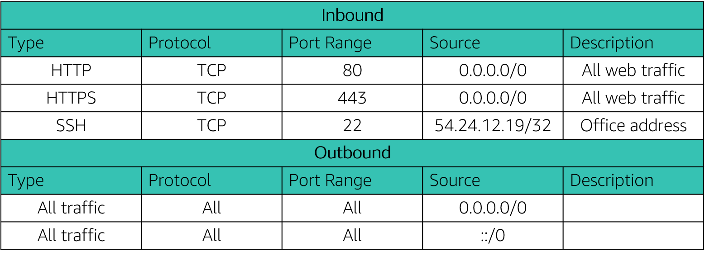
Custom security groups
You can specify allow rules, but not deny rules.
All rules are evaluated before the decision to allow traffic.
Notes:
When you create a custom security group, you can specify allow rules, but not deny rules. All rules are evaluated before the decision to allow traffic.

Slide 92

Network access control lists (network ACLs)
AWS Cloud
Region
Availability Zone
VPC: 10.0.0.0/16
Public subnet:10.0.0.0/24
Network ACLs act at the subnet level.
Private subnet: 10.0.4.0/22
Notes:
A network access control list (network ACL) is an optional layer of security for your Amazon VPC. It acts as a firewall for controlling traffic in and out of one or more subnets. To add another layer of security to your VPC, you can set up network ACLs with rules that are similar to your security groups.
Each subnet in your VPC must be associated with a network ACL. If you don't explicitly associate a subnet with a network ACL, the subnet is automatically associated with the default network ACL. You can associate a network ACL with multiple subnets; however, a subnet can be associated with only one network ACL at a time. When you associate a network ACL with a subnet, the previous association is removed.

Slide 93
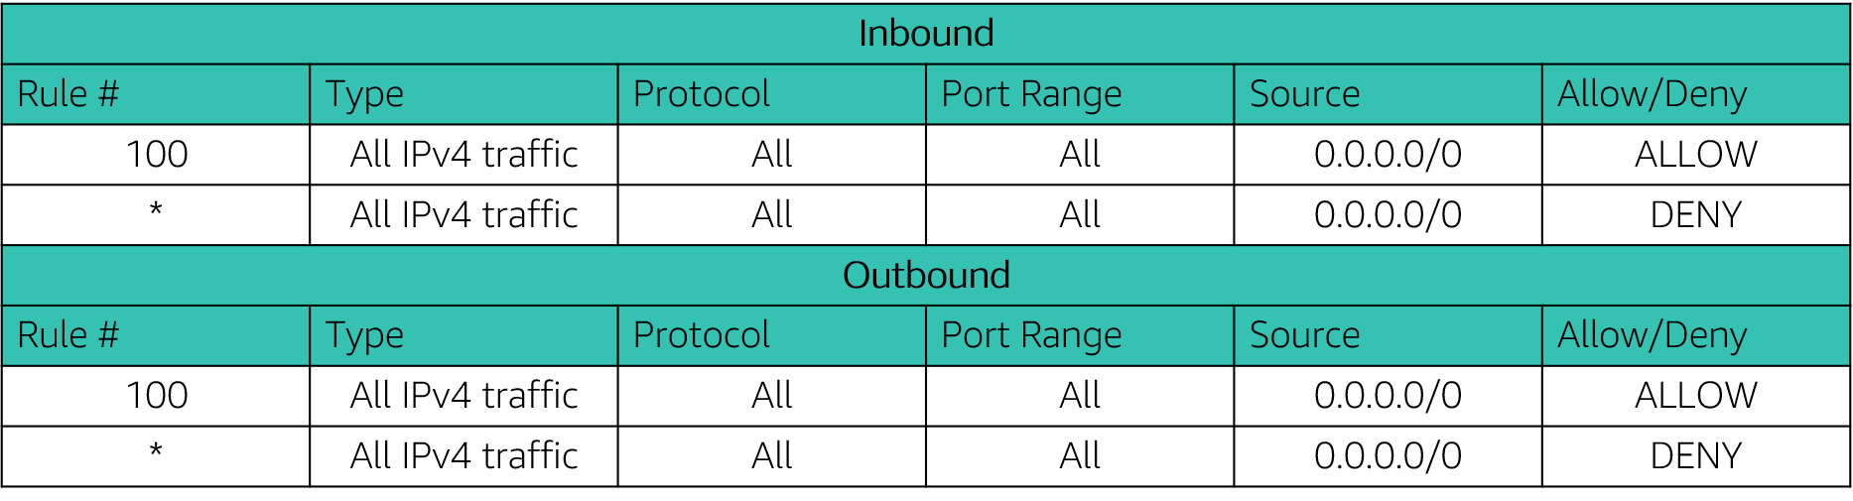
Network ACLs
A network ACL has separate inbound and outbound rules, and each rule can either allow or deny traffic.
Default network ACLs allow all inbound and outbound IPv4 traffic.
Network ACLs are stateless.
Notes:
A network ACL has separate inbound and outbound rules, and each rule can either allow or deny traffic. Your VPC automatically comes with a modifiable default network ACL. By default, it allows all inbound and outbound IPv4 traffic and, if applicable, IPv6 traffic. The table shows a default network ACL.
Network ACLs are stateless, which means that no information about a request is maintained after a request is processed.

Slide 94
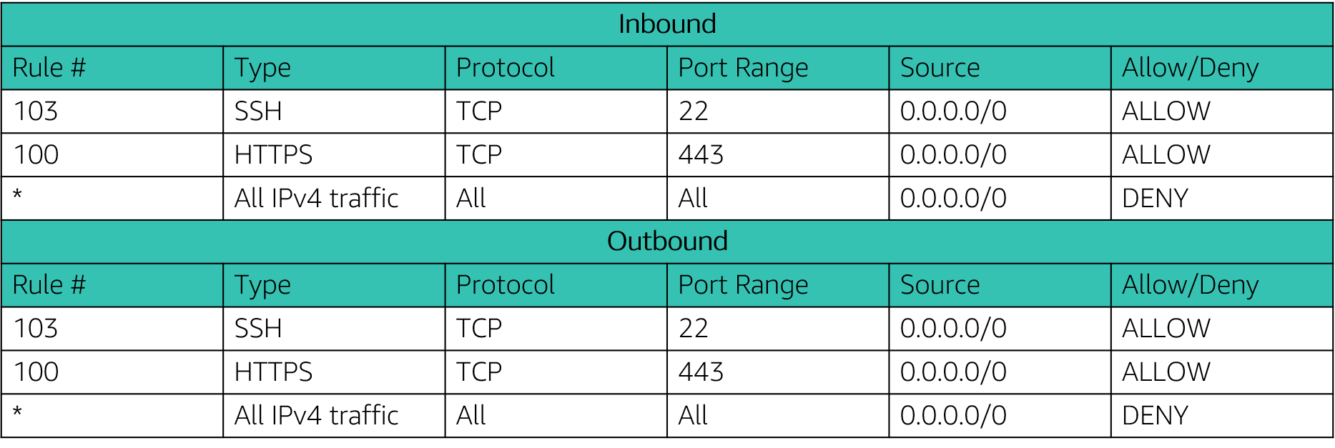
Custom network ACLs
Custom network ACLs deny all inbound and outbound traffic until you add rules.
You can specify both allow and deny rules.
Rules are evaluated in number order, starting with the lowest number.
Notes:
You can create a custom network ACL and associate it with a subnet. By default, each custom network ACL denies all inbound and outbound traffic until you add rules.
A network ACL contains a numbered list of rules that are evaluated in order, starting with the lowest numbered rule. The purpose is to determine whether traffic is allowed in or out of any subnet that is associated with the network ACL. The highest number that you can use for a rule is 32,766. AWS recommends that you create rules in increments (for example, increments of 10 or 100) so that you can insert new rules where you need them later.
For more information about network ACLs, see Network ACLs in the AWS Documentation.

Slide 95
Security groups versus network ACLs
Attribute | Security Groups | Network ACLs
Scope | Instance level | Subnet level
Supported Rules | Allow rules only | Allow and deny rules
State | Stateful (return traffic is automatically allowed, regardless of rules) | Stateless (return traffic must be explicitly allowed by rules)
Order of Rules | All rules are evaluated before decision to allow traffic | Rules are evaluated in number order before decision to allow traffic
Notes:
Here is a summary of the differences between security groups and network ACLs:
Security groups act at the instance level, but network ACLs act at the subnet level.
Security groups support allow rules only, but network ACLs support both allow and deny rules.
Security groups are stateful, but network ACLs are stateless.
For security groups, all rules are evaluated before the decision is made to allow traffic. For network ACLs, rules are evaluated in number order before the decision is made to allow traffic.

Slide 96
Activity: Design a VPC
Scenario: You have a small business with a website that is hosted on an Amazon Elastic Compute Cloud (Amazon EC2) instance. You have customer data that is stored on a backend database that you want to keep private. You want to use Amazon VPC to set up a VPC that meets the following requirements:
Your web server and database server must be in separate subnets.
The first address of your network must be 10.0.0.0. Each subnet must have 256 total IPv4 addresses.
Your customers must always be able to access your web server.
Your database server must be able to access the internet to make patch updates.
Your architecture must be highly available and use at least one custom firewall layer.
Notes:
Now, it’s your turn! In this scenario, you are a small business owner with a website that is hosted on an Amazon Elastic Compute Cloud (Amazon EC2) instance. You have customer data that is stored on a backend database that you want to keep private.
See if you can design a VPC that meets the following requirements:
Your web server and database server must be in separate subnets.
The first address of your network must be 10.0.0.0. Each subnet must have 256 IPv4 addresses.
Your customers must always be able to access your web server.
Your database server must be able to access the internet to make patch updates.
Your architecture must be highly available and use at least one custom firewall layer.

Slide 97
Section 5: Amazon Route 53
Module 5: Networking and Content Delivery
Notes:
Section 5: Amazon Route 53

Slide 98

Amazon Route 53
Is a highly available and scalable Domain Name System (DNS) web service
Is used to route end users to internet applications by translating names (like www.example.com) into numeric IP addresses (like 192.0.2.1) that computers use to connect to each other
Is fully compliant with IPv4 and IPv6
Connects user requests to infrastructure running in AWS and also outside of AWS
Is used to check the health of your resources
Features traffic flow
Enables you to register domain names
Amazon Route 53
Notes:
Amazon Route 53 is a highly available and scalable cloud Domain Name System (DNS) web service. It is designed to give developers and businesses a reliable and cost-effective way to route users to internet applications by translating names (like www.example.com) into the numeric IP addresses (like 192.0.2.1) that computers use to connect to each other. In addition, Amazon Route 53 is fully compliant with IPv6.
Amazon Route 53 effectively connects user requests to infrastructure running in AWS—such as Amazon EC2 instances, Elastic Load Balancing load balancers, or Amazon S3 buckets—and can also be used to route users to infrastructure that is outside of AWS.
You can use Amazon Route 53 to configure DNS health checks so you that can route traffic to healthy endpoints or independently monitor the health of your application and its endpoints.
Amazon Route 53 traffic flow helps you manage traffic globally through several routing types, which can be combined with DNS failover to enable various low-latency, fault-tolerant architectures. You can use Amazon Route 53 traffic flow’s simple visual editor to manage how your users are routed to your application’s endpoints—whether in a single AWS Region or distributed around the globe.
Amazon Route 53 also offers Domain Name Registration—you can purchase and manage domain names (like example.com), and Amazon Route 53 will automatically configure DNS settings for your domains.

Slide 99


Amazon Route 53 DNS resolution
Requests www.example.com
Checks with Route 53 for IP address
User
Returns IP address 192.0.2.0
DNS resolver
Returns IP address 192.0.2.0
Amazon Route 53
Notes:
Here is the basic pattern that Amazon Route 53 follows when a user initiates a DNS request. The DNS resolver checks with your domain in Route 53, gets the IP address, and returns it to the user.

Slide 100
Amazon Route 53 supported routing
Simple routing – Use in single-server environments
Weighted round robin routing – Assign weights to resource record sets to specify the frequency
Latency routing – Help improve your global applications
Geolocation routing – Route traffic based on location of your users
Geoproximity routing – Route traffic based on location of your resources
Failover routing – Fail over to a backup site if your primary site becomes unreachable
Multivalue answer routing – Respond to DNS queries with up to eight healthy records selected at random
Notes:
Amazon Route 53 supports several types of routing policies, which determine how Amazon Route 53 responds to queries:
Simple routing (round robin) – Use for a single resource that performs a given function for your domain (such as a web server that serves content for the example.com website).
Weighted round robin routing – Use to route traffic to multiple resources in proportions that you specify. Enables you to assign weights to resource record sets to specify the frequency with which different responses are served. You might want to use this capability to do A/B testing, which is when you send a small portion of traffic to a server where you made a software change. For instance, suppose you have two record sets that are associated with one DNS name: one with weight 3 and one with weight 1. In this case, 75 percent of the time, Amazon Route 53 will return the record set with weight 3, and 25 percent of the time, Amazon Route 53 will return the record set with weight 1. Weights can be any number between 0 and 255.
Latency routing (LBR) – Use when you have resources in multiple AWS Regions and you want to route traffic to the Region that provides the best latency. Latency routing works by routing your customers to the AWS endpoint (for example, Amazon EC2 instances, Elastic IP addresses, or load balancers) that provides the fastest experience based on actual performance measurements of the different AWS Regions where your application runs.
Geolocation routing – Use when you want to route traffic based on the location of your users. When you use geolocation routing, you can localize your content and present some or all of your website in the language of your users. You can also use geolocation routing to restrict the distribution of content to only the locations where you have distribution rights. Another possible use is for balancing the load across endpoints in a predictable, easy-to-manage way, so that each user location is consistently routed to the same endpoint.
Geoproximity routing – Use when you want to route traffic based on the location of your resources and, optionally, shift traffic from resources in one location to resources in another.
Failover routing (DNS failover) – Use when you want to configure active-passive failover. Amazon Route 53 can help detect an outage of your website and redirect your users to alternate locations where your application is operating properly. When you enable this feature, Amazon Route 53 health-checking agents will monitor each location or endpoint of your application to determine its availability. You can take advantage of this feature to increase the availability of your customer-facing application.
Multivalue answer routing – Use when you want Route 53 to respond to DNS queries with up to eight healthy records that are selected at random. You can configure Amazon Route 53 to return multiple values—such as IP addresses for your web servers—in response to DNS queries. You can specify multiple values for almost any record, but multivalue answer routing also enables you to check the health of each resource so that Route 53 returns only values for healthy resources. It's not a substitute for a load balancer, but the ability to return multiple health-checkable IP addresses is a way to use DNS to improve availability and load balancing.

Slide 101
Section 5 key takeaways
Amazon Route 53 is a highly available and scalable cloud DNS web service that translates domain names into numeric IP addresses.
Amazon Route 53 supports several types of routing policies.
Multi-Region deployment improves your application’s performance for a global audience.
You can use Amazon Route 53 failover to improve the availability of your applications.
Notes:
Some key takeaways from this section of the module include:
Amazon Route 53 is a highly available and scalable cloud DNS web service that translates domain names into numeric IP addresses.
Amazon Route 53 supports several types of routing policies.
Multi-Region deployment improves your application’s performance for a global audience.
You can use Amazon Route 53 failover to improve the availability of your applications.

Slide 102
Section 6: Amazon CloudFront
Module 5: Networking and Content Delivery
Notes:
Section 6: Amazon CloudFront
The purpose of networking is to share information between connected resources. So far in this module, you learned about VPC networking with Amazon VPC. You learned about the different options for connecting your VPC to the internet, to remote networks, to other VPCs, and to AWS services.
Content delivery occurs over networks, too—for example, when you stream a movie from your favorite streaming service. In this final section, you learn about Amazon CloudFront, which is a content delivery network (CDN) service.

Slide 103

Content delivery and network latency
Hop
Router
Hop
Hop
Origin server
Hop
Router
Router
Hop
Hop
Client
Router
Hop
User
Notes:
As explained earlier in this module when you were learning about AWS Direct Connect, one of the challenges of network communication is network performance. When you browse a website or stream a video, your request is routed through many different networks to reach an origin server. The origin server (or origin) stores the original, definitive versions of the objects (webpages, images, and media files). The number of network hops and the distance that the request must travel significantly affect the performance and responsiveness of the website. Further, network latency is different in various geographic locations. For these reasons, a content delivery network might be the solution.

Slide 104
Content delivery network (CDN)
Is a globally distributed system of caching servers
Caches copies of commonly requested files (static content)
Delivers a local copy of the requested content from a nearby cache edge or Point of Presence
Accelerates delivery of dynamic content
Improves application performance and scaling
Notes:
A content delivery network (CDN) is a globally distributed system of caching servers. A CDN caches copies of commonly requested files (static content, such as Hypertext Markup Language, or HTML; Cascading Style Sheets, or CSS; JavaScript; and image files) that are hosted on the application origin server. The CDN delivers a local copy of the requested content from a cache edge or Point of Presence that provides the fastest delivery to the requester.
CDNs also deliver dynamic content that is unique to the requester and is not cacheable. Having a CDN deliver dynamic content improves application performance and scaling. The CDN establishes and maintains secure connections closer to the requester. If the CDN is on the same network as the origin, routing back to the origin to retrieve dynamic content is accelerated. In addition, content such as form data, images, and text can be ingested and sent back to the origin, thus taking advantage of the low-latency connections and proxy behavior of the PoP.

Slide 105

Amazon CloudFront
Fast, global, and secure CDN service
Global network of edge locations and Regional edge caches
Self-service model
Pay-as-you-go pricing
Amazon CloudFront
Notes:
Amazon CloudFront is a fast CDN service that securely delivers data, videos, applications, and application programming interfaces (APIs) to customers globally with low latency and high transfer speeds. It also provides a developer-friendly environment. Amazon CloudFront delivers files to users over a global network of edge locations and Regional edge caches. Amazon CloudFront is different from traditional content delivery solutions because it enables you to quickly obtain the benefits of high-performance content delivery without negotiated contracts, high prices, or minimum fees. Like other AWS services, Amazon CloudFront is a self-service offering with pay-as-you-go pricing.

Slide 106
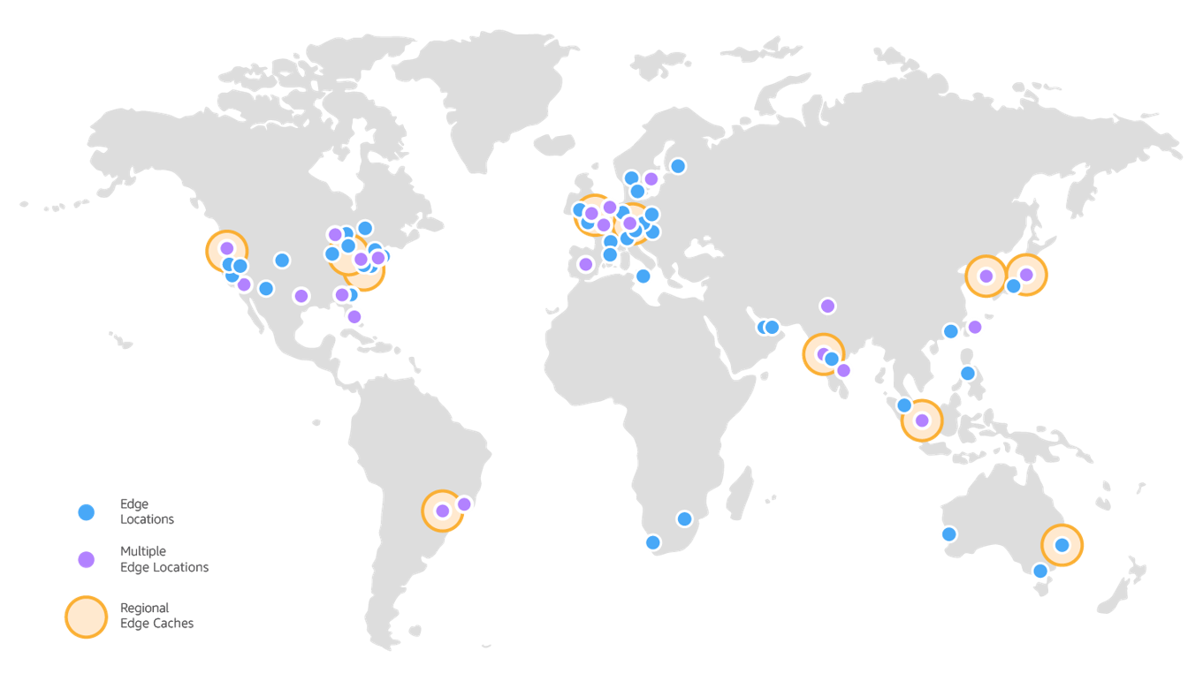
Amazon CloudFront infrastructure
Edge locations
Multiple edge locations
Regional edge caches
Edge locations – Network of data centers that CloudFront uses to serve popular content quickly to customers.
Regional edge cache – CloudFront location that caches content that is not popular enough to stay at an edge location. It is located between the origin server and the global edge location.
Notes:
Amazon CloudFront delivers content through a worldwide network of data centers that are called edge locations. When a user requests content that you serve with CloudFront, the user is routed to the edge location that provides the lowest latency (or time delay) so that content is delivered with the best possible performance. CloudFront edge locations are designed to serve popular content quickly to your viewers.
As objects become less popular, individual edge locations might remove those objects to make room for more popular content. For the less popular content, CloudFront has Regional edge caches. Regional edge caches are CloudFront locations that are deployed globally and are close to your viewers. They are located between your origin server and the global edge locations that serve content directly to viewers. A Regional edge cache has a larger cache than an individual edge location, so objects remain in the Regional edge cache longer. More of your content remains closer to your viewers, which reduces the need for CloudFront to go back to your origin server and improves overall performance for viewers.
For more information about how Amazon CloudFront works, see How CloudFront Delivers Content in the AWS Documentation.

Slide 107
Amazon CloudFront benefits
Fast and global
Security at the edge
Highly programmable
Deeply integrated with AWS
Cost-effective
Notes:
Amazon CloudFront provides the following benefits:
Fast and global – Amazon CloudFront is massively scaled and globally distributed. To deliver content to end users with low latency, Amazon CloudFront uses a global network that consists of edge locations and regional caches.
Security at the edge – Amazon CloudFront provides both network-level and application-level protection. Your traffic and applications benefit through various built-in protections, such as AWS Shield Standard, at no additional cost. You can also use configurable features, such as AWS Certificate Manager (ACM), to create and manage custom Secure Sockets Layer (SSL) certificates at no extra cost.
Highly programmable – Amazon CloudFront features can be customized for specific application requirements. It integrates with Lambda@Edge so that you can run custom code across AWS locations worldwide, which enables you to move complex application logic closer to users to improve responsiveness. The CDN also supports integrations with other tools and automation interfaces for DevOps. It offers continuous integration and continuous delivery (CI/CD) environments.
Deeply integrated with AWS – Amazon CloudFront is integrated with AWS, with both physical locations that are directly connected to the AWS Global Infrastructure and other AWS services. You can use APIs or the AWS Management Console to programmatically configure all features in the CDN.
Cost-effective – Amazon CloudFront is cost-effective because it has no minimum commitments and charges you only for what you use. Compared to self-hosting, Amazon CloudFront avoids the expense and complexity of operating a network of cache servers in multiple sites across the internet. It eliminates the need to overprovision capacity to serve potential spikes in traffic. Amazon CloudFront also uses techniques like collapsing simultaneous viewer requests at an edge location for the same file into a single request to your origin server. The result is reduced load on your origin servers and reduced need to scale your origin infrastructure, which can result in further cost savings. If you use AWS origins such as Amazon Simple Storage Service (Amazon S3) or Elastic Load Balancing, you pay only for storage costs, not for any data transferred between these services and CloudFront.

Slide 108
Amazon CloudFront pricing
Data transfer out
Charged for the volume of data transferred out from Amazon CloudFront edge location to the internet or to your origin.
HTTP(S) requests
Charged for number of HTTP(S) requests.
Invalidation requests
No additional charge for the first 1,000 paths that are requested for invalidation each month. Thereafter, $0.005 per path that is requested for invalidation.
Dedicated IP custom SSL
$600 per month for each custom SSL certificate that is associated with one or more CloudFront distributions that use the Dedicated IP version of custom SSL certificate support.
Notes:
Amazon CloudFront charges are based on actual usage of the service in four areas:
Data transfer out – You are charged for the volume of data that is transferred out from Amazon CloudFront edge locations, measured in GB, to the internet or to your origin (both AWS origins and other origin servers). Data transfer usage is totaled separately for specific geographic regions, and then cost is calculated based on pricing tiers for each area. If you use other AWS services as the origins of your files, you are charged separately for your use of those services, including storage and compute hours.
HTTP(S) requests – You are charged for the number of HTTP(S) requests that are made to Amazon CloudFront for your content.
Invalidation requests – You are charged per path in your invalidation request. A path that is listed in your invalidation request represents the URL (or multiple URLs if the path contains a wildcard character) of the object that you want to invalidate from CloudFront cache. You can request up to 1,000 paths each month from Amazon CloudFront at no additional charge. Beyond the first 1,000 paths, you are charged per path that is listed in your invalidation requests.
Dedicated IP custom Secure Sockets Layer (SSL) – You pay $600 per month for each custom SSL certificate that is associated with one or more CloudFront distributions that use the Dedicated IP version of custom SSL certificate support. This monthly fee is prorated by the hour. For example, if your custom SSL certificate was associated with at least one CloudFront distribution for just 24 hours (that is, 1 day) in the month of June, your total charge for using the custom SSL certificate feature in June is (1 day / 30 days) * $600 = $20.
For the latest pricing information, see the Amazon CloudFront pricing page.

Slide 109
Section 6 key takeaways
A CDN is a globally distributed system of caching servers that accelerates delivery of content.
Amazon CloudFront is a fast CDN service that securely delivers data, videos, applications, and APIs over a global infrastructure with low latency and high transfer speeds.
Amazon CloudFront offers many benefits.
Notes:
Some key takeaways from this section of the module include:
A CDN is a globally distributed system of caching servers that accelerates delivery of content.
Amazon CloudFront is a fast CDN service that securely delivers data, videos, applications, and APIs over a global infrastructure with low latency and high transfer speeds.
Amazon CloudFront offers many benefits, including:
Fast and global
Security at the edge
Highly programmable
Deeply integrated with AWS
Cost-effective

Slide 110
Thank you
Notes:
Thanks for participating!

Slide 111
It Helps to Network
Copyright Google LLC. For educational purposes in accordance with the terms of use set forth on the program Website.
Notes:
Welcome to It Helps to Network, I’m ______. In this module we’ll be learning about networking in Google Cloud.

Slide 112
Course map
Module 1
Module 2
Module 3
Module 4
Module 5
So, What’s the Cloud Anyway?
Start with a Solid Platform
Use Google Cloud to Build Your Apps
Where Do I Store This Stuff?
There’s an API for That!
Module 6
Module 7
Module 8
Module 9
Module 10
You Can’t Secure the Cloud, Right?
It Helps to Network
Let Google Keep an Eye on Things
You Have the Data, but What Are You Doing with It?
Let Machines Do the Work
Google Cloud skills badges
Copyright Google LLC. For educational purposes in accordance with the terms of use set forth on the program Website.
Notes:
We’ve considered what the Cloud is and why it’s so important, the different ways that you can interact with Google Cloud, and using Google Cloud to build your apps. We then explored the different storage options available to you, followed by the use of APIs and then cloud security. In this seventh module of the Google Cloud Computing Foundations Course, we’ll find out how networking in Google Cloud works and what you need to consider before setting up those networks.

Slide 113

Learn how to ... (1/2)
Demonstrate how to build secure networks in the cloud
Explore basic networking in the cloud
Discuss how to build virtual private clouds (VPCs)
Explain the use of public and private IP addresses in the cloud
Describe the Google Network, including regions, zones, cache nodes, points of presence (PoPs), and fiber architecture
Explore the role of firewall rules and routes
Copyright Google LLC. For educational purposes in accordance with the terms of use set forth on the program Website.
Notes:
The objective of this module is for you to be able to demonstrate how to build secure networks in the cloud.
The specific learning objectives to achieve this include you being able to provide an overview of networking in the cloud, discuss how virtual private clouds are built, explain the use of public and private IP addresses, describe the Google Network, as well as the role of firewall rules and routes.

Slide 114
Learn how to ... (2/2)
Explore hybrid cloud networking options including virtual private networks (VPNs), interconnect, and direct peering
Differentiate between load balancing options in the cloud
Copyright Google LLC. For educational purposes in accordance with the terms of use set forth on the program Website.
Notes:
You’ll also be able to consider various hybrid cloud networking options and differentiate between load balancing options.

Slide 115
Agenda (1/3)
Introduction to Networking in the Cloud
Defining a Virtual Private Cloud
Public and Private IP Address Basics
Google’s Network Architecture
Routes and Firewall Rules in the Cloud
Copyright Google LLC. For educational purposes in accordance with the terms of use set forth on the program Website.
Notes:
This module starts with an introduction to networking in the cloud. We’ll then move on to understanding what a virtual private cloud is, explaining public and private IP addresses and reviewing Google network architecture. Next, we’ll look at how routes and firewall rules work in the cloud.

Slide 116
Agenda (2/3)
Multiple VPC Networks
Building Hybrid Clouds using VPNs, Interconnecting, and Direct Peering
Different Options for Load Balancing
Copyright Google LLC. For educational purposes in accordance with the terms of use set forth on the program Website.
Notes:
The next topic will explore how multiple VPC networks can be used, which is supported by two labs. In the first, we’ll create VPC networks and VM instances, and in the other, we’ll create a web server and explore IAM roles and service accounts. We’ll then learn how to build hybrid clouds using VPNs, Interconnecting and direct peering.

Slide 117
Agenda
Introduction to Networking in the Cloud
Defining a Virtual Private Cloud
Public and Private IP Address Basics
Google’s Network Architecture
Routes and Firewall Rules in the Cloud
Copyright Google LLC. For educational purposes in accordance with the terms of use set forth on the program Website.
Notes:
Let’s start with the first topic, an introduction to networking in the cloud.

Slide 118
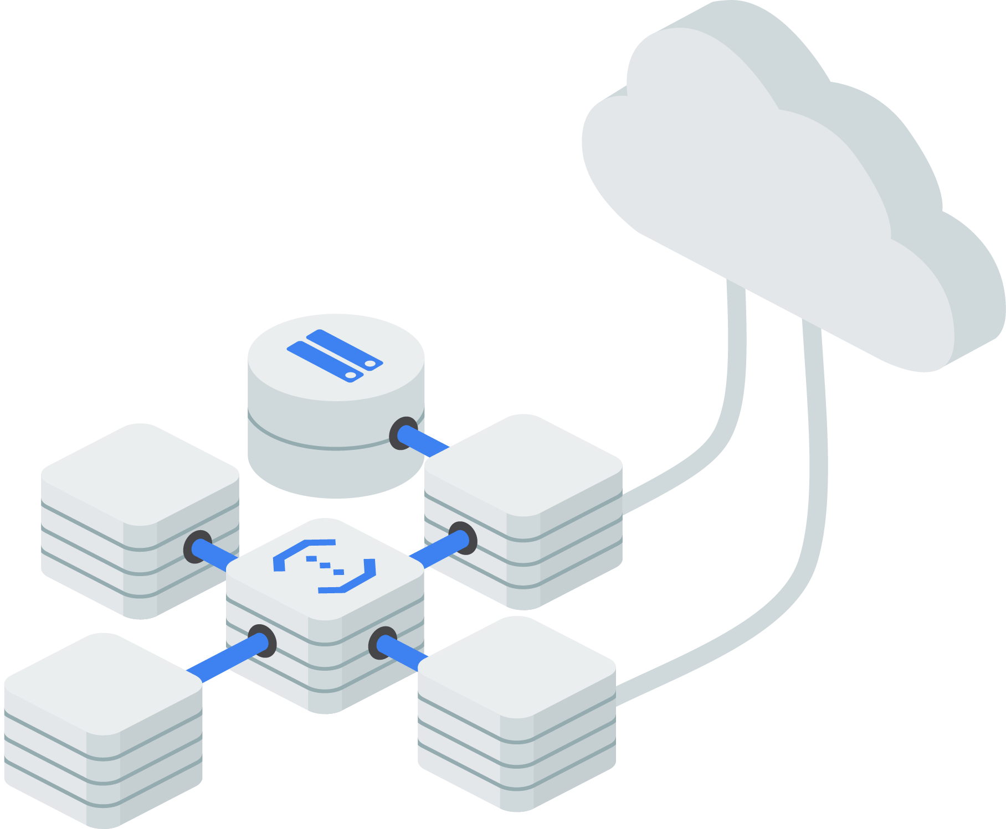
A background to networking
Copyright Google LLC. For educational purposes in accordance with the terms of use set forth on the program Website.
Notes:
Computers communicate with each other on a network. The computers in a single location, like an office, are connected on a local area network (LAN). Multiple locations can have their LANs connected to a wide area network, or WAN. Most networks today are connected to the internet, enabling millions of personal computers, servers, smartphones, and other devices to communicate, and provide and consume IT services.

Slide 119
Grace Hopper (US, UK, ES) 2022
Havfrue (US, IE, DK) 2019
Dunant (US, FR) 2020
Faster (US, JP, TW) 2016
Equiano (PT, NG, ZA) 2021
PLCN (US, TW) 2020
SJC (JP, HK, SG) 2013
Unity (US, JP) 2010
Curie (CL, US) 2019
Monet
(US, BR)
2017
Junior (Rio, Santos) 2018
JGA-S (GU, AU) 2019
Tannat (BR, UY, AR) 2018
Indigo (SG, ID, AU) 2019
Google Cloud PoPs and Network
Edge point of presence
Network
Copyright Google LLC. For educational purposes in accordance with the terms of use set forth on the program Website.
Notes:
Since around 2004, Google has been a leader in building out fast, powerful, high-quality cloud infrastructure.
Google’s high-quality private network connects regional locations to more than 100 global network points of presence close to users. Google Cloud also uses state-of-the-art software-defined networking and distributed systems technologies to host and deliver services around the world. When every millisecond of latency counts, Google ensures that content is delivered with the highest throughput.
https://cloud.google.com/about/locations/

Slide 120
How Google networking works
Network
Global container for
subnetworks
Cloud DNS
Internet
Web clients
Cloud Load Balancer
Subnetwork 1
(10.1.0.0/16)
Frontend
Compute Engine
Cloud DNS Cached content
Enterprise data center
Enterprise networks
(192.168.0.0/16)
Enterprise computing
Subnetwork 2
(10.2.0.0/16)
Cloud VPN
Backend
Compute Engine
Cloud Interconnect
Cloud firewall
Copyright Google LLC. For educational purposes in accordance with the terms of use set forth on the program Website.
Notes:
Optional content available for use if required
Here’s an example network diagram for an application which bridges an organization's physical data center and Google Cloud.
The web client, or end user, performs a Domain Name System lookup, which is served by Cloud DNS. Content Delivery Networks, or CDNs, are locations within the Google network that is used to cache content closer to the users to improve application performance. The user requests a page. If the CDN option was selected when you configured the Cloud Load Balancer, then the request will go to the closest CDN location, which will serve that page without getting it from the servers, if the CDN has the page stored.
For a page that the CDN doesn’t have, it will call to the cloud load balancer. The cloud load balancer will pick an appropriate frontend server to serve the request, and return the page to the user.
In Google Cloud, a "network" is an isolated global resource holding network configuration. Instances are deployed in regional subnetworks, however the policy (firewall, routing, and so on), and access through VPN, are configured at the global network level.
Depending on the content of the page, the frontend Compute Engine server may have to talk to a Compute Engine backend server, which is regularly updated with data feeds from other sites. The subnetworks are configured so that the frontend subnet cannot talk directly to the data center or colocation facility.

Slide 121
Agenda
Introduction to Networking in the Cloud
Defining a Virtual Private Cloud
Public and Private IP Address Basics
Google’s Network Architecture
Routes and Firewall Rules in the Cloud
Copyright Google LLC. For educational purposes in accordance with the terms of use set forth on the program Website.
Notes:
In this topic, we’ll explore what a virtual private cloud is.

Slide 122

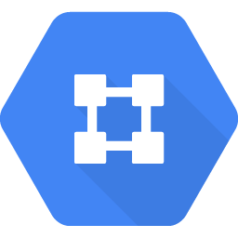
VPCs are software defined network (SDN) constructs
Allow the deployment of IaaS resources
No IP address ranges
Global
Contain subnets
Copyright Google LLC. For educational purposes in accordance with the terms of use set forth on the program Website.
Notes:
Virtual Private Cloud networks, or VPC, are used to build private networks on top of the larger Google network. With VPCs, you can apply many of the same security and access control rules as if you were building a physical network.
VPCs allow the deployment of infrastructure as a service resources, such as compute instances and containers.
They have no IP address ranges, are global, and span all available Google Cloud regions.
VPCs contain sub-networks that span all zones in a region and can have default, auto, or custom modes. Sub-networks are also referred to as subnets.

Slide 123
A VPC network is a virtual version of a physical network and is a global resource
On Premises
Internet
VPC Network
Internet Gateway
VPN Gateway
Region: us-west1
Region: us-east1
VPC Routing
Zone: us-west1-a
Zone: us-east1-a
Zone: us-east1-b
VM
10.240.0.2
VM
10.240.0.3
VM
192.168.1.2
VM
192.168.1.3
VM
10.2.0.2
VM
10.2.0.3
subnet1: 10.240.0.0/24
subnet2: 192.168.1.0/24
subnet3: 10.2.0.0/16
Copyright Google LLC. For educational purposes in accordance with the terms of use set forth on the program Website.
Notes:
Subnets are regional resources. They must be created in VPC networks to define sets of usable IP ranges for instances. VMs in different zones within the same region can share the same subnet.
In this example, subnet1 is defined as 10.240.0.0/24 in the us-west1 region. Two VM instances in the us-west1-a zone are in this subnet. Their IP addresses both come from the available range of addresses in subnet1.
Subnet2 is defined as 192.168.1.0/24 in the us-east1 region. Two VM instances in the us-east1-a zone are in this subnet. Their IP addresses both come from the available range of addresses in subnet2.
Subnet3 is defined as 10.2.0.0/16, also in the us-east1 region. One VM instance in the us-east1-a zone and a second instance in the us-east1-b zone are in subnet3, each receiving an IP address from its available range. Because subnets are regional resources, instances can have their network interfaces associated with any subnet in the same region that contains their zones.
A single VPN can be used to give private connectivity from a physical data center to the VPC.

Slide 124
Subnets are regional and extend across zones in the same region
On Premises
Internet
VPC Network
Internet Gateway
VPN Gateway
Region: us-west1
Region: us-east1
VPC Routing
Zone: us-west1-a
Zone: us-east1-a
Zone: us-east1-b
VM
10.240.0.2
VM
10.240.0.3
VM
192.168.1.2
VM
192.168.1.3
VM
10.2.0.2
VM
10.2.0.3
subnet1: 10.240.0.0/24
subnet2: 192.168.1.0/24
subnet3: 10.2.0.0/16
Copyright Google LLC. For educational purposes in accordance with the terms of use set forth on the program Website.
Notes:
Subnets are defined by an internal IP address prefix range and are specified in CIDR notation. CIDR stands for Classless Inter-Domain Routing. IP ranges cannot overlap between subnets. They can be expanded, but can never shrink. While IP ranges are specific to one region, they can cross zones within the region. You can also create multiple subnets in a single region. Although subnets don’t need to conform to a hierarchical IP schema, the internal IP ranges for a subnet must conform to RFC 1918.

Slide 125
Network behavior within a project
Google Cloud Project
Internet
Public IP
Public IP
VPC
Network 1
VPC
Network 2
VPC
Network 3
VPC
Network 4
VPC
Network 5
VM2
VM3
VM4
us-east1
Private IP
Private IP
VM1
asia-east1
Copyright Google LLC. For educational purposes in accordance with the terms of use set forth on the program Website.
Notes:
Virtual machines that are in different regions but in the same VPC can communicate privately. VM1 and VM2 can communicate at a local level even though they’re separated geographically.
Virtual machines that reside in different VPCs, even if the subnets are in the same region, need to communicate via the internet. In this instance, VM3 and VM4 will need public IP addresses to traverse the Internet. Networks don’t communicate with any other network by default.

Slide 126
The differences between auto and custom networks
Auto subnet mode
 | One subnet from each region is automatically created
 | Set of predefined IP ranges
 | Comes with default firewall rules
 | Expandable up to /16 only
 | Good for isolated use cases (Proof of concepts (PoCs), testing, etc.)
Custom subnet mode
 | No subnets are automatically created
 | Subnets and IP ranges are defined
 | No default firewalls rules
 | Expandable to any RFC 1918 size
 | Recommended for Production environments
Copyright Google LLC. For educational purposes in accordance with the terms of use set forth on the program Website.
Notes:
Google Cloud offers two types of VPC networks, determined by their subnet creation mode.
When an auto mode network is created, one subnet from each region is automatically created within it. As new Google Cloud regions become available, new subnets in those regions are automatically added to auto mode networks. The automatically created subnets use a set of predefined IP ranges and default firewall rules can be applied. In addition to the automatically created subnets, you can add more subnets manually to auto mode networks, in regions you choose, using IP ranges outside set of predefined IP ranges. When expanding the IP range in an auto mode network, the broadest prefix you can use is /16. Any prefix broader than /16 would conflict with the primary IP ranges of other automatically created subnets. Due to its limited flexibility, an auto mode network is better suited to isolated use cases, such as proof of concepts, testing, and so on.
When a custom mode network is created, no subnets are automatically created. This type of network provides you with complete control over its subnets and IP ranges. You decide which subnets to create, in regions you choose, and using IP ranges you specify. You also define the firewall rules, and you can expand the IP range to any RFC 1918 size. Custom mode networks are therefore a lot more flexible and are better suited to production environments.
While you can switch a network from auto mode to custom mode, this conversion is one-way. Custom mode networks cannot be changed to auto mode networks.

Slide 127
Agenda
Introduction to Networking in the Cloud
Defining a Virtual Private Cloud
Public and Private IP Address Basics
Google’s Network Architecture
Routes and Firewall Rules in the Cloud
Copyright Google LLC. For educational purposes in accordance with the terms of use set forth on the program Website.
Notes:
Next, we’ll learn the basics of public and private IP addresses in the cloud.

Slide 128
A VPC is made up of subnets
Subnets need to be configured with a private IP address range.
IP addresses are used for internal network communication.
Each octet is represented by 8 bits.
The /## determines the number of address bits that are static.
10 . 0 . 0 . 0 /16
00001010
00000000
00000000
00000000
/16 freezes first two octets
Copyright Google LLC. For educational purposes in accordance with the terms of use set forth on the program Website.
Notes:
Each sub-network, or subnet, must be configured with a private IP CIDR address. CIDR stands for Classless Inter-Domain Routing. The CIDR range will determine what private IP addresses will be used by virtual machines in the subnet. Private IP addresses are only used for communication within the VPC and cannot be routed to the internet.
Each octet in an IP address is represented by 8 binary bits. So a typical IPV4 address is 32 bits long. The number at the end of the range determines how many bits will be static or frozen. This number determines how many IP addresses are available with a CIDR address.

Slide 129
A /16 range will provide 65,536 available IP addresses
The CIDR range determines how many IP addresses are available.
Adding 1 to the /## will cut the available IP addresses in half.
CIDR IP address totals
/16 65,536 | /17 32,768 | /18 16,384 | /19 8,192 | /20 4,096 | /21 2,048 | /22 1,024
/23 512 | /24 256 | /25 128 | /26 64 | /27 32 | /28 16
Copyright Google LLC. For educational purposes in accordance with the terms of use set forth on the program Website.
Notes:
A /16 range will provide 65,536 available IP addresses. Everytime you add 1 to the last number, the number of available IP addresses is cut in half.

Slide 130
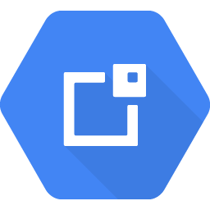
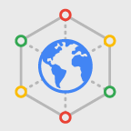
Public and Private IP address basics
Internet
Cloud External IP Addresses
Internal IP
 | Allocated from subnet range to VMs by DHCP.
 | DHCP lease is renewed every 24 hours.
 | VM name and IP is registered with network-scoped DNS.
External IP
 | Can be assigned from pool (ephemeral) or reserved (static).
 | Billed when not attached to a running VM.
 | VM doesn't know the external IP; it’s mapped to the internal IP.
Copyright Google LLC. For educational purposes in accordance with the terms of use set forth on the program Website.
Notes:
Internal IP addresses are allocated to VMs by a Dynamic Host Configuration Protocol (DHCP) service. The lease for the IPs are renewed every 24 hours. The name of the virtual machine is the host name, and the host name will be associated with the internal IP address through a network-scoped DNS service.
External IP addresses can be ephemeral or reserved. They are assigned from a pool of IP addresses associated with the region. If you allocate a reserved IP address but don't attach it to a virtual machine, you will be billed for the IP address. Virtual machines are unaware of their public IP address. If you look at the operating system network configuration the virtual machine will only show the private IP address.

Slide 131
Agenda
Introduction to Networking in the Cloud
Defining a Virtual Private Cloud
Public and Private IP Address Basics
Google’s Network Architecture
Routes and Firewall Rules in the Cloud
Copyright Google LLC. For educational purposes in accordance with the terms of use set forth on the program Website.
Notes:
We’ll now review Google’s network architecture.

Slide 132
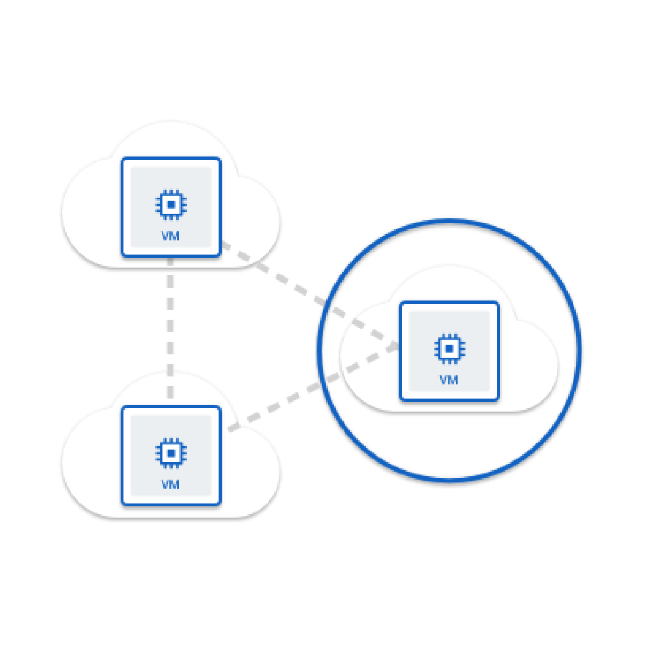
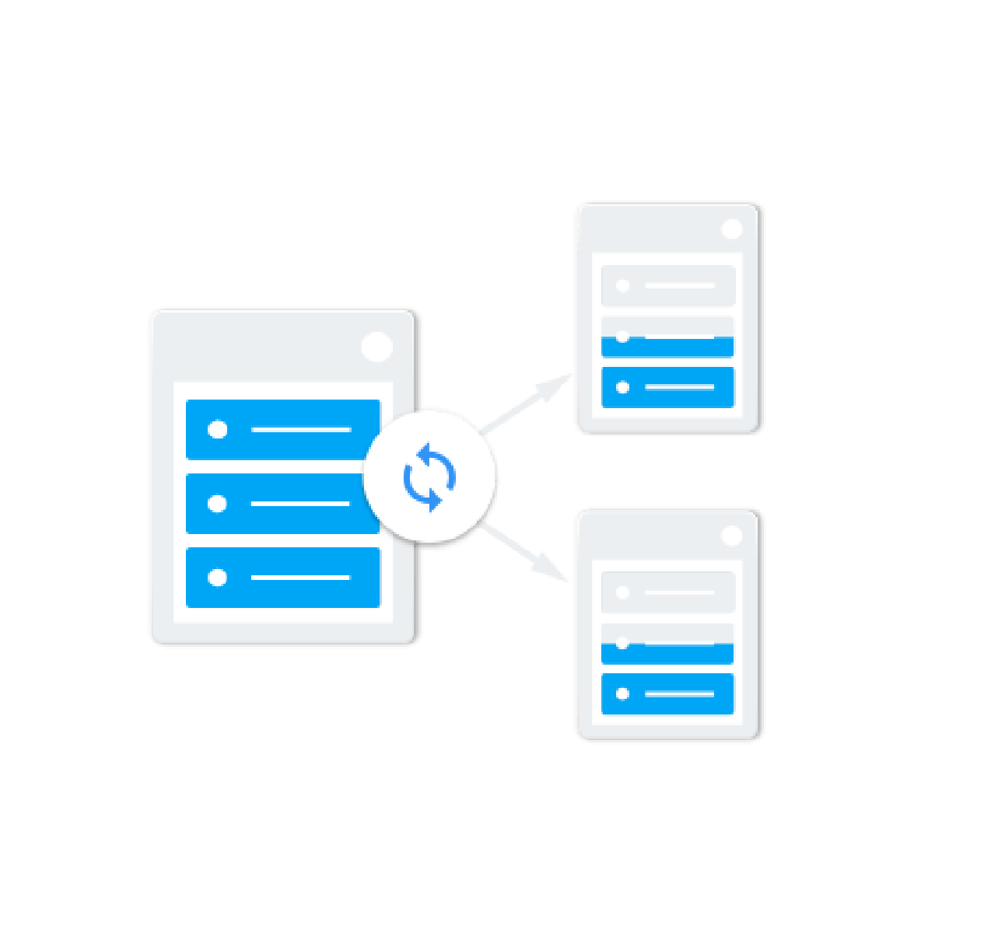
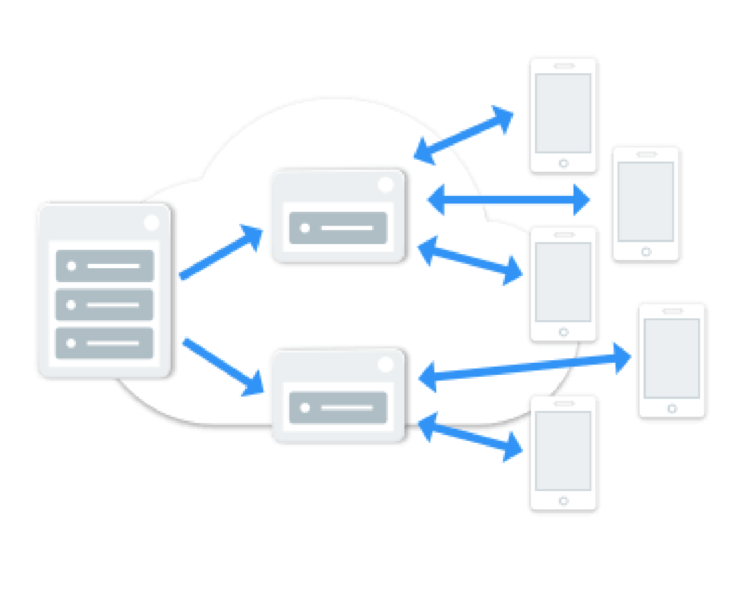
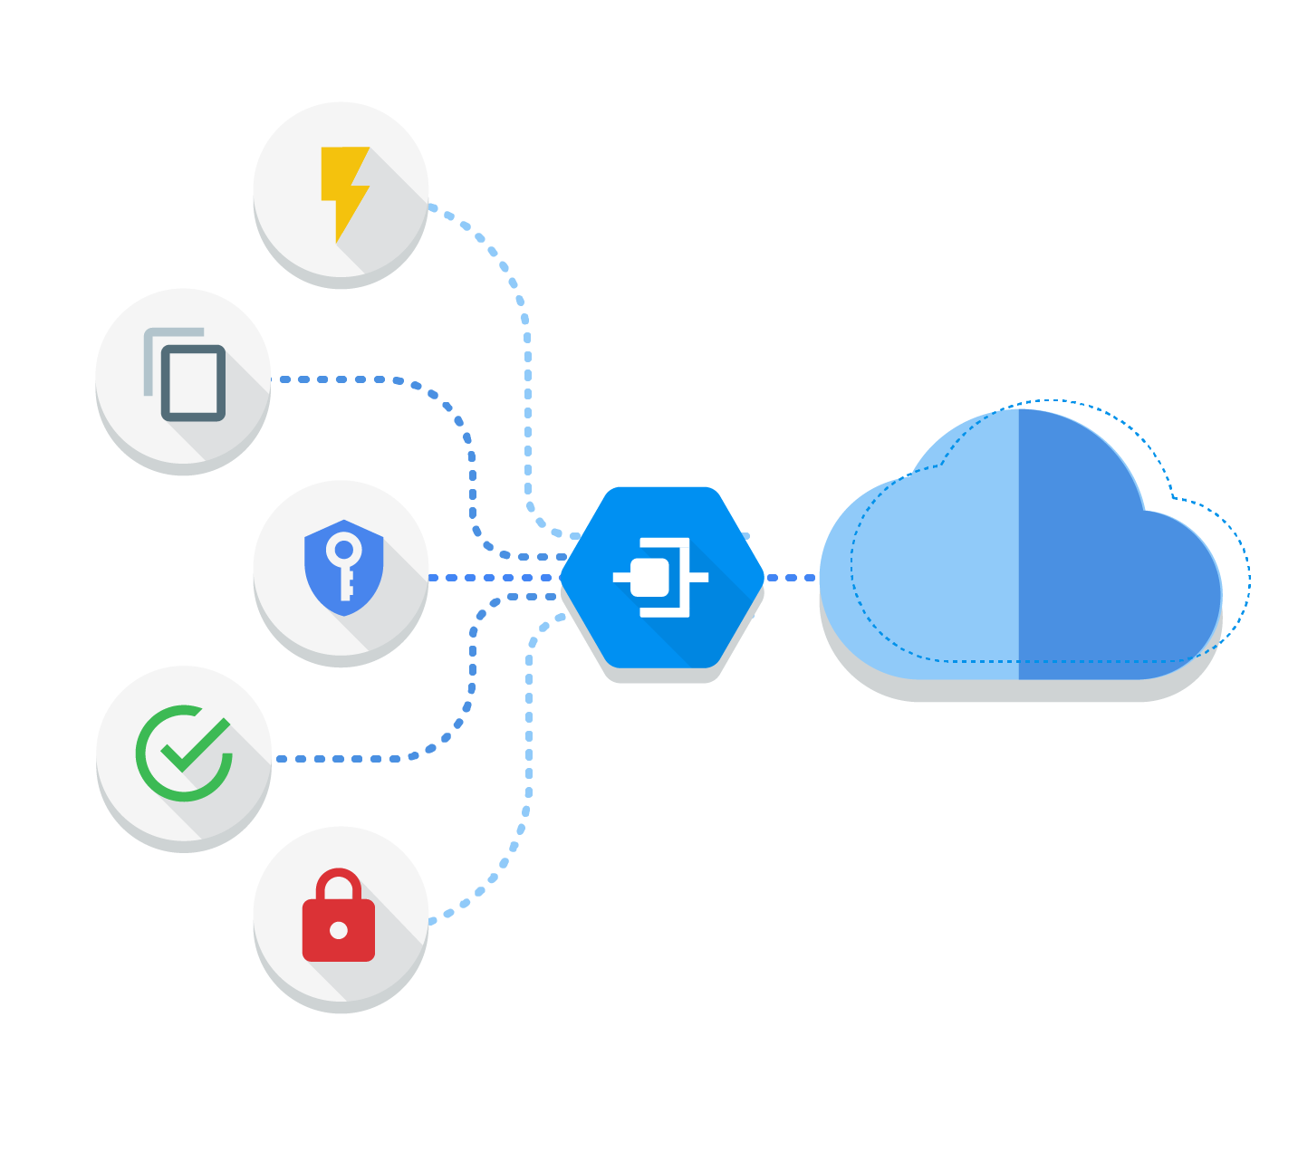
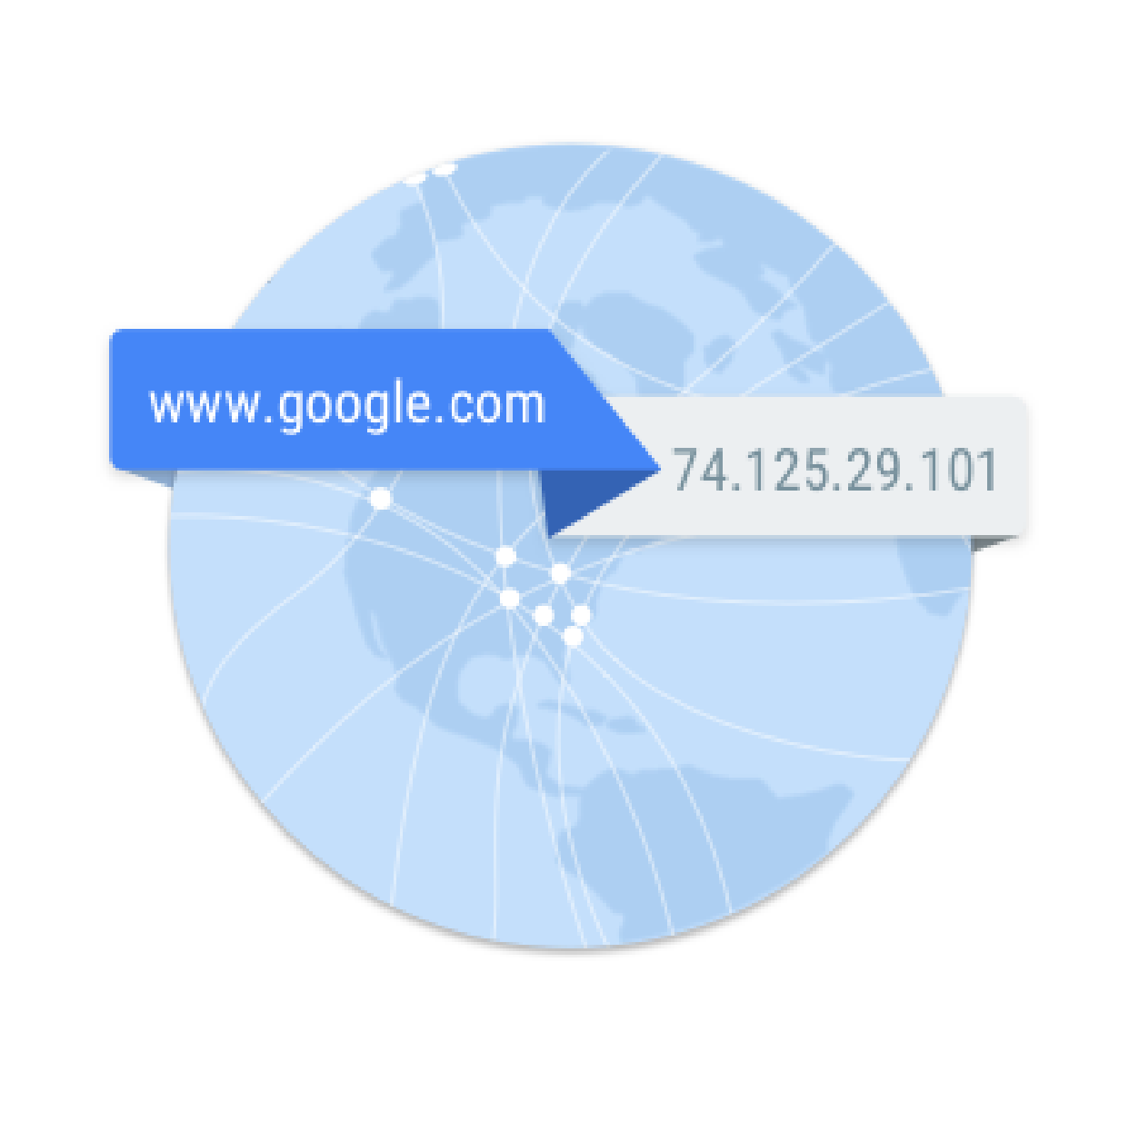
The primary products included in Google networking
Virtual Private Cloud
Cloud Load Balancer
Cloud CDN
Cloud Interconnect
Cloud DNS
Manage networking for resources
Worldwide autoscaling and load balancing
Content delivery network
Fast, high availability interconnect
Highly available global DNS network
Copyright Google LLC. For educational purposes in accordance with the terms of use set forth on the program Website.
Notes:
Virtual Private Cloud is a comprehensive set of networking capabilities and infrastructure that’s managed by Google. With Virtual Private Cloud, you can connect your Google Cloud resources in a virtual private cloud and isolate them from each other for purposes of security, compliance, and development versus test versus production.
Cloud Load Balancing provides high performance, scalable load balancing for Google Cloud to ensure consistent performance for users.
A content delivery network serves content to end users with high availability and high performance, usually by storing files close to the user. With Cloud CDN, Google’s global network provides low-latency, low-cost content delivery.
Cloud Interconnect lets you connect your own infrastructure to Google’s network edge with enterprise-grade connections. Connections are offered by Google’s partner network-service providers, and may offer higher service levels than standard internet connections.
Cloud DNS (Domain Name System) translates requests for domain names into IP addresses. Google provides the infrastructure to publish specific domain names in high-volume DNS services suitable for production applications.

Slide 133
Finland
Netherlands
London
Warsaw
Montréal
Belgium
Frankfurt
Toronto
Paris
Oregon
Iowa*
Zurich
Milan
Salt Lake City
N. Virginia
Madrid
Las Vegas
Seoul
Tokyo
Los Angeles
S. Carolina
Osaka
Doha
Delhi
Taiwan
Mumbai
Hong Kong
Singapore
Jakarta
São Paulo
Santiago
Sydney
Melbourne
Google Cloud Regions and Zones
Current region with 3 zones
Future region with 3 zones
* Exception: region has 4 zones.
Copyright Google LLC. For educational purposes in accordance with the terms of use set forth on the program Website.
Notes:
This map represents Google Cloud at a high level. Google Cloud consists of regions, represented by the markers in blue, together with proposed future regions in white. A region is a specific geographical location where you can run your resources. The number on each region represents the zones within that region.
https://cloud.google.com/about/locations/

Slide 134
Finland
Netherlands
London
Warsaw
Montréal
Belgium
Frankfurt
Toronto
Paris
Oregon
Iowa*
Zurich
Milan
Salt Lake City
N. Virginia
Madrid
Las Vegas
Seoul
Tokyo
Los Angeles
S. Carolina
Osaka
Doha
Delhi
Taiwan
Mumbai
Hong Kong
Singapore
Jakarta
São Paulo
Santiago
Sydney
Melbourne
Google Cloud Regions and PoPs
Current region with 3 zones
Future region with 3 zones
Edge point of presence
* Exception: region has 4 zones.
Copyright Google LLC. For educational purposes in accordance with the terms of use set forth on the program Website.
Notes:
Points of presence, or PoPs, are represented by the blue dots. The PoPs are where the Google network is connected to the rest of the internet.
By operating an extensive global network of interconnection points, Google Cloud can bring its traffic closer to its peers, thereby reducing costs and providing users with a better experience.
https://cloud.google.com/about/locations/

Slide 135
Finland
Netherlands
London
Warsaw
Montréal
Belgium
Frankfurt
Toronto
Paris
Oregon
Iowa*
Zurich
Milan
Salt Lake City
N. Virginia
Madrid
Las Vegas
Seoul
Tokyo
Los Angeles
S. Carolina
Osaka
Doha
Delhi
Taiwan
Mumbai
Hong Kong
Singapore
Jakarta
São Paulo
Santiago
Sydney
Melbourne
Google Cloud Regions, PoPs, and network
Current region with 3 zones
Future region with 3 zones
Edge point of presence
Network
* Exception: region has 4 zones.
Copyright Google LLC. For educational purposes in accordance with the terms of use set forth on the program Website.
Notes:
Google’s global private network is represented by the blue lines. The network connects regions and PoPs and is composed of hundreds of thousands of miles of fiber optic cable and several submarine cable investments. The cables that have a year next to it, are our latest investments.
The last component that makes up the architecture is Google’s services themselves.
https://cloud.google.com/about/locations/

Slide 136
Agenda
Introduction to Networking in the Cloud
Defining a Virtual Private Cloud
Public and Private IP Address Basics
Google’s Network Architecture
Routes and Firewall Rules in the Cloud
Copyright Google LLC. For educational purposes in accordance with the terms of use set forth on the program Website.
Notes:
In this topic, we’ll consider routes and how firewall rules allows traffic to flow within a VPC.

Slide 137
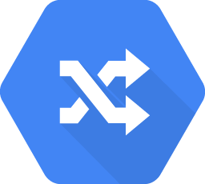
A route maps an IP range to a destination
Every network has routes that let instances in a network send traffic directly to each other.
Every network has a default route that directs packets to destinations that are outside the network.
Firewall rules must also allow the packet.
Copyright Google LLC. For educational purposes in accordance with the terms of use set forth on the program Website.
Notes:
By default, every network has routes that let instances in a network send traffic directly to each other, even across subnets. In addition, every network has a default route that directs packets to destinations that are outside the network.
Although these routes cover most normal routing needs, you can also create special routes that override these routes.
Just creating a route doesn’t ensure that packets will be received by the specified next hop. Firewall rules must also allow the packet.
The default network has pre-configured firewall rules that allow all instances in the network to talk with each other. Manually created networks don’t have such rules, so you must create them, as you will experience in the first lab.

Slide 138
Routes map traffic to destination networks
VM Routing Table
192.168.5.0/24
10.146.0.0/20
10.128.1.0/20
0.0.0.0/0
192.168.5.0/24
10.128.1.0/20
Internet
10.146.0.0/20
0.0.0.0/0
Copyright Google LLC. For educational purposes in accordance with the terms of use set forth on the program Website.
Notes:
Routes match packets by destination IP address. However, no traffic will flow without also matching a firewall rule.
A route is created when a network is created, enabling traffic delivery from “anywhere.” Also, a route is created when a subnet is created. This is what enables VMs on the same network to communicate. This diagram shows a simplified routing table, you will now look at this in more detail.

Slide 139
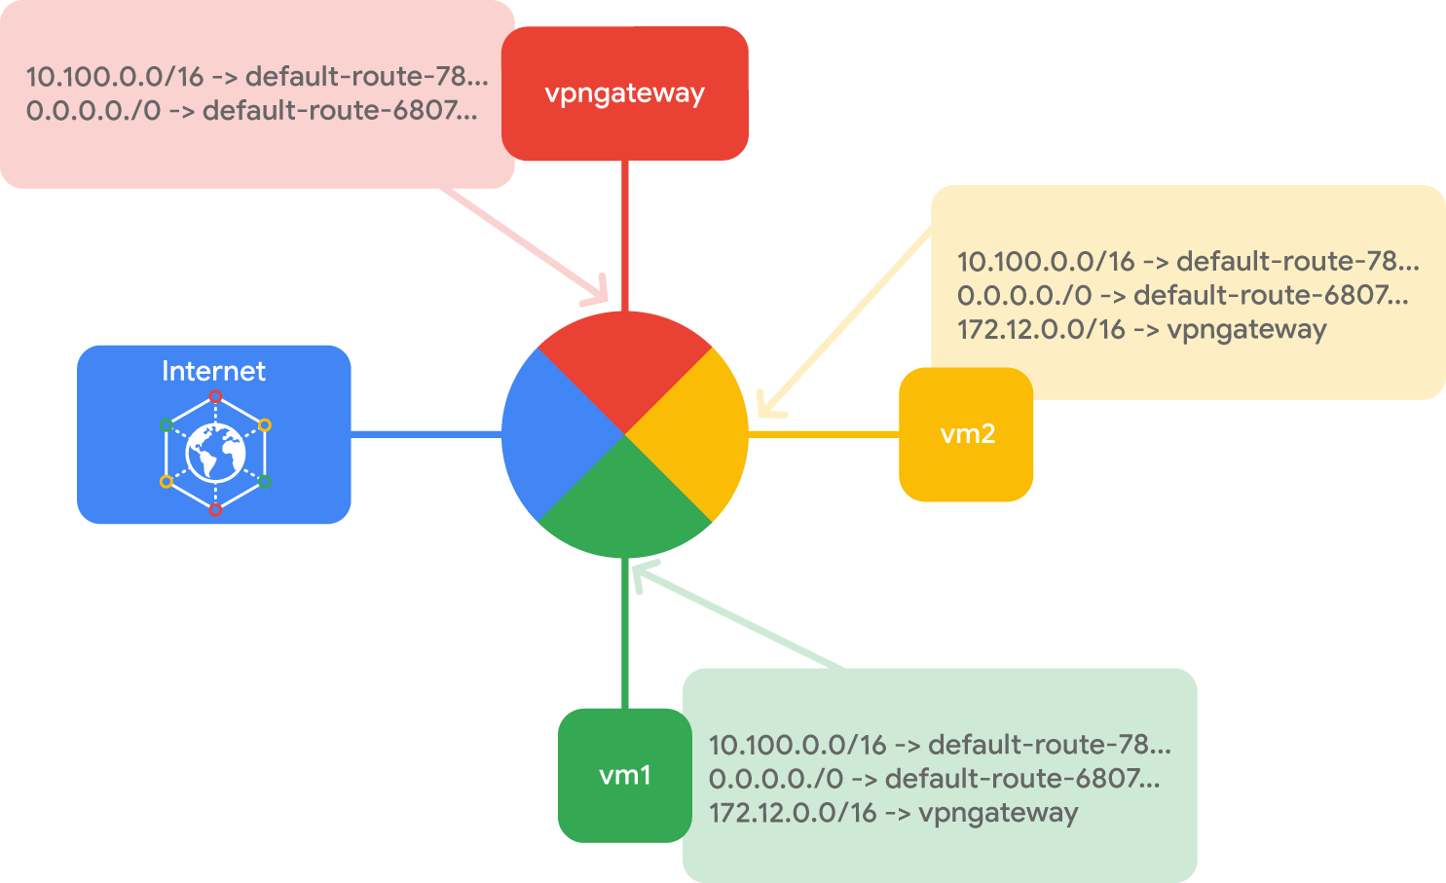
Instance routing tables
10.100.0.0/16 -> default-route-78…
0.0.0.0./0 -> default-route-6807...
vpngateway
Internet
vm2
10.100.0.0/16 -> default-route-78…
0.0.0.0./0 -> default-route-6807…
172.12.0.0/16 -> vpngateway
vm1
10.100.0.0/16 -> default-route-78…
0.0.0.0./0 -> default-route-6807…
172.12.0.0/16 -> vpngateway
Copyright Google LLC. For educational purposes in accordance with the terms of use set forth on the program Website.
Notes:
Each route in the Routes collection may apply to one or more instances. A route applies to an instance if the network and instance tags match. If the network matches and there are no instance tags specified, the route applies to all instances in that network. Compute Engine then uses the Routes collection to create individual read-only routing tables for each instance.
This diagram shows a massively scalable virtual router at the core of each network. Every virtual machine instance in the network is directly connected to this router, and all packets leaving a virtual machine instance are first handled at this layer before they are forwarded to their next hop. The virtual network router selects the next hop for a packet by consulting the routing table for that instance.

Slide 140
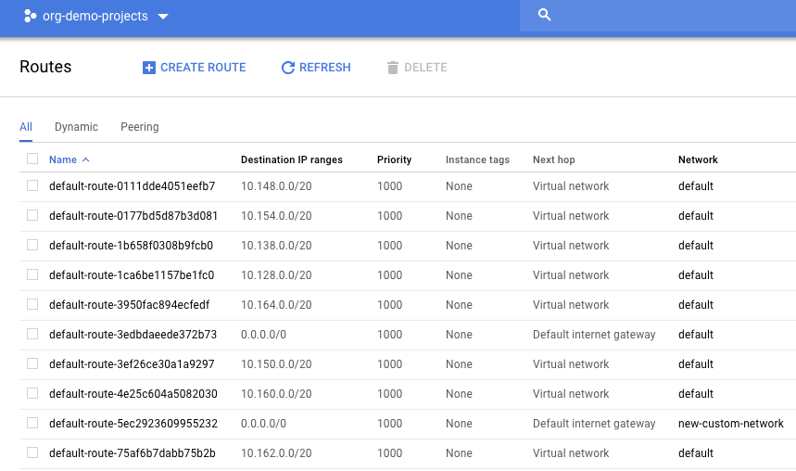
Routes define the paths network traffic takes from a VM instance to other destinations
Copyright Google LLC. For educational purposes in accordance with the terms of use set forth on the program Website.
Notes:
Every route consists of a destination and a next hop. Traffic whose destination IP is within the destination range is sent to the next hop for delivery.

Slide 141
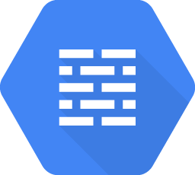
Firewalls protect virtual machine instances from unapproved connections
VPC network functions as a distributed firewall.
Firewall rules are applied to the network as a whole.
Connections are allowed or denied at the instance level.
Firewall rules are stateful.
Implied deny all ingress and allow all egress.
Copyright Google LLC. For educational purposes in accordance with the terms of use set forth on the program Website.
Notes:
Google Cloud firewall rules protect virtual machine instances from unapproved connections, both inbound and outbound, known as ingress and egress, respectively. Essentially, every VPC network functions as a distributed firewall.
Although firewall rules are applied to the network as a whole, connections are allowed or denied at the instance level. You can think of the firewall as existing not only between your instances and other networks, but between individual instances within the same network.
Google Cloud firewall rules are stateful. This means that if a connection is allowed between a source and a target or a target and a destination, all subsequent traffic in either direction will be allowed. In other words, firewall rules allow bidirectional communication once a session is established.
Also, if for some reason, all firewall rules in a network are deleted, there is still an implied "Deny all" ingress rule and an implied "Allow all" egress rule for the network.

Slide 142


Express your desired firewall configuration as a set of firewall rules
Direction of the rule
Source or destination of the connection
Protocol and port of the connection
Action of the rule
Priority of the rule
Rule assignment
Copyright Google LLC. For educational purposes in accordance with the terms of use set forth on the program Website.
Notes:
Conceptually, a firewall rule is composed of certain parameters.
The direction of the rule. Inbound connections are matched against ingress rules only, and outbound connections are matched against egress rules only.
For the ingress direction, sources can be specified as part of the rule with IP addresses, source tags, or a source service account. For the egress direction, destinations can be specified as part of the rule with one or more ranges of IP addresses.
The protocol and port of the connection, where any rule can be restricted to apply to specific protocols only or specific combinations of protocols and ports only.
The action of the rule, which is to allow or deny packets that match the direction, protocol, port, and source or destination of the rule.
The priority of the rule, which governs the order in which rules are evaluated. The first matching rule is applied.
The rule assignment. By default, all rules are assigned to all instances, but you can assign certain rules to certain instances only.
Let’s look at some Google Cloud firewall use cases for both egress and ingress.

Slide 143
Agenda (2/3)
Multiple VPC Networks
Building Hybrid Clouds using VPNs, Interconnecting, and Direct Peering
Different Options for Load Balancing
Copyright Google LLC. For educational purposes in accordance with the terms of use set forth on the program Website.
Notes:
The next topic will explore how multiple VPC networks can be used, which is supported by two labs. In the first, we’ll create VPC networks and VM instances, and in the other, we’ll create a web server and explore IAM roles and service accounts. We’ll then learn how to build hybrid clouds using VPNs, Interconnecting and direct peering.

Slide 144



Connect resources from multiple projects to a common VPC network
Cloud VPC Network
On-Premises
Recommendation Service
Data Warehouse
Web Application Server
Personalization Service
Processed Changes
Data Warehouse
Clients
Analytics Service
Data Warehouse
Connectivity
Google Cloud Project
Copyright Google LLC. For educational purposes in accordance with the terms of use set forth on the program Website.
Notes:
Shared VPC allows an organization to connect resources from multiple projects to a common VPC network. This allows the resources to communicate with each other securely and efficiently using internal IPs from that network.
In this diagram, there’s one network that belongs to the Web Application Server’s project. This network is shared with three other projects, namely the Recommendation Service, the Personalization Service, and the Analytics Service. Each of those service projects has instances that are in the same network as the Web Application Server, allowing for private communication to that server, using internal IP addresses. The Web Application Server communicates with clients and on-premises using the server’s external IP address. The backend services, on the other hand, cannot be reached externally because they only communicate using internal IP addresses.
When you use shared VPC, you designate a project as a host project and attach one or more other service projects to it. In this case, the Web Application Server’s project is the host project, and the three other projects are the service projects. The overall VPC network is called the shared VPC network.

Slide 145

VPC Network Peering allows private RFC 1918 connectivity across two VPC networks
Organization node example.com
Organization node SaaS.com
VPC Consumer Network
VPC Producer Network
Consumer Network Admin
Consumer Instance Admin
Producer Instance Admin
Producer Network Admin
Private IP
Project customer-prod
Project service-prod
Client
Compute Engine
Serving Instance
Compute Engine
Copyright Google LLC. For educational purposes in accordance with the terms of use set forth on the program Website.
Notes:
VPC Network Peering allows private RFC 1918 connectivity across two VPC networks, regardless of whether they belong to the same project or the same organization. Now, remember that each VPC network will have firewall rules that define what traffic is allowed or denied between the networks.
In this diagram, there are two organizations that represent a consumer and a producer respectively. Each organization has its own organization node, VPC network, VM instances, Network Admin and Instance Admin. In order for VPC Network Peering to be established successfully, the Producer Network Admin needs to peer the Producer Network with the Consumer Network, and the Consumer Network Admin needs to peer the Consumer Network with the Producer Network. When both peering connections are created, the VPC Network Peering session becomes Active and routes are exchanged This allows the VM instances to communicate privately, using their internal IP addresses.
VPC Network Peering is a decentralized or distributed approach to multi-project networking, because each VPC network may remain under the control of separate administrator groups and maintain its own global firewall and routing tables. Historically, such projects would consider external IP addresses or VPNs to facilitate private communication between VPC networks. However, VPC Network Peering does not incur the network latency, security, and cost drawbacks that are present when using external IP addresses or VPNs.

Slide 146

Considerations for VPC Network Peering
Works with Compute Engine, Google Kubernetes Engine, and App Engine flexible environments.
Peered VPC networks remain administratively separate.
Each side of a peering association is set up independently.
No subnet IP range overlap across peered VPC networks.
Copyright Google LLC. For educational purposes in accordance with the terms of use set forth on the program Website.
Notes:
There are some things to remember when using VPC Network Peering.
VPC Network Peering works with Compute Engine, Google Kubernetes Engine, and App Engine flexible environments.
Peered VPC networks remain administratively separate, which means that routes, firewalls, VPNs, and other traffic management tools are administered and applied separately in each of the VPC networks.
Each side of a peering association is set up independently, so peering will be active only when the configuration from both sides matches. This allows either side to delete the peering association at any time.
A subnet CIDR prefix in one peered VPC network cannot overlap with a subnet CIDR prefix in another peered network. This means that two auto mode VPC networks that only have the default subnets cannot peer.

Slide 147
Only directly peered networks can communicate
N1
VPC Peering
Compute Engine
Compute Engine
N2
Compute Engine
VPC Peering
Compute Engine
N3
Compute Engine
Compute Engine
No transitive Peering
Copyright Google LLC. For educational purposes in accordance with the terms of use set forth on the program Website.
Notes:
There’s one more thing to remember when using VPC Network Peering. Only directly peered networks can communicate, meaning that transitive peering is not supported. In other words, if VPC network N1 is peered with N2 and N3, but N2 and N3 are not directly connected, VPC network N2 cannot communicate with VPC network N3 over the peering. This is critical if N1 is a SaaS organization offering services to N2 and N3.

Slide 148
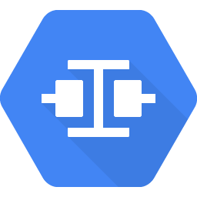
Cloud Interconnect offers two options to extend an on-premises network to a Google Cloud VPC network
Cloud Interconnect - Dedicated
Cloud Interconnect - Partner
Copyright Google LLC. For educational purposes in accordance with the terms of use set forth on the program Website.
Notes:
Cloud Interconnect provides two options for extending an on-premises network to a Google Cloud VPC network. Cloud Interconnect - Dedicated, also referred to as Dedicated Interconnect, and Cloud Interconnect - Partner, also referred to as Partner Interconnect. Choosing an interconnect type will depend on connection requirements, such as the connection location and capacity.

Slide 149
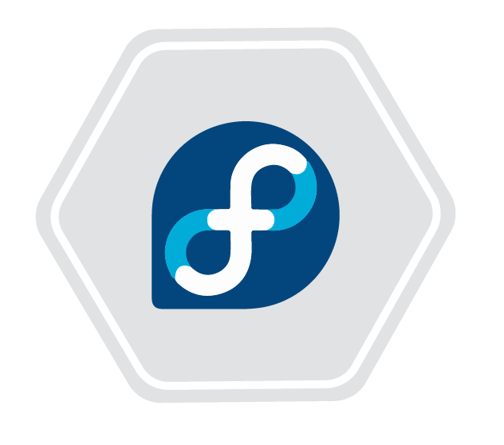




Dedicated Interconnect
Cloud Network
Customer Network
Co-location Facility
Headquarters
Compute Engine
Google Peering Edge
Customer Peering Router
VM Instances
External Data Center
One Network
Copyright Google LLC. For educational purposes in accordance with the terms of use set forth on the program Website.
Notes:
Dedicated Interconnect provides direct physical connectivity between an organization’s on-premise network and the Google Cloud network edge, allowing them to transfer large amounts of data between networks, which can be more cost-effective than purchasing additional bandwidth over the public internet.

Slide 150
Partner Interconnect
Cloud Network
Customer Network
Co-location Facility
Headquarters
Compute Engine
Google Peering Edge
Service Provider Peering
Customer Peering Router
VM Instances
External Data Center
One Network
Copyright Google LLC. For educational purposes in accordance with the terms of use set forth on the program Website.
Notes:
If 10 Gbps or 100 Gbps connections aren’t required, Partner Interconnect provides a variety of capacity options. Also, if an organization can't physically meet Google's network requirements in a colocation facility, they can use Partner Interconnect to connect to a variety of service providers to reach their VPC networks.
Partner Interconnect provides a service provider-enabled connectivity between an on-premise network and the Google Cloud network edge, allowing an organization to extend their private network into their cloud network. The service provider can provide solutions that minimize router requirements on the organization premises to only supporting an ethernet interface to the cloud.

Slide 151



Dedicated Interconnect provides direct physical connections
Colocation Facility
my-network (my-project1)
Colocation Facility
Subnet:
192.168.0.0/24
us-central1 10.128.0.0/20
Zone 1
Compute
Cloud Router
On-premises router
User
Google Peering Edge
10.128.0.2
Link-local address:
169.254.10.1
Link-local address:
169.254.10.2
196.168.0.11
My-interconnect (my-project1)
Copyright Google LLC. For educational purposes in accordance with the terms of use set forth on the program Website.
Notes:
Optional content available for use if required
In order to use Dedicated Interconnect, you need to provision a cross connect between the Google network and your own router in a common colocation facility, as shown in this diagram. To exchange routes between the networks, you configure a BGP session over the interconnect between the Cloud Router and the on-premises router. This will allow user traffic from the on-premises network to reach Google Cloud resources on the VPC network, and vice versa.

Slide 152

Partner Interconnect provides connectivity through a supported service provider
Service provide network
On-premises network
VPC network
Google Cloud region
On-premises subnet
VPC subnet
Co-location facility
Cloud Router
Cloud peering edge
Service provider peering edge
On-premises router
BGP
Copyright Google LLC. For educational purposes in accordance with the terms of use set forth on the program Website.
Notes:
Optional content available for use if required
If you can't meet the specific requirements to configure dedicated interconnect for your hybrid cloud, you can leverage one of Google’s partners to set up partner interconnect. In this example, the partner network provider will manage the circuit between the customer and Google. Partner interconnect can use links from 50mbps to 10 gbps. Two dedicated links is required for a 99.9 SLA. 4 lines are required for a 99.99 SLA.

Slide 153
A comparison of interconnect options
Connection | Provides | Capacity | Requirements | Access type
IPsec VPN tunnels | Encrypted tunnel to VPC networks through the public internet | 1.5 - 3.0 Gbps per tunnel | On-premises VPN gateway | Internal IP addresses
Dedicated Interconnect | Dedicated, direct connection to VPC networks | 8 x 10 Gbps circuits, or 2 x 100 Gbps circuits per connection | Connection in a colocation facility | Internal IP addresses
Partner Interconnect | Dedicated bandwidth, connection to VPC network through a service provider | 50 Mbps – 10 Gbps per connection | Service provider | Internal IP addresses
Copyright Google LLC. For educational purposes in accordance with the terms of use set forth on the program Website.
Notes:
Let’s compare the interconnect options just considered. All of these options provide internal IP address access between resources in an on-premises network and a VPC network. The main differences are the connection capacity and the requirements for using a service.
The IPsec VPN tunnels that Cloud VPN offers have a capacity of 1.5 to 3 Gbps per tunnel and require a VPN device on the on-premises network. The 1.5-Gbps capacity applies to traffic that traverses the public internet, and the 3-Gbps capacity applies to traffic that is traversing a direct peering link. Configuring multiple tunnels allows you to scale this capacity.
Dedicated Interconnect provides high-bandwidth connections with a minimum of 10 Gbps. Traffic flows directly between networks, not through the public Internet. Setup requires routing equipment in a Google-supported colocation facility that supports the regions that you want to connect to. Connection capacity is delivered over one or more 10 Gbps or 100 Gbps Ethernet circuits, with a maximum of 8 x 10 Gbps circuits (80 Gbps), or 2 x 100 Gbps (200 Gbps) circuits for each Dedicated Interconnect connection.
Partner Interconnect has a capacity of 50 Mbps to 10 Gbps per connection, and requirements depend on the service provider.
The recommendation is to start with VPN tunnels and, depending on the proximity to a colocation facility and capacity requirements, to switch to Dedicated Interconnect or Partner Interconnect when there’s a need for enterprise-grade connections to Google Cloud.

Slide 154

Direct Peering provides a direct connection between a business network and Google’s
Leverage Google’s broad-reaching edge network locations.
Exchange BGP routes between Google and the peering entity.
Reach all of Google’s services.
No SLA applies.
Peering requirements must be satisfied.
Copyright Google LLC. For educational purposes in accordance with the terms of use set forth on the program Website.
Notes:
Google allows an organization to establish a direct peering connection between their business network and Google’s. With this connection, they’ll be able to exchange internet traffic between their network and Google’s at one of Google’s broad-reaching edge network locations.
Direct peering with Google is done by exchanging BGP routes between Google and the peering entity. After a direct peering connection is in place, they can use it to reach all of Google’s services, including the full suite of Google Cloud products. Unlike Dedicated Interconnect, Direct Peering doesn’t have an SLA.
In order to use Direct Peering, they need to satisfy the peering requirements.
-------------------------
Source for peering requirements: https://peering.google.com/#/options/peering

Slide 155
Module 10: Automatic Scaling and Monitoring
AWS Academy Cloud Foundations
© 2019, Amazon Web Services, Inc. or its Affiliates. All rights reserved.
Notes:
Welcome to Module 10: Automatic Scaling and Monitoring

Slide 156
Section 1: Elastic Load Balancing
Module 10: Automatic Scaling and Monitoring
Notes:
Section 1: Elastic Load Balancing

Slide 157





Elastic Load Balancing
Distributes incoming application or network traffic across multiple targets in a single Availability Zone or across multiple Availability Zones.
Scales your load balancer as traffic to your application changes over time.
Elastic Load
Balancing
IP addresses
Containers
Lambda functions
EC2 instances
Notes:
Modern high-traffic websites must serve hundreds of thousands—if not millions—of concurrent requests from users or clients, and then return the correct text, images, video, or application data in a fast and reliable manner. Additional servers are generally required to meet these high volumes.
Elastic Load Balancing is an AWS service that distributes incoming application or network traffic across multiple targets—such as Amazon Elastic Compute Cloud (Amazon EC2) instances, containers, internet protocol (IP) addresses, and Lambda functions—in a single Availability Zone or across multiple Availability Zones. Elastic Load Balancing scales your load balancer as traffic to your application changes over time. It can automatically scale to most workloads.

Slide 158

Types of load balancers
Notes:
Elastic Load Balancing is available in three types:
An Application Load Balancer operates at the application level (Open Systems Interconnection, or OSI, model layer 7). It routes traffic to targets—Amazon Elastic Compute Cloud (Amazon EC2) instances, containers, Internet Protocol (IP) addresses, and Lambda functions—based on the content of the request. It is ideal for advanced load balancing of Hypertext Transfer Protocol (HTTP) and Secure HTTP (HTTPS) traffic. An Application Load Balancer provides advanced request routing that is targeted at delivery of modern application architectures, including microservices and container-based applications. An Application Load Balancer simplifies and improves the security of your application by ensuring that the latest Secure Sockets Layer/Transport Layer Security (SSL/TLS) ciphers and protocols are used at all times.
A Network Load Balancer operates at the network transport level (OSI model layer 4), routing connections to targets—EC2 instances, microservices, and containers—based on IP protocol data. It works well for load balancing both Transmission Control Protocol (TCP) and User Datagram Protocol (UDP) traffic. A Network Load Balancer is capable of handling millions of requests per second while maintaining ultra-low latencies. A Network Load Balancer is optimized to handle sudden and volatile network traffic patterns.
A Classic Load Balancer provides basic load balancing across multiple EC2 instances, and it operates at both the application level and network transport level. A Classic Load Balancer supports the load balancing of applications that use HTTP, HTTPS, TCP, and SSL. The Classic Load Balancer is an older implementation. When possible, AWS recommends that you use a dedicated Application Load Balancer or Network Load Balancer.
To learn more about the differences between the three types of load balancers, see Product comparisons on the Elastic Load Balancing Features page.

Slide 159

How Elastic Load Balancing works
With Application Load Balancers and Network Load Balancers, you register targets in target groups, and route traffic to the target groups.
With Classic Load Balancers, you register instances with the load balancer.
AWS Cloud
Load balancer accepts incoming traffic from clients.
Availability Zone A
Availability Zone B
Listener
Listener checks for connection requests.
Listener
Load balancer routes traffic only to healthy targets.
Load balancer performs health checks to monitor health of registered targets.
.
.
.
.
X
Target
Target
Target
Target
Target
Notes:
A load balancer accepts incoming traffic from clients and routes requests to its registered targets (such as EC2 instances) in one or more Availability Zones.
You configure your load balancer to accept incoming traffic by specifying one or more listeners. A listener is a process that checks for connection requests. It is configured with a protocol and port number for connections from clients to the load balancer. Similarly, it is configured with a protocol and port number for connections from the load balancer to the targets.
You can also configure your load balancer to perform health checks, which are used to monitor the health of the registered targets so that the load balancer only sends requests to the healthy instances. When the load balancer detects an unhealthy target, it stops routing traffic to that target. It then resumes routing traffic to that target when it detects that the target is healthy again.
There is a key difference in how the load balancer types are configured. With Application Load Balancers and Network Load Balancers, you register targets in target groups, and route traffic to the target groups. With Classic Load Balancers, you register instances with the load balancer.

Slide 160
Load balancer: Listeners
Load balancer
A Listener is a process that defines the port and protocol that the load balancer listens on
Each load balancer needs at least one listener to accept traffic
Up to 50 listeners can be on a load balancer
Routing rules are defined on listeners
Listener
Rule
Target
Target
Target Group (example.com)
Health check
Notes:
Before you start using your Application Load Balancer, you must add one or more listeners.
A listener is a process that checks for a connection request from a client to an instance by using the protocol and port that you specify.
The listener rules that you define also determine how traffic from connecting clients are routed by the load balancer to one or more targets or target groups.

Slide 161
Load balancer: Target groups
Load balancer
A target group is a group of registered targets that provide support to
EC2 instances
ECS container instances
A single target can have multiple target group registrations
You can also configure health checks on a per target group basis. When you specify a target group in a listener rule for your load balancer, health checks are performed on all the targets that are registered to the target group.
Listener
Rule
Target
Target
Target Group (example.com)
Health check

Slide 162
Application Load Balancer components
Load Balancer
Listener
Listener
Rule
Rule
Rule
Rule
Target
Target
Target
Target
Target
Target
Target
Target group (example.com)
Health check
Target group (example.com/blog)
Health check
Target group (example.com/mobile)
Health check
Notes:
Here is an example Application Load Balancer for the example.com website. As you can see, the load balancer serves as the single point of contact for all clients. It distributes incoming application traffic across multiple targets.
An Application Load Balancer can have more than one listener. In this example, there are two listeners.
Each listener checks for connection requests from clients, using the protocol and port that you configure.
The listener forwards requests to one or more target groups, based on the defined rules.
Each rule specifies a target group, condition, and priority.
When the condition is met, the traffic is forwarded to the target group.
You must define a default rule for each listener, and you can add rules that specify different target groups based on the content of the request.
This configuration is also known as content-based routing.
Each target group routes requests to one or more registered targets, such as EC2 instances, using the protocol and port number that you specify.
You can register a target with multiple target groups.
You can configure health checks on a per target group basis.
Health check are performed on all targets that are registered to a target group when the target group is specified in a listener rule for your load balancer.
Notice that each listener contains a default rule, and one listener contains another rule that routes requests to a different target group. As implied in the graphic, you have the option to register a target with multiple target groups.

Slide 163

ELB load balancer: Features
High availability (HA)
Health checks
Security features
Transport Layer Security (TLS) termination
Layer 4 or layer 7 load balancing
Operational monitoring
ELB load balancers automatically distribute traffic across multiple targets.
Elastic Load Balancing (ELB)
Notes:
A load balancer distributes workloads across multiple compute resources, such as virtual servers. Elastic load balancers can be configured in the Amazon EC2 service area in the AWS Management Console, or by invoking the AWS Command Line Interface (AWS CLI) or software development kits (SDKs).
Key features of ELB load balancers include:
High availability (HA)—ELB load balancers can distribute traffic across multiple targets—including EC2 instances, containers, and IP addresses—either in a single Availability Zone or multiple Availability Zones.
Health checks—ELB load balancers can be configured to detect unhealthy targets, stop sending traffic to them, and then spread the load across the remaining healthy targets.
Security—You can create and manage security groups that are associated with load balancers. You can also create an internal (non-internet-facing) load balancer.
Transport Layer Security (TLS) termination—The load balancers include integrated certificate management and Secure Sockets Layer (SSL) decryption, which allow you to centrally manage the SSL settings of the load balancer and offload CPU-intensive work from your applications.
Layer 4 or layer 7 load balancing:
You can load balance HTTP/HTTPS applications for features that are specific to layer 7. Layer 7 is the application layer in the Open Systems Interconnection (OSI) model.
You can also choose to use strict layer 4 load balancing for applications that rely purely on TCP. Layer 4 is the transport layer in the OSI model.
Operational Monitoring—The ELB load balancers provide integration with Amazon CloudWatch metrics and request tracing, which allow you to monitor application performance in real time.

Slide 164


Elastic Load Balancing use cases
Highly available and fault-tolerant applications
Containerized applications
Elasticity and scalability
Virtual private cloud (VPC)
Hybrid environments
Invoke Lambda functions over HTTP(S)
Notes:
There are many reasons to use a load balancer:
Achieve high availability and better fault tolerance for your applications – Elastic Load Balancing balances traffic across healthy targets in multiple Availability Zones. If one or more of your targets in a single Availability Zone are unhealthy, Elastic Load Balancing will route traffic to healthy targets in other Availability Zones. After the targets return to a healthy state, load balancing will automatically resume traffic to them.
Automatically load balance your containerized applications – With enhanced container support for Elastic Load Balancing, you can now load balance across multiple ports on the same EC2 instance. You can also take advantage of deep integration with Amazon Elastic Container Service (Amazon ECS), which provides a fully-managed container offering. You only need to register a service with a load balancer, and Amazon ECS transparently manages the registration and de-registration of Docker containers. The load balancer automatically detects the port and dynamically reconfigures itself.
Automatically scale your applications – Elastic Load Balancing works with Amazon CloudWatch and Amazon EC2 Auto Scaling to help you scale your applications to the demands of your customers. Amazon CloudWatch alarms can trigger auto scaling for your EC2 instance fleet when the latency of any one of your EC2 instances exceeds a preconfigured threshold. Amazon EC2 Auto Scaling then provisions new instances and your applications will be ready to serve the next customer request. The load balancer will register the EC2 instance and direct traffic to it as needed.
Use Elastic Load Balancing in your virtual private cloud (VPC) – You can use Elastic Load Balancing to create a public entry point into your VPC, or to route request traffic between tiers of your application within your VPC. You can assign security groups to your load balancer to control which ports are open to a list of allowed sources. Because Elastic Load Balancing works with your VPC, all your existing network access control lists (network ACLs) and routing tables continue to provide additional network controls. When you create a load balancer in your VPC, you can specify whether the load balancer is public (default) or internal. If you select internal, you do not need to have an internet gateway to reach the load balancer, and the private IP addresses of the load balancer will be used in the load balancer’s Domain Name System (DNS) record.
Enable hybrid load balancing – Elastic Load Balancing enables you to load balance across AWS and on-premises resources by using the same load balancer. For example, if you must distribute application traffic across both AWS and on-premises resources, you can register all the resources to the same target group and associate the target group with a load balancer. Alternatively, you can use DNS-based weighted load balancing across AWS and on-premises resources by using two load balancers, with one load balancer for AWS and other load balancer for on-premises resources. You can also use hybrid load balancing to benefit separate applications where one application is in a VPC and the other application is in an on-premises location. Put the VPC targets in one target group and the on-premises targets in another target group, and then use content-based routing to route traffic to each target group.
Invoking Lambda functions over HTTP(S) – Elastic Load Balancing supports invoking Lambda functions to serve HTTP(S) requests. This enables users to access serverless applications from any HTTP client, including web browsers. You can register Lambda functions as targets and use the support for content-based routing rules in Application Load Balancers to route requests to different Lambda functions. You can use an Application Load Balancer as a common HTTP endpoint for applications that use servers and serverless computing. You can build an entire website by using Lambda functions, or combine EC2 instances, containers, on-premises servers, and Lambda functions to build applications.

Slide 165

Load balancer monitoring
Amazon CloudWatch metrics – Used to verify that the system is performing as expected and creates an alarm to initiate an action if a metric goes outside an acceptable range.
Access logs – Capture detailed information about requests sent to your load balancer.
AWS CloudTrail logs – Capture the who, what, when, and where of API interactions in AWS services.
Notes:
You can use the following features to monitor your load balancers, analyze traffic patterns, and troubleshoot issues with your load balancers and targets:
Amazon CloudWatch metrics – Elastic Load Balancing publishes data points to Amazon CloudWatch for your load balancers and your targets. CloudWatch enables you to retrieve statistics about those data points as an ordered set of time series data, known as metrics. You can use metrics to verify that your system is performing as expected. For example, you can create a CloudWatch alarm to monitor a specified metric and initiate an action (such as sending a notification to an email address) if the metric goes outside what you consider an acceptable range.
Access logs – You can use access logs to capture detailed information about the requests that were made to your load balancer and store them as log files in Amazon Simple Storage Service (Amazon S3). You can use these access logs to analyze traffic patterns and to troubleshoot issues with your targets or backend applications.
AWS CloudTrail logs – You can use AWS CloudTrail to capture detailed information about the calls that were made to the Elastic Load Balancing application programming interface (API) and store them as log files in Amazon S3. You can use these CloudTrail logs to determine who made the call, what calls were made, when the call was made, the source IP address of where the call came from, and so on.

Slide 166
Section 1 key takeaways
Elastic Load Balancing distributes incoming application or network traffic across multiple targets in one or more Availability Zones.
Elastic Load Balancing supports three types of load balancers:
Application Load Balancer
Network Load Balancer
Classic Load Balancer
ELB offers instance health checks, security, and monitoring.
Notes:
Some key takeaways from this section of the module include:
Elastic Load Balancing distributes incoming application or network traffic across multiple targets (such as Amazon EC2 instances, containers, IP addresses, and Lambda functions) in one or more Availability Zones.
Elastic Load Balancing supports three types of load balancers:
Application Load Balancer
Network Load Balancer
Classic Load Balancer
Elastic Load Balancing offers several monitoring tools for continuous monitoring and logging for auditing and analytics.

Slide 167
Section 2: Amazon CloudWatch
Module 10: Automatic Scaling and Monitoring
Notes:
Section 2: Amazon CloudWatch

Slide 168
Monitoring AWS resources
To use AWS efficiently, you need insight into your AWS resources:
How do you know when you should launch more Amazon EC2 instances?
Is your application's performance or availability being affected by a lack of sufficient capacity?
How much of your infrastructure is actually being used?
Notes:
To use AWS efficiently, you need insight into your AWS resources.
For example, you might want to know:
When you should launch more Amazon EC2 instances?
If your application’s performance or availability is being affected by a lack of sufficient capacity?
How much of your infrastructure is actually being used?
How do you capture this information?

Slide 169



Amazon CloudWatch
Monitors –
AWS resources
Applications that run on AWS
Collects and tracks –
Standard metrics
Custom metrics
Alarms –
Send notifications to an Amazon SNS topic
Perform Amazon EC2 Auto Scaling or Amazon EC2 actions
Events –
Define rules to match changes in AWS environment and route these events to one or more target functions or streams for processing
Amazon
CloudWatch
Notes:
You can capture this information with Amazon CloudWatch.
Amazon CloudWatch is a monitoring and observability service that is built for DevOps engineers, developers, site reliability engineers (SRE), and IT managers. CloudWatch monitors your AWS resources (and the applications that you run on AWS) in real time. You can use CloudWatch to collect and track metrics, which are variables that you can measure for your resources and applications.
You can create an alarm to monitor any Amazon CloudWatch metric in your account and use the alarm to automatically send a notification to an Amazon Simple Notification Service (Amazon SNS) topic or perform an Amazon EC2 Auto Scaling or Amazon EC2 action. For example, you can create alarms on the CPU utilization of an EC2 instance, Elastic Load Balancing request latency, Amazon DynamoDB table throughput, Amazon Simple Queue Service (Amazon SQS) queue length, or even the charges on your AWS bill. You can also create an alarm on custom metrics that are specific to your custom applications or infrastructure.
You can also use Amazon CloudWatch Events to define rules that match incoming events (or changes in your AWS environment) and route them to targets for processing. Targets can include Amazon EC2 instances, AWS Lambda functions, Kinesis streams, Amazon ECS tasks, Step Functions state machines, Amazon SNS topics, Amazon SQS queues, and built-in targets. CloudWatch Events becomes aware of operational changes as they occur. CloudWatch Events responds to these operational changes and takes corrective action as necessary, by sending messages to respond to the environment, activating functions, making changes, and capturing state information.
With CloudWatch, you gain system-wide visibility into resource utilization, application performance, and operational health. There is no upfront commitment or minimum fee; you simply pay for what you use. You are charged at the end of the month for what you use.

Slide 170


CloudWatch alarms
Create alarms based on –
Static threshold
Anomaly detection
Metric math expression
Specify –
Namespace
Metric
Statistic
Period
Conditions
Additional configuration
Actions
Notes:
You can create a CloudWatch alarm that watches a single CloudWatch metric or the result of a math expression based on CloudWatch metrics. You can create a CloudWatch alarm based on a static threshold, anomaly detection, or a metric math expression.
When you create an alarm based on a static threshold, you choose a CloudWatch metric for the alarm to watch and the threshold for that metric. The alarm goes to ALARM state when the metric breaches the threshold for a specified number of evaluation periods.
For an alarm based on a static threshold, you must specify the:
Namespace – A namespace contains the CloudWatch metric that you want, for example, AWS/EC2.
Metric – A metric is the variable you want to measure, for example, CPU Utilization.
Statistic – A statistic can be an average, sum, minimum, maximum, sample count, a predefined percentile, or a custom percentile.
Period – A period is the evaluation period for the alarm. When the alarm is evaluated, each period is aggregated into one data point.
Conditions – When you specify the conditions for a static threshold, you specify whenever the metric is Greater, Greater or Equal, Lower or Equal, or Lower than the threshold value, and you also specify the threshold value.
Additional configuration information – This includes the number of data points within the evaluation period that must be breached to trigger the alarm, and how CloudWatch should treat missing data when it evaluates the alarm.
Actions – You can choose to send a notification to an Amazon SNS topic, or to perform an Amazon EC2 Auto Scaling action or Amazon EC2 action.
For more information on creating CloudWatch alarms, see the topics under Using Alarms in the AWS Documentation.

Slide 171
Section 2 key takeaways
Amazon CloudWatch helps you monitor your AWS resources—and the applications that you run on AWS—in real time.
CloudWatch enables you to –
Collect and track standard and custom metrics.
Set alarms to automatically send notifications to SNS topics or perform Amazon EC2 Auto Scaling or Amazon EC2 actions.
Define rules that match changes in your AWS environment and route these events to targets for processing.
Notes:
Some key takeaways from this section of the module include:
Amazon CloudWatch helps you monitor your AWS resources—and the applications that you run on AWS—in real time.
CloudWatch enables you to –
Collect and track standard and custom metrics.
Set alarms to automatically send notifications to SNS topics or perform Amazon EC2 Auto Scaling or Amazon EC2 actions based on the value of the metric or expression relative to a threshold over a number of time periods.
Define rules that match changes in your AWS environment and route these events to targets for processing.

Slide 172
Section 3: Amazon EC2 Auto Scaling
Module 10: Automatic Scaling and Monitoring
Notes:
Section 3: Amazon EC2 Auto Scaling
When you run your applications on AWS, you want to ensure that your architecture can scale to handle changes in demand. In this section, you will learn how to automatically scale your EC2 instances with Amazon EC2 Auto Scaling.

Slide 173

Amazon EC2 Auto Scaling
Amazon EC2 Auto Scaling:
Automatically launch or terminate Amazon EC2 instances based on:
Health status checks
User-defined policies that are driven by Amazon CloudWatch
Schedules
Other criteria (i.e., programmatically)
Manually using set-desired-capacity
Scale out to meet demand, scale in to reduce costs
Amazon EC2 Auto Scaling
Notes:
Amazon EC2 Auto Scaling helps you maintain application availability and allows you to automatically add or remove EC2 instances according to conditions you define. For example, you can configure EC2 Auto Scaling to terminate EC2 instances the fail health status checks, and launch new EC2 Instances to replace the terminated ones. You can create user-defined policies that use Amazon CloudWatch to trigger when to add or remove Amazon EC2 instances based on conditions such as average CPU utilization of your Amazon EC2 fleet.
If you have predictable load changes, you can set a schedule through Amazon EC2 Auto Scaling to plan your scaling activities. The features of Amazon EC2 Auto Scaling give you the ability to scale out in order to meet demand and to scale in to reduce costs.

Slide 174
EC2 Auto Scaling in action
Launch Configuration / Launch Template
Instance configuration to be launched. Specify: AMI Instance type Security group Instance key pair Storage IAM roles User data Only one active launch configuration at a time.
EC2 Auto Scaling Policy
Parameters for performing an Amazon EC2 Auto Scaling action. How to trigger policies? Amazon CloudWatch Instance failure (health check) Scheduled Manually Scale out or in, and by how much: ChangeInCapacity (+/-#) ExactCapacity(#) ChangeInPercent (+/-%) Cooldown period (simple scaling) Warmup period (step scaling)
EC2 Auto Scaling
EC2 Auto Scaling Group
Logical group of EC2 instances. Automatically scale between: Minimum Desired (optional) Maximum Integration with Elastic Load Balancing (optional). Health checks to maintain group size. Distribute and balance instances across Availability Zones.
Notes:
To configure EC2 Auto Scaling, you must first create a launch configuration, and then create an Auto Scaling group.
To create a launch configuration, you must specify AWS Identity and Access Management (IAM) roles, security groups, storage, instance type, user data, key pairs, etc. These requirements are similar to the requirements for launching an EC2 instance. However—unlike an EC2 instance—when you create a launch configuration, you do not specify an Amazon VPC or subnet where your instances will launch. This detail will be specified by the Auto Scaling group that uses your launch configuration.
Launch configurations do allow you to specify one networking option: whether or not to automatically assign a public IP address to each new instance that is created from the launch configuration. Note that it is not necessary to select this option if your instances will be launched in a private subnet behind a public ELB load balancer.
There are two basic ways to trigger changes to an EC2 Auto Scaling group.
Define a scaling policy that either scales out or scales in based on a CloudWatch alarm. You can define a CloudWatch alarm—for example, Average CPU Utilization > 50 percent for 2 minutes—that calls an EC2 Auto Scaling policy. The policy will specify one of two options. The first option is to add or remove a fixed number of instances. the second option is to adjust the number of running instances as a percentage of the desired capacity for the EC2 Auto Scaling group.
Define a scheduled action. Scheduled actions set a new desired capacity value at a specific time. You can specify a scheduled action to trigger on a specific date and time. You can also specify a recurring action that is run at specific times throughout a week, month, or year. Scheduled actions are an excellent way to prewarm capacity in response to anticipated traffic spikes.

Slide 175
Why is scaling important?
Unused
capacity
Over
capacity
Su M T W Th F Sa
Su M T W Th F Sa
Used capacity (demand)
Provisioned capacity
Notes:
Scaling is the ability to increase or decrease the compute capacity of your application. To understand why scaling is important, consider this example of a workload that has varying resource requirements. In this example, the most resource capacity is required on Wednesday, and the least resource capacity is required on Sunday.
One option is to allocate more than enough capacity so you can always meet your highest demand—in this case, Wednesday. However, this situation means that you are running resources that will be underutilized most days of the week. With this option, your costs are not optimized.
Another option is to allocate less capacity to reduce costs. This situation means that you are under capacity on certain days. If you don't solve your capacity problem, your application could underperform or potentially even become unavailable for users.

Slide 176
Amazon EC2 Auto Scaling
Helps you maintain application availability
Enables you to automatically add or remove EC2 instances according to conditions that you define
Detects impaired EC2 instances and unhealthy applications, and replaces the instances without your intervention
Provides several scaling options – Manual, scheduled, dynamic or on-demand, and predictive
Su M T W Th F Sa
Used capacity (demand)
Provisioned capacity
Notes:
In the cloud, because computing power is a programmatic resource, you can take a flexible approach to scaling. Amazon EC2 Auto Scaling is an AWS service that helps you maintain application availability and enables you to automatically add or remove EC2 instances according to conditions you define. You can use the fleet management features of EC2 Auto Scaling to maintain the health and availability of your fleet.
Amazon EC2 Auto Scaling provides several ways to adjust scaling to best meet the needs of your applications. You can add or remove EC2 instances manually, on a schedule, in response to changing demand, or in combination with AWS Auto Scaling for predictive scaling. Dynamic scaling and predictive scaling can be used together to scale faster.
To learn more about Amazon EC2 Auto Scaling, see the Amazon EC2 Auto Scaling product page.

Slide 177

Typical weekly traffic at Amazon.com
Provisioned capacity
Sunday
Monday
Tuesday
Wednesday
Thursday
Friday
Saturday
Notes:
Automatic scaling is useful for predictable workloads—for example, the weekly traffic at the retail company Amazon.com.

Slide 178


November traffic to Amazon.com
76 percent
Provisioned capacity
The challenge is to efficiently guess the unknown quantity of how much compute capacity you need.
24 percent
November
Notes:
Automatic scaling is also useful for dynamic on-demand scaling. Amazon.com experiences a seasonal peak in traffic in November (on Black Friday and Cyber Monday, which are days at the end of November when US retailers hold major sales). If Amazon provisions a fixed capacity to accommodate the highest use, 76 percent of the resources are idle for most of the year. Capacity scaling is necessary to support the fluctuating demands for service. Without scaling, the servers could crash due to saturation, and the business would lose customer confidence.

Slide 179

Auto Scaling groups
Auto Scaling group
An Auto Scaling group is a collection of EC2 instances that are treated as a logical grouping for the purposes of automatic scaling and management.
Minimum size
Launch or terminate instances as needed
Desired capacity
Maximum size
Notes:
An Auto Scaling group is a collection of Amazon EC2 instances that are treated as a logical grouping for the purposes of automatic scaling and management. The size of an Auto Scaling group depends on the number of instances you set as the desired capacity. You can adjust its size to meet demand, either manually or by using automatic scaling.
You can specify the minimum number of instances in each Auto Scaling group, and Amazon EC2 Auto Scaling is designed to prevent your group from going below this size. You can specify the maximum number of instances in each Auto Scaling group, and Amazon EC2 Auto Scaling is designed to prevent your group from going above this size. If you specify the desired capacity, either when you create the group or at any time afterwards, Amazon EC2 Auto Scaling is designed to adjust the size of your group so it has the specified number of instances. If you specify scaling policies, then Amazon EC2 Auto Scaling can launch or terminate instances as demand on your application increases or decreases.
For example, this Auto Scaling group has a minimum size of one instance, a desired capacity of two instances, and a maximum size of four instances. The scaling policies that you define adjust the number of instances within your minimum and maximum number of instances, based on the criteria that you specify.

Slide 180

Creating a steady-state group
Steady-state group:
You set an EC2 Auto Scaling group with the same min, max, and desired values
Instance is recreated automatically if it becomes unhealthy or if Availability Zone fails
Still potential downtime while instance recycles
Use case: Maintain a steady-state NAT server in each Availability Zone.
Auto Scaling group
Instance
Min = 1
Max = 1
Desired = 1
Notes:
EC2 Auto Scaling health checks enable you to create a steady-state group that ensures that a single instance is always running. This is useful for situations, such as when you have a network address translation (NAT) server, and you do not want it to be a single point of failure in a standard public/private subnet architecture.
To create a steady-state group for an instance:
Create a launch configuration that creates the instance.
Create an EC2 Auto Scaling group with a minimum, maximum, and desired size of 1. When one of these instances is marked as unhealthy, such as when an instance check fails or an external script marks the instance as unhealthy with a call to the AWS CLI aws autoscaling set-instance-health command.
The EC2 Auto Scaling group will terminate the existing instance and create a new instance from the group's launch configuration.
Note that in cases such as deploying a NAT instance, the NAT is still a single point of failure. You can still experience significant downtime while a failed NAT instance is recycling.

Slide 181
Scheduled scaling: Amazon EC2
Scaling that’s based on a schedule allows you to scale your application in response to predictable load changes.
Sun | Mon | Tues | Wed | Thurs | Fri | Sat
Example weekly traffic to an application
Sun | Mon | Tues | Wed | Thurs | Fri | Sat
Notes:
Scaling based on a schedule enables you to scale your application in response to predictable load changes. For example, you notice that every week, the traffic to your web application starts to increase on Wednesday, remains high on Thursday, and starts to decrease on Friday. In these situations, you can plan your scaling activities based on the predictable traffic patterns of your web application.
To configure an Auto Scaling group to scale based on a schedule:
Create a scheduled action, which tells Amazon EC2 Auto Scaling to perform a scaling action at specified times.
Specify the start time when the scaling action should take effect, and the new minimum, maximum, and desired sizes for the scaling action.
At the specified time, Amazon EC2 Auto Scaling updates the group with the values for minimum, maximum, and desired size that are specified by the scaling action.

Slide 182
Scaling out versus scaling in
Elastic Load Balancing
Auto Scaling group
Auto Scaling group
Auto Scaling group
Base configuration
Scale out (launch instances)
Scale in (terminate instances)
Notes:
With Amazon EC2 Auto Scaling, launching instances is referred to as scaling out, and terminating instances is referred to as scaling in.

Slide 183

How Amazon EC2 Auto Scaling works
What
Where
When
VPC
Maintain current number
Private subnet
Health checks
AMI
Auto Scaling group
Manual scaling
EC2 instance
Min, max, desired capacity
Scheduled scaling
Launch configuration
Auto Scaling group
Scheduled actions
AMI
Instance type
IAM role
Security groups
EBS volumes
VPC and subnets
Load balancer
Dynamic scaling
Scaling policies
Predictive scaling
AWS Auto Scaling
Notes:
To launch EC2 instances, an Auto Scaling group uses a launch configuration, which is an instance configuration template. You can think of a launch configuration as what you are scaling. When you create a launch configuration, you specify information for the instances. The information you specify includes the ID of the Amazon Machine Image (AMI), the instance type, AWS Identity and Access Management (IAM) role, additional storage, one or more security groups, and any Amazon Elastic Block Store (Amazon EBS) volumes.
You define the minimum and maximum number of instances and desired capacity of your Auto Scaling group. Then, you launch it into a subnet within a VPC (you can think of this as where you are scaling). Amazon EC2 Auto Scaling integrates with Elastic Load Balancing to enable you to attach one or more load balancers to an existing Auto Scaling group. After you attach the load balancer, it automatically registers the instances in the group and distributes incoming traffic across the instances.
Finally, you specify when you want the scaling event to occur. You have many scaling options:
Maintain current instance levels at all times – You can configure your Auto Scaling group to maintain a specified number of running instances at all times. To maintain the current instance levels, Amazon EC2 Auto Scaling performs a periodic health check on running instances in an Auto Scaling group. When Amazon EC2 Auto Scaling finds an unhealthy instance, it terminates that instance and launches a new one.
Manual scaling – With manual scaling, you specify only the change in the maximum, minimum, or desired capacity of your Auto Scaling group.
Scheduled scaling – With scheduled scaling, scaling actions are performed automatically as a function of date and time. This is useful for predictable workloads when you know exactly when to increase or decrease the number of instances in your group. For example, say that every week, the traffic to your web application starts to increase on Wednesday, remains high on Thursday, and starts to decrease on Friday. You can plan your scaling actions based on the predictable traffic patterns of your web application. To implement scheduled scaling, you create a scheduled action.
Dynamic, on-demand scaling – A more advanced way to scale your resources enables you to define parameters that control the scaling process. For example, you have a web application that currently runs on two instances and you want the CPU utilization of the Auto Scaling group to stay close to 50 percent when the load on the application changes. This option is useful for scaling in response to changing conditions, when you don't know when those conditions will change. Dynamic scaling gives you extra capacity to handle traffic spikes without maintaining an excessive amount of idle resources. You can configure your Auto Scaling group to scale automatically to meet this need. The scaling policy type determines how the scaling action is performed. You can use Amazon EC2 Auto Scaling with Amazon CloudWatch to trigger the scaling policy in response to an alarm.
Predictive scaling – You can use Amazon EC2 Auto Scaling with AWS Auto Scaling to implement predictive scaling, where your capacity scales based on predicted demand. Predictive scaling uses data that is collected from your actual EC2 usage, and the data is further informed by billions of data points that are drawn from our own observations. AWS then uses well-trained machine learning models to predict your expected traffic (and EC2 usage), including daily and weekly patterns. The model needs at least 1 day of historical data to start making predictions. It is re-evaluated every 24 hours to create a forecast for the next 48 hours. The prediction process produces a scaling plan that can drive one or more groups of automatically scaled EC2 instances.
To learn more about these options, see Scaling the Size of Your Auto Scaling Group in the AWS Documentation.

Slide 184
Amazon EC2 launch templates
Create templates for EC2 instance launch requests:
The template contains configuration information to launch an EC2 instance
Store launch parameters –
For example: AMI ID, instance type, subnet, key pair
You can avoid the need to specify them every time you launch an instance
Specify the launch template to use when you launch instances:
Reduces the risk of deployment errors
T2.micro | Ami-1a2b
Subnet-1111 | Key-pair-1
Example launch parameters that are stored in a template
Notes:
Launch templates enable you to create templates for your launch requests. When you create a launch template, the following details can be specified ahead of time:
Instance type.
Subnet to launch the instance into.
The key pair to assign.
The security group to apply.
The person who creates the launch template can decide which launch options to include in the template. In addition, launch templates:
Enable you to pre-select EC2 launch options.
Support versioning.
The benefits of launch templates are that they:
Streamline and simplify the launch process for EC2 Auto Scaling, Spot Fleet, Spot Instances, and On-Demand Instances.
Reduce the number of steps that are required to create an instance by capturing all launch parameters within one resource.
Make it easier to implement standards and best practices, thus –
Helping to better manage costs
Improving security
Minimizing the risk of deployment errors

Slide 185

EC2 launch template versions
EC2 launch templates have versions:
Each version can have different launch parameters.
You can use any version of the launch template.
You can set any version of the launch template as the default version.
By default, the default template is the first version of the template.
Notes:
For each launch template, you can create one or more numbered launch template versions. Each version can have different launch parameters, as illustrated here.
When you launch an instance from a launch template, you can use any version of the launch template. If you do not specify a version, the default version is used.
You can set any version of the launch template as the default version. By default, it's the first version of the launch template.
The diagram shows a launch template with three versions.
The first version specifies the instance type, AMI ID, subnet, and key pair to use when launching the instance.
The second version is based on the first version, and it also specifies a security group for the instance.
The third version uses different values for some of the parameters. Version 2 is set as the default version. If you launched an instance from this launch template, the launch parameters from version 2 would be used if no other version were specified.

Slide 186



Implementing dynamic scaling
Elastic Load Balancing
Auto Scaling group
CPU utilization
If average CPU utilization is > 60% for 5 minutes…
Execute Amazon EC2 Auto Scaling policy
Amazon EC2 Auto Scaling
Amazon CloudWatch
Notes:
One common configuration for implementing dynamic scaling is to create a CloudWatch alarm that is based on performance information from your EC2 instances or load balancer. When a performance threshold is breached, a CloudWatch alarm triggers an automatic scaling event that either scales out or scales in EC2 instances in the Auto Scaling group.
To understand how it works, consider this example:
You create an Amazon CloudWatch alarm to monitor CPU utilization across your fleet of EC2 instances and execute automatic scaling policies if the average CPU utilization across the fleet goes above 60 percent for 5 minutes.
Amazon EC2 Auto Scaling instantiates a new EC2 instance into your Auto Scaling group based on the launch configuration that you create.
After the new instance is added, Amazon EC2 Auto Scaling makes a call to Elastic Load Balancing to register the new EC2 instance in that Auto Scaling group.
Elastic Load Balancing then performs the required health checks and starts distributing traffic to that instance. Elastic Load Balancing routes traffic between EC2 instances and feeds metrics to Amazon CloudWatch.
Amazon CloudWatch, Amazon EC2 Auto Scaling, and Elastic Load Balancing work well individually. Together, however, they become more powerful and increase the control and flexibility over how your application handles customer demand.

Slide 187

AWS Auto Scaling
Monitors your applications and automatically adjusts capacity to maintain steady, predictable performance at the lowest possible cost
Provides a simple, powerful user interface that enables you to build scaling plans for resources, including –
Amazon EC2 instances and Spot Fleets
Amazon Elastic Container Service (Amazon ECS) Tasks
Amazon DynamoDB tables and indexes
Amazon Aurora Replicas
AWS Auto Scaling
Notes:
So far, you learned about scaling EC2 instances with Amazon EC2 Auto Scaling. You also learned that you can use Amazon EC2 Auto Scaling with AWS Auto Scaling to perform predictive scaling.
AWS Auto Scaling is a separate service that monitors your applications. It automatically adjusts capacity to maintain steady, predictable performance at the lowest possible cost. The service provides a simple, powerful user interface that enables you to build scaling plans for resources, including:
Amazon EC2 instances and Spot Fleets
Amazon Elastic Container Service (Amazon ECS) tasks
Amazon DynamoDB tables and indexes
Amazon Aurora Replicas
If you are already using Amazon EC2 Auto Scaling to dynamically scale your EC2 instances, you can now use it with AWS Auto Scaling to scale additional resources for other AWS services.
To learn more information about AWS Auto Scaling, see AWS Auto Scaling.

Slide 188
Section 3 key takeaways
Scaling enables you to respond quickly to changes in resource needs.
Amazon EC2 Auto Scaling maintains application availability by automatically adding or removing EC2 instances.
An Auto Scaling group is a collection of EC2 instances.
A launch configuration is an instance configuration template.
Dynamic scaling uses Amazon EC2 Auto Scaling, CloudWatch, and Elastic Load Balancing.
AWS Auto Scaling is a separate service from Amazon EC2 Auto Scaling.
Notes:
Some key takeaways from this section of the module include:
Scaling enables you to respond quickly to changes in resource needs.
Amazon EC2 Auto Scaling helps you maintain application availability, and enables you to automatically add or remove EC2 instances according to your workloads.
An Auto Scaling group is a collection of EC2 instances.
A launch configuration is an instance configuration template.
You can implement dynamic scaling with Amazon EC2 Auto Scaling, Amazon CloudWatch, and Elastic Load Balancing.
AWS Auto Scaling is a separate service that monitors your applications, and it automatically adjusts capacity for the following resources:
Amazon EC2 instances and Spot Fleets
Amazon ECS tasks
Amazon DynamoDB tables and indexes
Amazon Aurora Replicas

Slide 189
Module 3 Agenda: Section 3.3
Configuring Elastic Apps with Autoscaling
Copyright Google LLC. For educational purposes in accordance with the terms of use set forth on the program Website.
Notes:
Our next topic looks at building elastic applications with autoscaling.

Slide 190





How autoscaling works
Startup and shutdown scripts
Cloud Storage
n
Autoscaler
Instructs managed instance group
Instance group
OS image
Template
Resources
Image services
Compute Engine
Copyright Google LLC. For educational purposes in accordance with the terms of use set forth on the program Website.
Notes:
Let’s look at how autoscaling works.
Autoscaler controls managed instance groups, adding and removing instances using policies. A policy includes the minimum and maximum number of replicas.
In this diagram, n is any number of instance replicas based on a template. The template requisitions resources from Compute Engine, identifies an OS image to boot, and starts new VMs.
Startup and shutdown scripts can be used for many purposes. However, in cases where speed of autoscaling is required, it is a common practice to "bake" customizations and software installation into the OS Image, and use scripts for graceful entry and exit. For example, a shutdown script can be used to notify a load balancer that the instance is going out of service, and not to send any more traffic.

Slide 191

Scale-out policy decision
managed instance group
100%
100%
100%
85%
100%
100%
100%
85%
Target CPU utilization = 0.75
Actual utilization = 385/400 = 96.25%
If +1 then 385/500 = 77% (Still above target 75%)
If +2 then 385/600 = 64.16%
Copyright Google LLC. For educational purposes in accordance with the terms of use set forth on the program Website.
Notes:
The percentage utilization that an additional VM contributes depends on the size of the group. The 4th VM added to a group offers 25% increase in capacity to the group. The 10th VM added to a group only offers 10% more capacity, even though the VMs are the same size.
In this case shown in the diagram Autoscaler is conservative and rounds up. In other words, it would prefer to start an extra VM that isn't really needed than to possibly run out of capacity,

Slide 192
Scale-in policy decision
managed instance group
80%
55%
40%
36%
73%
46%
Target CPU utilization = 0.75
Actual utilization = 330/600 = 55%
If -1 then 330/500 = 66% (Still below target)
If -2 then 330/400 = 82.5%
Copyright Google LLC. For educational purposes in accordance with the terms of use set forth on the program Website.
Notes:
In this example, removing one VM doesn't get close enough to the target of 75%. Removing a second VM would exceed the target. Autoscaler behaves conservatively. So it will shut down one VM rather than two VMs. It would prefer underutilization over running out of resource when it is needed.

Slide 193
Module 7
Different Options for Load Balancing
Copyright Google LLC. For educational purposes in accordance with the terms of use set forth on the program Website.
Notes:
Now you will consider the different load balancing options available.

Slide 194
Use load balancing to distribute user requests among sets of instances
Global | HTTP(S) load balancing | Distributes HTTP(S) traffic among groups of instances based on: Proximity to the user Requested URL Both | External
 | SSL Proxy load balancing | Distributes SSL traffic among groups of instances based on proximity to the user.
 | TCP Proxy load balancing | Distributes TCP traffic among groups of instances based on proximity to the user.
Regional | Network load balancing | Distributes traffic among a pool of instances within a region. Can balance any kind of TCP/UDP traffic.
 | Internal load balancing | Distributes traffic from Google Cloud virtual machine instances to a group of instances in the same region. | Internal
Copyright Google LLC. For educational purposes in accordance with the terms of use set forth on the program Website.
Notes:
You can use load balancing to take more advantage of an augmented infrastructure. You’ve already configured networking between different virtual machines, but how are you going to route traffic between multiple virtual machines?
Load balancing is the first thing that comes into play. HTTP(S), SSL proxy, and TCP proxy load balancing are global services, whereas network and internal load balancing are regional.

Slide 195
Traffic flows through an HTTP(S) global load balancer in different stages
Optional content available for use if required
1
Firewall rule
5
4
2
Backends
3
Internet
Backend service
Global
forwarding rule
Target proxy
6
External
Global IP
Managed instance group
Serving capacity
Zone
Instance health
IP address
Protocol
Port
URL map
Health check
7
Load balancing configuration
Copyright Google LLC. For educational purposes in accordance with the terms of use set forth on the program Website.
Notes:
Optional content available for use if required
This diagram walks you through the different stages traffic will flow through an HTTP(S) global load balancer. The numbers represent the ordered steps of how data goes from the internet to virtual machines.
In step one, traffic gets routed to an external regional IP address that’s associated with a global load balancer. External global IP addresses cannot be assigned to any regional or zonal resource.
In step two, the global forwarding rule will forward traffic to a target proxy. In step three, the target proxy can either forward traffic backend service or use URL maps that can send traffic to specific managed instance groups based on the URL.
For step four, the backend service will track the serving capacity and instance health of each backend and always send traffic to the backend that is closest to the user that has capacity.
For steps five through seven, the backends can either be a managed or unmanaged group of instances. Firewall rules and health checks will help determine if traffic will reach the instances.

Slide 196

Cloud Load Balancing with SSL proxy
Cloud Load Balancing with SSL
User in Iowa
User in Boston
SSL traffic
SSL traffic
Connection-1
Cloud Load Balancing (with SSL proxy)
Load balancing IP: 120.1.1.1, port: 443
Terminate TCP
connection here
*
Zone:
us-central1-b
Zone:
us-east1-b
*
Connection-2
*
*
You can separately decide if you want SSL between the proxy and your backends or not. Google recommends using SSL.
Instance
Instance
Instance Group
Instance
Instance Group
Instance
Instance
Instance
Region: US Central
Region: US East
Copyright Google LLC. For educational purposes in accordance with the terms of use set forth on the program Website.
Notes:
Optional content available for use if required
In this example, traffic from users in Iowa and Boston is terminated at the global load balancing layer using a customer’s SSL certificate. Up to 10 SSL certificates can be loaded on the load balancer. The load balancer will connect to the associated virtual machines using a second TCP connection.

Slide 197


HTTP(S) and internal load balancing example
Optional content available for use if required
us-central-1a
Database tier
User in San Francisco
Internal tier
Web tier
Internal load balancing
IP:10.10.10.10, Port: 80
User in Iowa
Web tier
Database tier
Google global load balancing
HTTP(S) Load Balancer
100.1.1.1,80
Internal tier
User in Singapore
us-central-1b
IP:10.20.1.1,
Port: 80
Internal load balancing
Web tier
Database tier
Internal tier
asia-east-1a
Copyright Google LLC. For educational purposes in accordance with the terms of use set forth on the program Website.
Notes:
Optional content available for use if required
Internal load balancers are used to distribute local traffic within a VPC. In the example, the web tier is sending private traffic to the internal load balancer and the load balancer will distribute traffic to the internal tier. The internal tier only has private IP addresses, so none of the traffic will be routable outside the VPC. Internal load balancers are a great way to decouple your application from detailed, specific, configuration settings.

Slide 198
Let Google Keep an Eye on Things
Copyright Google LLC. For educational purposes in accordance with the terms of use set forth on the program Website.
Notes:
Hi, welcome to Let Google Keep an Eye on Things, I’m ____________. In this module we’ll learn about automation and monitoring in the cloud.

Slide 199
Course map
Module 1
Module 2
Module 3
Module 4
Module 5
So, What’s the Cloud Anyway?
Start with a Solid Platform
Use Google Cloud to Build Your Apps
Where Do I Store This Stuff?
There’s an API for That!
Module 6
Module 7
Module 8
Module 9
Module 10
You Can’t Secure the Cloud, Right?
It Helps to Network
Let Google Keep an Eye on Things
You Have the Data, but What Are You Doing with It?
Let Machines Do the Work
Google Cloud skills badges
Copyright Google LLC. For educational purposes in accordance with the terms of use set forth on the program Website.
Notes:
So far in this Google Cloud Computing Foundations Course, we’ve discussed what the cloud is and using Google Cloud to build apps. We then explored storage options, the role of APIs, cloud security, and networking. In this module, we’ll look at the role Google Cloud can play in automating the creation and management of your Google Cloud resources, as well as ensuring your infrastructure and applications are running optimally.

Slide 200
Agenda
Monitoring and Managing Your Services, Applications, and Infrastructure
Google Cloud's operations suite
Lab: Cloud Monitoring: Qwik Start
Copyright Google LLC. For educational purposes in accordance with the terms of use set forth on the program Website.
Notes:
This module starts with an introduction to infrastructure as code before moving on to Cloud Deployment Manager as an IaC tool. We’ll then discuss the importance of monitoring and managing existing services, applications, and infrastructure, before we look at the integrated tools that make up Google Cloud's operations suite.

Slide 201




Critical monitoring and management activities
Performance monitoring
Logging and error-reporting
Real-time debugging
Tracing performance bottlenecks
Copyright Google LLC. For educational purposes in accordance with the terms of use set forth on the program Website.
Notes:
There are a number of activities that are essential in managing existing services, applications, and infrastructure.
You need visibility of the performance, uptime, and overall health of web applications and other internet-accessible services running on your cloud environment. This includes gathering metrics, events, and metadata from applicable platforms and application components.
You need to search, filter and view logs from your cloud and open source app services. Application errors should be reported and aggregated as alerts.
Latency management is an important part of managing overall application performance. It’s important to be able to answer questions such as: How long does it take my app to handle a given request?, Why do some of my requests take longer than others?, or What’s the overall latency of requests to my application?
In the event that a bug does exist, you need to inspect the state of your running applications, in real time, to investigate your code’s behavior and determine the cause of the problem.

Slide 202







Google Cloud's operations suite
Cloud Monitoring
Cloud Logging
Error
Reporting
Operations suite
Cloud Trace
Cloud Debugger
Cloud Profiler
Copyright Google LLC. For educational purposes in accordance with the terms of use set forth on the program Website.
Notes:
Google Cloud's operations suite provides powerful monitoring, logging, and diagnostics for apps on Google Cloud. It equips you with insight into the health, performance, and availability of cloud-powered apps, enabling you to find and fix issues faster.
Google Cloud's operations suite gives you access to many different kinds of signals from your infrastructure platforms, virtual machines, containers, middleware, and application tier: logs, metrics, traces. It gives you insight into your application’s health, performance, and availability, so if issues occur you can fix them faster.

Slide 203




Cloud Monitoring
Identify trends, prevent issues
Reduce monitoring overhead
Improve signal-to-noise
Fix problems faster
Copyright Google LLC. For educational purposes in accordance with the terms of use set forth on the program Website.
Notes:
Let’s start by looking at Cloud Monitoring, a full-stack monitoring service that discovers and monitors cloud resources automatically.
Flexible dashboards and rich visualization tools help you to identify emergent issues. Anomaly reporting, pattern detection, and exhaustion prediction provide insights into longer-term trends that may require attention.
Monitoring provides a single integrated service for metrics, dashboards, uptime monitoring, and alerting. This means you spend less time maintaining disparate systems.
Advanced alerting capabilities, including the rate of change, cluster aggregation, and multi-condition policies, help ensure you are notified when critical issues occur while reducing the likelihood of false positives.
Integrated uptime monitoring and health checks ensure quick notification of failures. It’s possible to drill down from alerts to dashboards to logs and traces in order to identify the root cause of problems quickly.

Slide 204




Cloud Logging
Seamlessly resolve issues
Scalable and fully managed
All cloud logs in one place
Real-time insights
Copyright Google LLC. For educational purposes in accordance with the terms of use set forth on the program Website.
Notes:
Cloud Logging is a fully integrated solution that works seamlessly with Cloud Monitoring, Trace, Error Reporting, and Debugger. The integration allows users to navigate between incidents, charts, traces, errors, and logs. This helps users quickly find the root causes of issues in their system and applications.
Logging is built to scale and works well at sub-second ingestion latency at terabytes per second. Logging is a fully managed solution that takes away the overhead of deploying or managing a cluster, thus allowing users to focus their energy on innovation and building a product.
Logging provides a central place for all your logs. You can also configure Logging to export logs to other systems automatically.
Logging allows you to analyze high-volume application and system logs in real time. Advanced log analysis can be achieved by combining the power of the operations suite with the data and analytics products of Google Cloud. For example, you can create powerful real-time metrics from the log data and analyze log data in real time in BigQuery.

Slide 205




Error Reporting
Quickly understand errors
Automatic and real-time
Instant error notification
Popular languages
Copyright Google LLC. For educational purposes in accordance with the terms of use set forth on the program Website.
Notes:
Error Reporting allows you to identify and understand application errors through real-time exception monitoring and alerting.
Error Reporting allows you to see your application’s top errors in a dashboard.
Real production problems can be hidden in mountains of data. Error Reporting helps you see problems through the noise by constantly analyzing exceptions and intelligently aggregating them into meaningful groups tailored to your programming language and framework.
Error Reporting is constantly watching your service and instantly alerts you when a new application error cannot be grouped with existing ones. Directly jump from a notification to the details of the new error.
The exception stack trace parser is able to process Go, Java, .NET, Node.js, PHP, Python, and Ruby. You can also use Google’s client libraries and REST APIs to send errors with Cloud Logging.

Slide 206



Cloud Trace
Find performance bottlenecks
Fast, automatic issue detection
Broad platform support
Copyright Google LLC. For educational purposes in accordance with the terms of use set forth on the program Website.
Notes:
Cloud Trace is a distributed tracing system that collects latency data from applications and displays it in the Cloud Console.
Using Cloud Trace, you can inspect detailed latency information for a single request or view aggregate latency for your entire application. You can quickly find where bottlenecks are occurring and more quickly identify their root cause.
Trace continuously gathers and analyzes data from applications to automatically identify changes to an application's performance. These latency distributions, available through the Analysis Reports feature, can be compared over time or versions, and Trace will automatically generate an alert if it detects a significant shift in an application's latency profile.
The language-specific SDKs of Trace can analyze projects running on VMs. The Trace SDK is currently available for Java, Node.js, Ruby, and Go, and the Trace API can be used to submit and retrieve trace data from any source. A Zipkin collector is also available, which allows Zipkin tracers to submit data to Trace. Cloud Trace works out-of-the-box on many Google Cloud services like App Engine.

Slide 207




Cloud Debugger
Debug in production
Multiple source options
Collaborate while debugging
Use your workflows
Copyright Google LLC. For educational purposes in accordance with the terms of use set forth on the program Website.
Notes:
Cloud Debugger is a feature of Google Cloud that lets you inspect the state of a running application in real time, without stopping or slowing it down.
Debugger can be used with production applications. With a few mouse clicks, you can take a snapshot of your running application state or inject a new logging statement. A snapshot captures the call stack and variables at a specific code location the first time any instance executes that code. The injected log point behaves as if it were part of the deployed code writing the log messages to the same log stream.
Debugger is easier to use when source code is available. It knows how to display the correct version of the source code when a version control system is used, such as Cloud Source Repositories, GitHub, Bitbucket, or GitLab.
Users can easily collaborate with other team members by sharing their debug session. Sharing a debug session is as easy as sending the Console URL.
Debugger is integrated into existing developer workflows. Users can launch Debugger and take snapshots directly from Cloud Logging, Error Reporting, dashboards, integrated development environments, and the gcloud command-line interface.

Slide 208


Cloud Profiler
Low-impact production profiling
Broad platform support
Copyright Google LLC. For educational purposes in accordance with the terms of use set forth on the program Website.
Notes:
Poorly performing code increases the latency and cost of applications and web services every day. Cloud Profiler continuously analyzes the performance of CPU or memory-intensive functions executed across an application.
While it’s possible to measure code performance in development environments, the results generally don’t map well to what’s happening in production. Many production profiling techniques either slow down code execution or can only inspect a small subset of a codebase. Profiler uses statistical techniques and extremely low-impact instrumentation that runs across all production application instances to provide a complete picture of an application’s performance without slowing it down.
Profiler allows developers to analyze applications running anywhere, including Google Cloud, other cloud platforms, or on-premises, with support for Java, Go, Node.js, and Python.

